Slide 1
Looking after Yourself
Manage your Mind
Strategies for Wellness
& Mindfulness
AFRM Annual Trainee Meeting, 5 & 6 March, 2016
Dr Barbara Hannon

Slide 2
Personal Perspective & Myths
The system/ work environment will should provide protection
Coping skills/strategies for each of us are the same
Putting my head down and working harder will get me through difficult times
Once I am through the examinations everything will be easier so I will pick up strategies as I need them
Now is the time I should be taking it easy
Mindfulness/Relaxation therapies are soft options
Notes:
What works for my peers will work for me

Slide 3
Performance
High performance
Poor performance / burnout
Stress
Inertia
Stress-performance curve

Slide 4
Performance
Peak performance
“The zone”
Mindfulness
High performance
Poor performance / burnout
Stress
Inertia
Stress-performance curve

Slide 5
Mindfulness Strategies
From today take what resonates with you…….
Following up strategies such as mindfulness or other forms of healthy life balancing activities does require commitment of time and energy
i.e. regular practice on an ongoing basis
Not always the easy option in the short term however potentially significant benefits long term

Slide 6
Physiological Changes in the “Stress & Relaxation Responses”
Stress response Relaxation Response
Heart rate
Blood Pressure
Respiratory Rate
Muscle Tension
Sweating
Mental Arousal
Adrenalin/ cortisol Flow
Notes:
Relaxation response vs. stress response;
Where the stress response, ranging from the ‘fight or flight response’ to exhaustion, results in a number of short- and long-term physical and psychological changes that can have lasting effects, the relaxation response moderates, reduces and balances these changes.

Slide 7
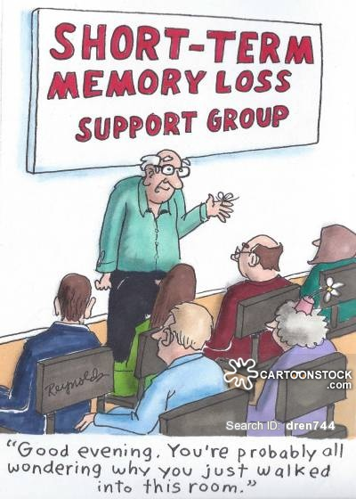
Adaptive responses vs harmful responses
Fight or
Flight
Response?
Freeze
Response?

Slide 8

Or……. Tend & Befriend, also known as Calm & Connect.
Mediated by oxytocin
Turns down stress response & modulates activity
in the
amygdala
Notes:
By tuning down the stress response, it helps to buffer its negative effects. It does this in part by suppressing the stress hormone cortisol. It also modulates activity in the amygdala, your brain’s stress centre. Under the influence of oxytocin, parts of your amygdala that tune into threats are turned down.

Slide 9
Physiology of the Relaxation Response is mediated through the Parasympathetic Nervous System
Immediate benefits of Relaxation:
reduces heart rate and thereby the work of the heart
reduces blood pressure
slows the rate of breathing, which reduces the need for oxygen
decreases muscle tension
change in blood flow distribution from skeletal to GIT
Longer Term
benefits in a range of chronic diseases
Notes:
Relaxation is a physical, emotional, and mental state that is induced through a deliberate and sustained focus.
Relaxation is also a mental exercise of increasing psychological flexibility;
An extensive body of evidence is available on the LT benefits of stress management and relaxation therapies in chronic disease populations

Slide 10
Healthy lifestyle and WC (NK-cell) activity
Behaviour
  Exercise
  Managing stress
  Enough sleep
  Balanced meals
  Not smoking
  Eating breakfast
  Not overworking
  Avoiding alcohol
Advantage in NK activity
  47%
  45
  44
  37
  27
  21
  17
  0
Kusaka Y. et al. Preventive Medicine 1992;21:602-15.

Slide 11
Early Research in Stress and Immunity
Study participants had their levels of stress measured after they were inoculated with 5 different cold viruses
The likelihood of getting a cold was directly proportional to level of stress which the host was experiencing not just at the time of exposure but over the preceding six months
    Cohen S. et al. N Eng J Med 1991;325:606-612.

Slide 12
Research in Stress and Immunity
If one contracts a viral illness, like influenza, then higher stress levels are associated with more severe symptoms
  Volunteers inoculated with measured dose of influenza A
  High stress levels associated with more severe flu (higher symptom scores, more mucous, higher interleukin-6)
    Cohen S et al. Psychosomatic Medicine. 1999;61(2):175-80.

Slide 13
Research in Stress and Immunity
Profound immune suppression of medical students over the exam period
  Lowered WC (Natural Killer cell) activity
  90% reduction in gamma interferon
Students often succumb to illness during or just after exams
Those who practiced relaxation or kept journals for important events had significantly better immunity & fewer infections in the exam period
IgA levels reduced by stressful life-events such as exam pressure, social isolation, grief, anxiety, and anxiety about control
    Kiecolt-Glaser J et al. J Cons Clin Psych 1992;60:569-75.
    Kiecolt-Glaser J et al. Annual Rev Psych 1991;11:169-80.

Slide 14
PNI –psychoneuroimmunology
Psychological stress and social factors can:
Lower immune markers (WCC, Ig)
Increase susceptibility to infections
Increase severity and progression of infections
Increase relapse of chronic and latent infections
Increase activity of inflammatory illnesses
Increase activity of autoimmune conditions
Poor response to immunization
Effect the activity of allergic conditions
Impair immune response to cancer
Metabolic syndrome- impaired bone mineralisation

Slide 15
Allostatic load and the brain
Prolonged stress leads to wear-and-tear on the body (allostatic load) is mediated through the Sympathetic Nervous System
Longer term Physiological Changes
Atrophy of nerve cells in the brain
Hippocampal formation: learning and memory
Prefrontal cortex: working memory, executive function
Plus growth of Amygdala is mediated by fear response
                McEwen BS. Ann N Y Acad Sci. 2004;1032:1-7.

Slide 16
Mindfulness and the brain
MRI assessed cortical thickness in 20 long-term mindfulness meditators
Brain regions associated with attention, concentration and sensory processing thicker in meditators than matched controls
Lazar SW, Kerr CE, Wasserman RH, et al. Neuroreport. 2005;16(17):1893-1897.
* Recent robust studies on long term mediators show increased activity in the prefrontal cortex

Slide 17
Stress and telomere shortening
Study on healthy premenopausal women: psychological stress associated with:
  higher oxidative stress
  lower telomerase activity (telomerase repairs DNA telomeres) leading to shorter telomere length
Women with highest levels of perceived stress c/w low stress women have shorter telomeres
  Average equivalent at least one decade of additional ageing
    Epel ES et al. Proc Natl Acad Sci U S A. 2004;101(49):17312-5.

Slide 18
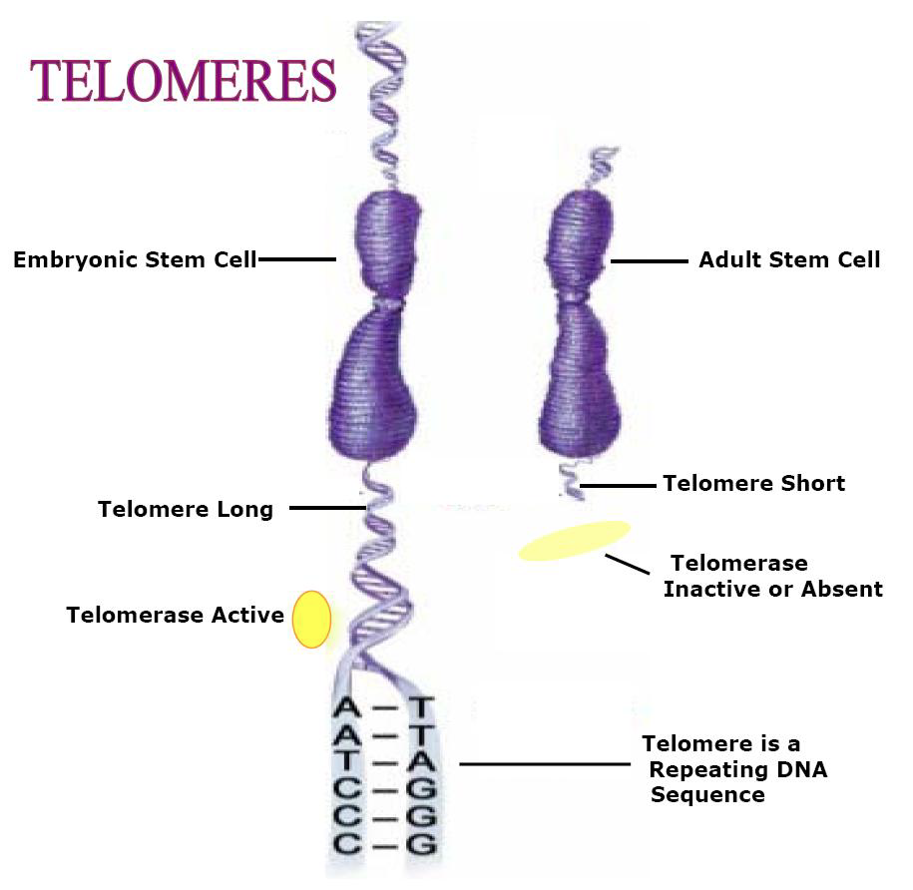
Mindfulness and telomerase
Study of mothers caring for children with disabilities – intervention
“meditation may slow genetic
ageing and enhance genetic
repair….
….by reducing cognitive
stress and stress arousal and
increasing positive states of
mind and hormonal factors,
that may promote telomere
maintenance”
Epel E, Daubenmier J, Moskowitz JT, Folkman
S, Blackburn E. Can meditation slow rate of
cellular aging? Cognitive stress, mindfulness,
and telomeres. Ann N Y Acad Sci. 2009
Aug;1172:34-53.

Slide 19
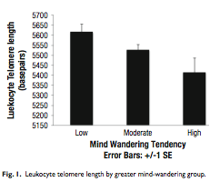
Mind wandering and ageing
The greater the level of mind wandering, the greater the level of telomere shortening (a marker of biological age)
Epel ES, Puterman E, Lin J, Blackburn E, et al. Wandering Minds and Aging Cells. Clinical Psychological Science 2012, in press

Slide 20
Mental Practice and stroke RCT
Mental practice (MP) of a motor skill
activates the same musculature and neural
pathways as physical practice of the same skill
Subjects receiving MP showed:
  statistically and clinically significant
  reductions in impairment
  significant increases in daily arm function
  new ability to perform important
  activities of daily living
    Page SJ, Levine P, Leonard A. Mental practice in chronic stroke: results of a randomized, placebo-controlled trial. Stroke. 2007 Apr;38(4):1293-7. Epub 2007 Mar 1.
Notes:
Subject had moderate deficits & received MP of 30 min x 2 daily

Slide 21
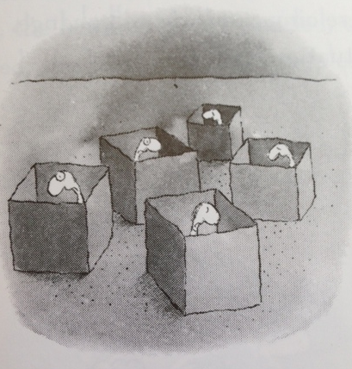
Burnout and psychiatric morbidity in new medical graduates
8 months into internship:
75% interns had burnout
73% (of interns) met
criteria for psychiatric
morbidity on at least
one occasion
Willcock SM et al. Burnout and psychiatric morbidity in new medical graduates. Med J Aust. 2004;181(7):357-60
Notes:
Willcock SM et al. Burnout and psychiatric morbidity in new medical graduates. Med J Aust. 2004;181(7):357-60

Slide 22
Doctor health and medical errors
Study determined prevalence of depression and burnout among residents medical staff in 3 US hospitals
20% of residents met criteria for depression
74% met the criteria for burnout
Depressed residents made 6.2 times as many medication errors as residents who were not depressed
Fahrenkopf AM, Sectish TC, Barger LK, et al. Rates of medication errors among depressed and burnt out residents: prospective cohort study. BMJ, doi:10.1136/bmj.39469.763218.BE (published 7 February 2008)

Slide 23
Signs of Burnout
Would you recognise these signs of burnout in yourself or a colleague?
1. Emotional exhaustion
2. Cynicism
3. Perceived clinical ineffectiveness
4. Sense of depersonalisation in relationships with co-workers, patients or both
If it was you consider how your health might be affected.
Notes:
The reality it it by thr time The above occurs , it is already advanced & possibly to late

Slide 24
Mindfulness in medical education
“At Harvard, a group of faculty members and students are developing workshops for first and second year students to teach “mindfulness” and self-renewal skills, based on the ESSENCE program developed by Dr Craig Hassed, Monash University
Administrators at Duke, discouraged by a low turnout for mental health education programs, have decided to present a wellness program focused on enhancing performance.
    Rosenthal JM, Okie S. White coat, mood indigo--depression in medical school. New England Journal of Medicine 2005;353;11:1085-8.

Slide 25
ESSENCE Model
E Education
S Stress management
S Spirituality
E Exercise
N Nutrition
C Connectedness
E Environment
The Essence of Health: The seven pillars of wellbeing Craig Hassed
Random House 2008

Slide 26
What are some of the daily stresses in Rehab Medicine?
Challenging personalities- pts/ families
Unwell patients –clinical decisions/ goals
Clear communication with staff- across a spectrum of nursing and >= 4 therapists
Communication & documentation- face to face, written, electronic not to mention devices....... Iphone, Ipad,sms email …….
…………..multiple usernames & passwords!

Slide 27
Multi tasking & procrastination
– “wired for distraction”
Physiologically there is a small release of dopamine from reward centre every time the brain switches to something novel so not paying attention can become “hard wired”
Studies on all ages do not show improved efficiency or that the brain copes well with multiple distractions
Multitasking is actually switching attention back & forth from different tasks so is actually “task switching”

Slide 28
Applications of Mindfulness
The ability to engage and remain focused on the current task & to keep returning to it
The ability to move on to the next task with confidence and without the constant pull of thoughts in default mode

Slide 29
In other words
Hebbe’s hypothesis
Neurones that fire together……
………..Wire together –old patterns or new
Science of neuroplasticity
What you feed the mind strengthens the neural circuits associated with those patterns

Slide 30
Steps in Mindfulness
Formal Practices
attention training/meditation
Informal Practices
- being mindful whilst engaged in activities

Slide 31
Steps in Mindfulness
4 Main Cognitive Practices
1)Perception or awareness
2)Letting Go - non attachment
3)Acceptance
4)Presence of Mind

Slide 32
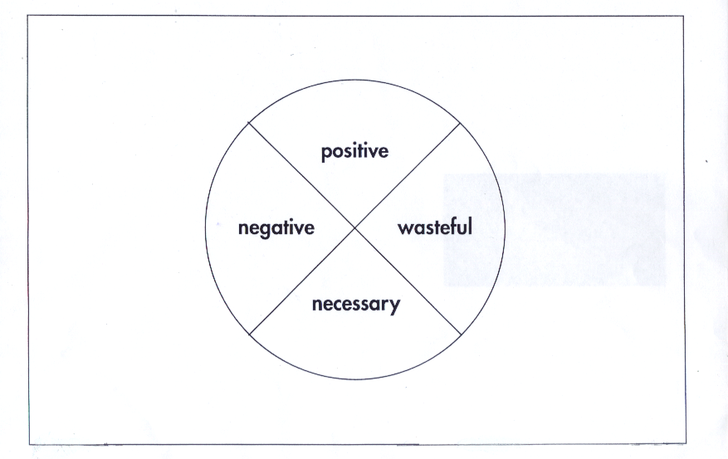
1. Perception- Observing Thought

Slide 33
Your thoughts create your experience of reality
Tendency to focus on a positive thought or emotion versus the tendency to repeatedly focus or ruminate on negative thoughts
(whether these be in the past or the future)
Leads to activation of the relevant physiological response in the body
Physiologically the brain & body cannot distinguish between what is real from what is imagined or not real.

Slide 34
Default Modes of Thinking
Rumination-dwelling on the past, worrying about the future
Procrastination
Daydreaming
Catastrophising
Diagnostic errors can occur through non objectivity eg Confirmation or Anchoring bias

Slide 35
What is your “AUTOPILOT” or default response under stress, fatigue or exams?

Slide 36
Consider Examination Stress
1) What is my own pattern of self talk/default mode of thinking like?
2) What is my relationship to that self talk?
3) Am I self sabotaging?

Slide 37
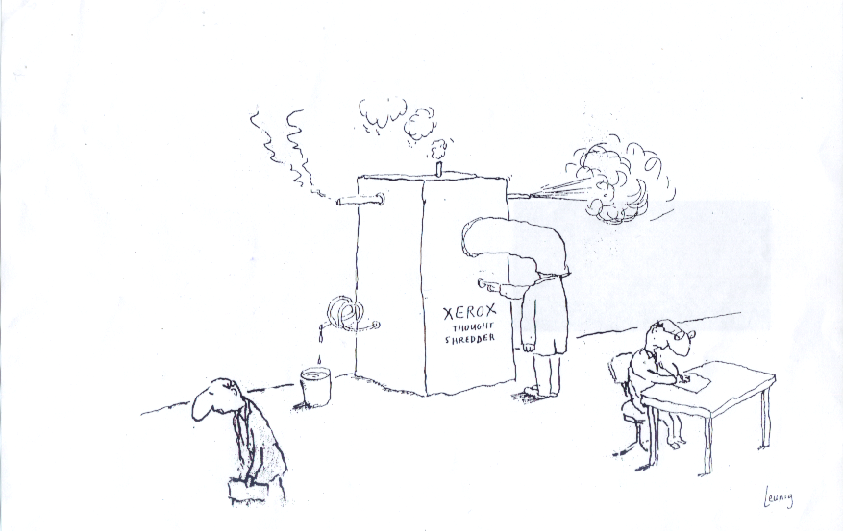
2. Letting GO- Non attachment

Slide 38
3. Acceptance
Includes learning to notice and tolerate uncomfortable thoughts and feelings
which can be physical or mental
Improving tolerance & softening of attitude to it can prevent escalation
Transience or non permanence of thoughts and feelings
Acceptance may allow them to subside &/or redirect

Slide 39
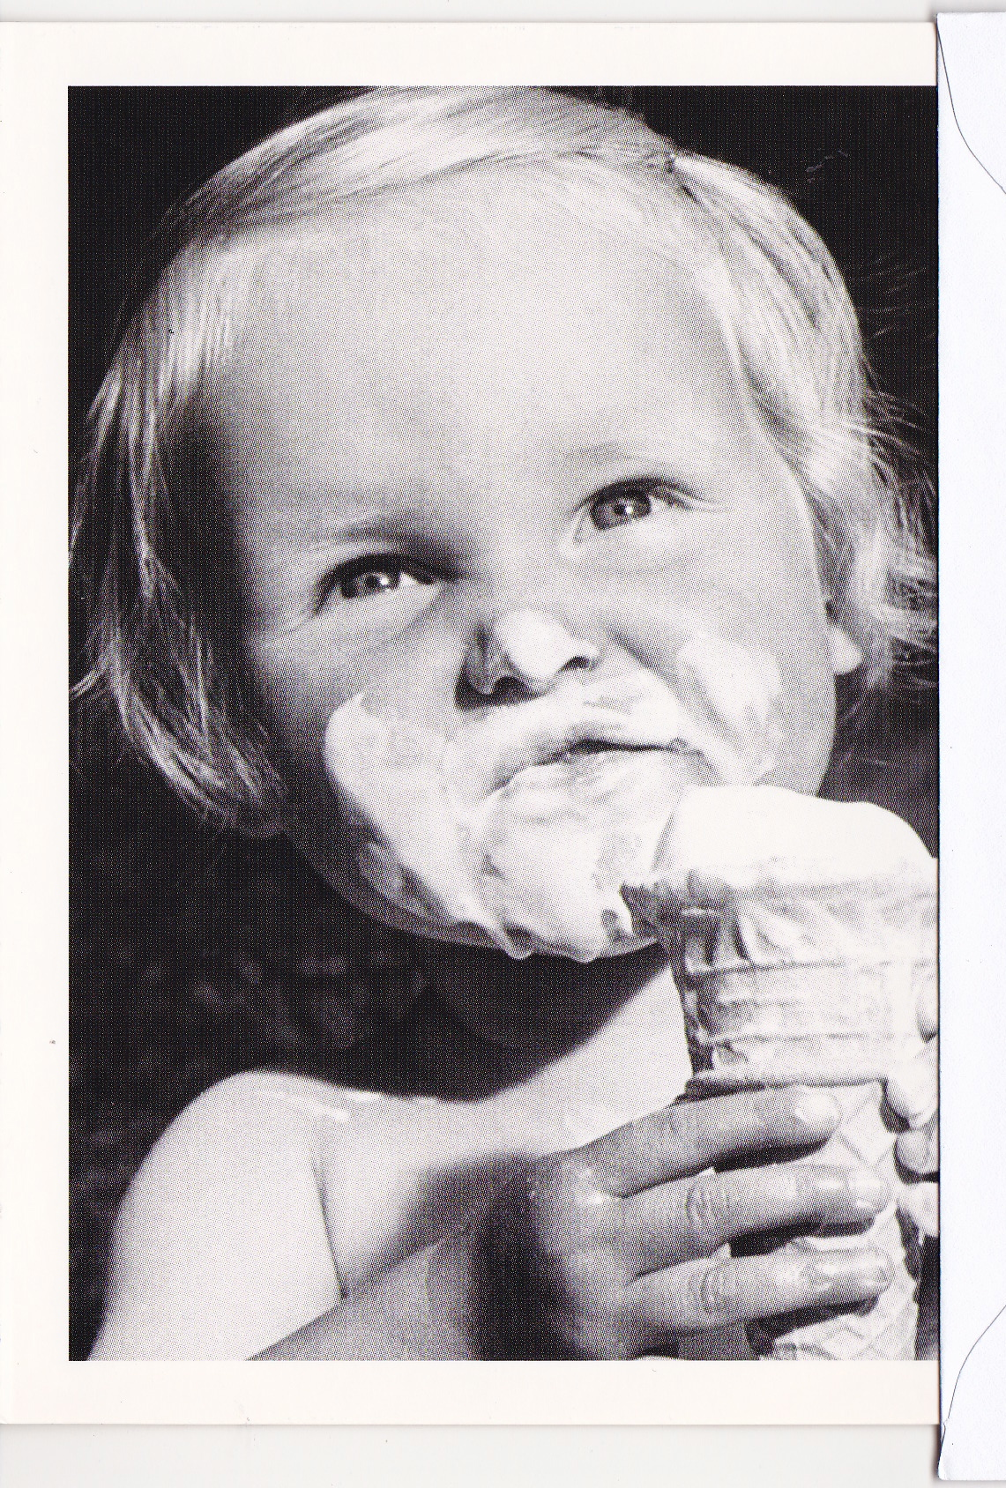
4. Presence of Mind
Paying attention to the present moment
The ability to sustain the focus of concentration
The ability to return to the focus of concentration
Absorption in the present moment

Slide 40

Practical exercise

Slide 41
Types of Meditation Practices
  1. Mindfulness - focus of the mind
based on breath, body scan, awareness of external surroundings, then awareness internally
-process of bringing awareness back to the focus again & again - analogy of contracting a muscle repeatedly
2. Visualization - may be a preferred option for some
3. Movement based awareness with mindfulness
eg Tai chi, Yoga
4. Mantra based

Slide 42
Mindfulness strategies for health
What stimulates your ‘relaxation response’?.. music, getting outdoors in nature etc
Punctuate your day- concept of traffic control for the mind
Develop an ability to recognize on your own individual limits & triggers which “push your buttons”
Be Kind to yourself

Slide 43
Plus general strategies for health
Exercise
Nutrition- moderation and healthy choices (obviously) AND watch what you go to for ‘comfort”
Massage & other forms of “bodywork”
Humour
Take regular “breaks” which may need to be a bit longer as you get older
Plan for medium and long hobbies with other interests eg existing or new?....

Slide 44
Recommendations & Resources
Craig Hassed & Richard Chambers Mindfulness for Wellbeing & Performance Monash University - online course 2016
https://www.futurelearn.com/courses/mindfulness-wellbeing-performance
SBS on demand until March 14 2016
Michael Mosely : Don’t worry, be Happy
https://www.theconnection.tv -The Connection DVD
www.goAMRA.org Mindfulness Research monthly
How Doctors Think. Jerome Groopman Scribe publications 2007
Appendix :RACP – Summary Health of Doctors Position Statement May 2013

Slide 45
RACP -Health of Doctors
Position Statement May 2013
Doctors, like anyone else, need to look after their own health.
As an important component of maintaining their own health, doctors should have their own general practitioner and undertake regular health checks.
While doctors as a group enjoy comparatively good physical health, certain characteristics of the medical profession predispose doctors to specific health risks.
Historically, the medical professional culture has encouraged doctors to sacrifice their own health through accepted practices such as working long hours and taking work home. Increasingly efforts are being made to address counterproductive workplace behaviours, and workplace bullying is no longer tolerated.

Slide 46
• When health concerns arise for doctors, they may be reluctant to seek appropriate medical care. Doctors may feel uncomfortable assuming the role of patient, and may opt instead to treat themselves or seek informal care from a colleague.
• Regulatory frameworks are an important consideration, as mandatory reporting of impaired doctors can act as a deterrent to seeking help.
• Doctors are encouraged to seek independent medical consultations, and there is growing recognition that a particular skill set can be taught to help doctors treat other doctors more effectively.

Slide 47
• Doctors’ health advisory and referral services are important avenues by which doctors can seek help, and these operate in all jurisdictions of Australia and New Zealand. We welcome the action that regulatory, accreditation and indemnity bodies are taking to support doctors’ health.
• Medical colleges have an important role as they engage with doctors in the course of their training and continuing professional development. The RACP has a number of initiatives underway and in development to support Fellows and trainees with health concerns.
• Occupational and environmental medicine physicians and rehabilitation physicians have a key role to play in supporting impaired doctors to realise the health benefits of work.

