Slide 1
Pain - what’s the big fuss
Dr. Nick Christelis
MBBCh, FRCA, FFPMRCA, FANZCA, FFPMANZCA
Pain Specialist Physician & Anaesthetist
Director - Victoria Pain Specialists
Senior Adjunct lecturer Monash University
Secretary Neuromodulation Society of Australia and New Zealand

Slide 2
Disclaimer
Conflicts of interests related to this talk
    Consultant, advisor to Boston Scientific & Nevro, Abbott
    All proceeds, to a practice educational fund
My aim is to improve the practice of pain meidicine & neuromodulation
This presentation reflects my views and approaches

Slide 3
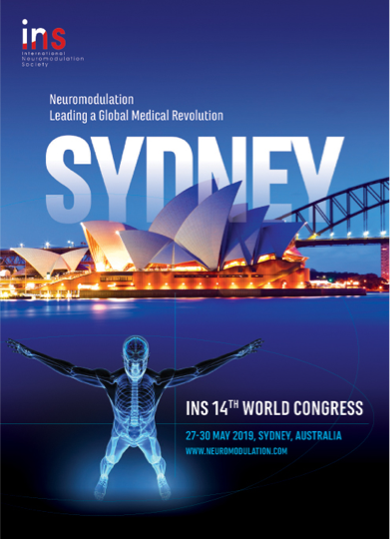
n.christelis@painspecialistsaustralia.com.au
@PainSpecialistN
linkedin.com/in/drnickchristelis/

Slide 4
Plan of discussion
What does a pain specialist do
Neuropathic pain & sensitisation
Opioids - dose conversions
Approach to back pain
Approach to shoulder pain

Slide 5
Pain Specialist Physician

Slide 6
Neuropathic pain
History: disease/lesion affects somatosensory system
Symptoms: anatomical distribution related to somatosensory system
Signs: negative &/or positive sensory phenomenon
Diagnostic test: confirms damage to somatosensory system

Slide 7
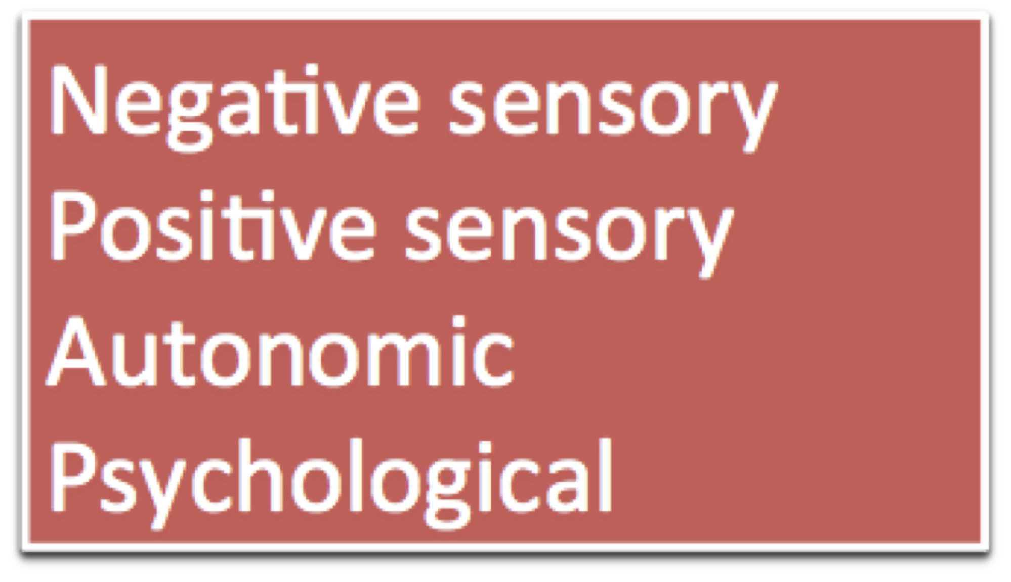
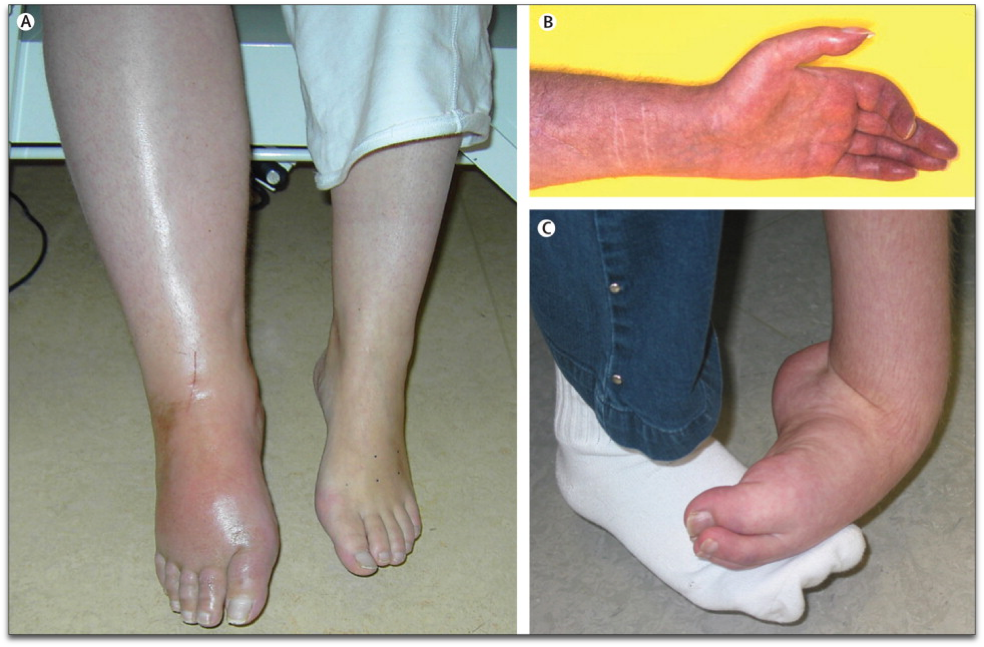

Neuropathic pain
Spontaneous pain - ongoing or paroxysms
Evoked pain - allodynia or hyperalgesia

Slide 8
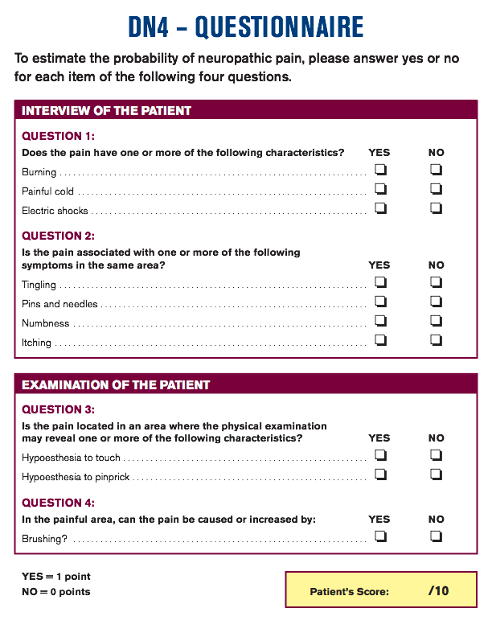
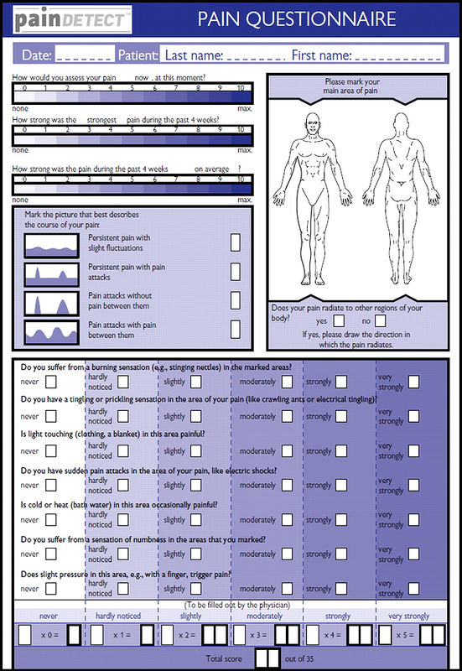

Slide 10
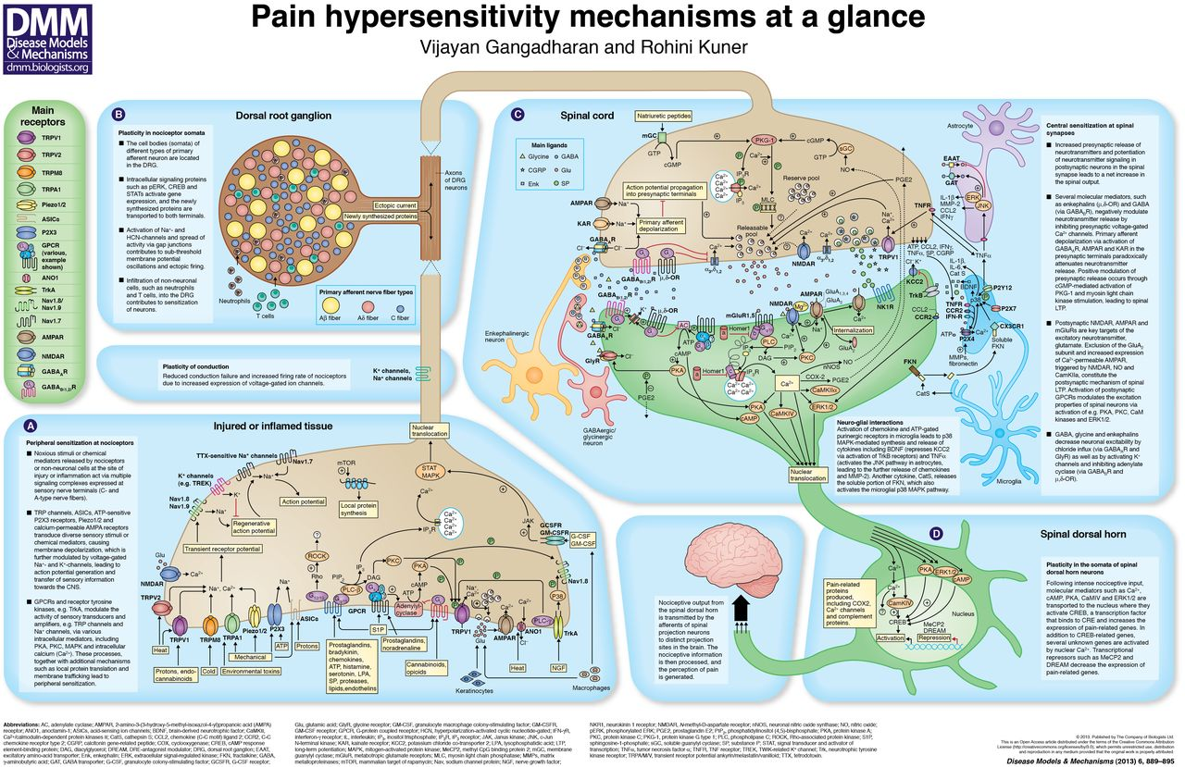
Gangadharan V, Kuner R. Pain hypersensitivity mechanisms at a glance. Disease Models & Mechanisms 6, 889-895 (2013) doi:10.1242/dmm.011502

Slide 12
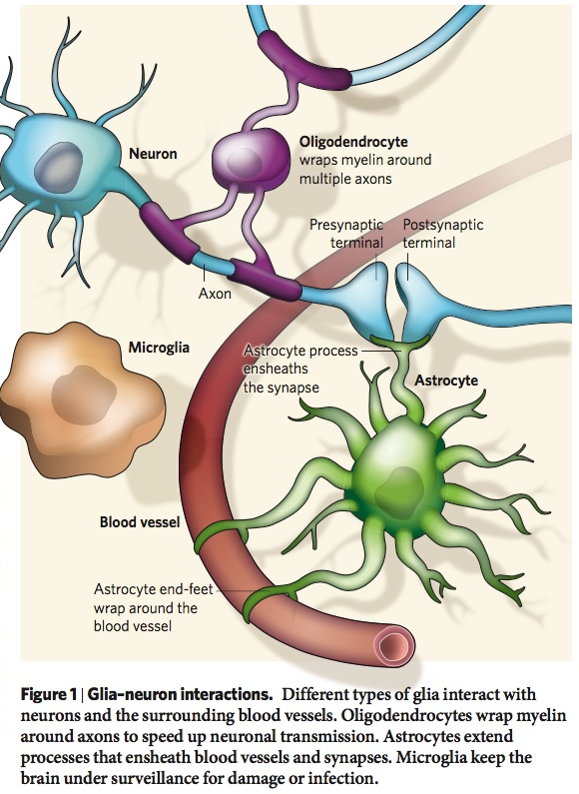

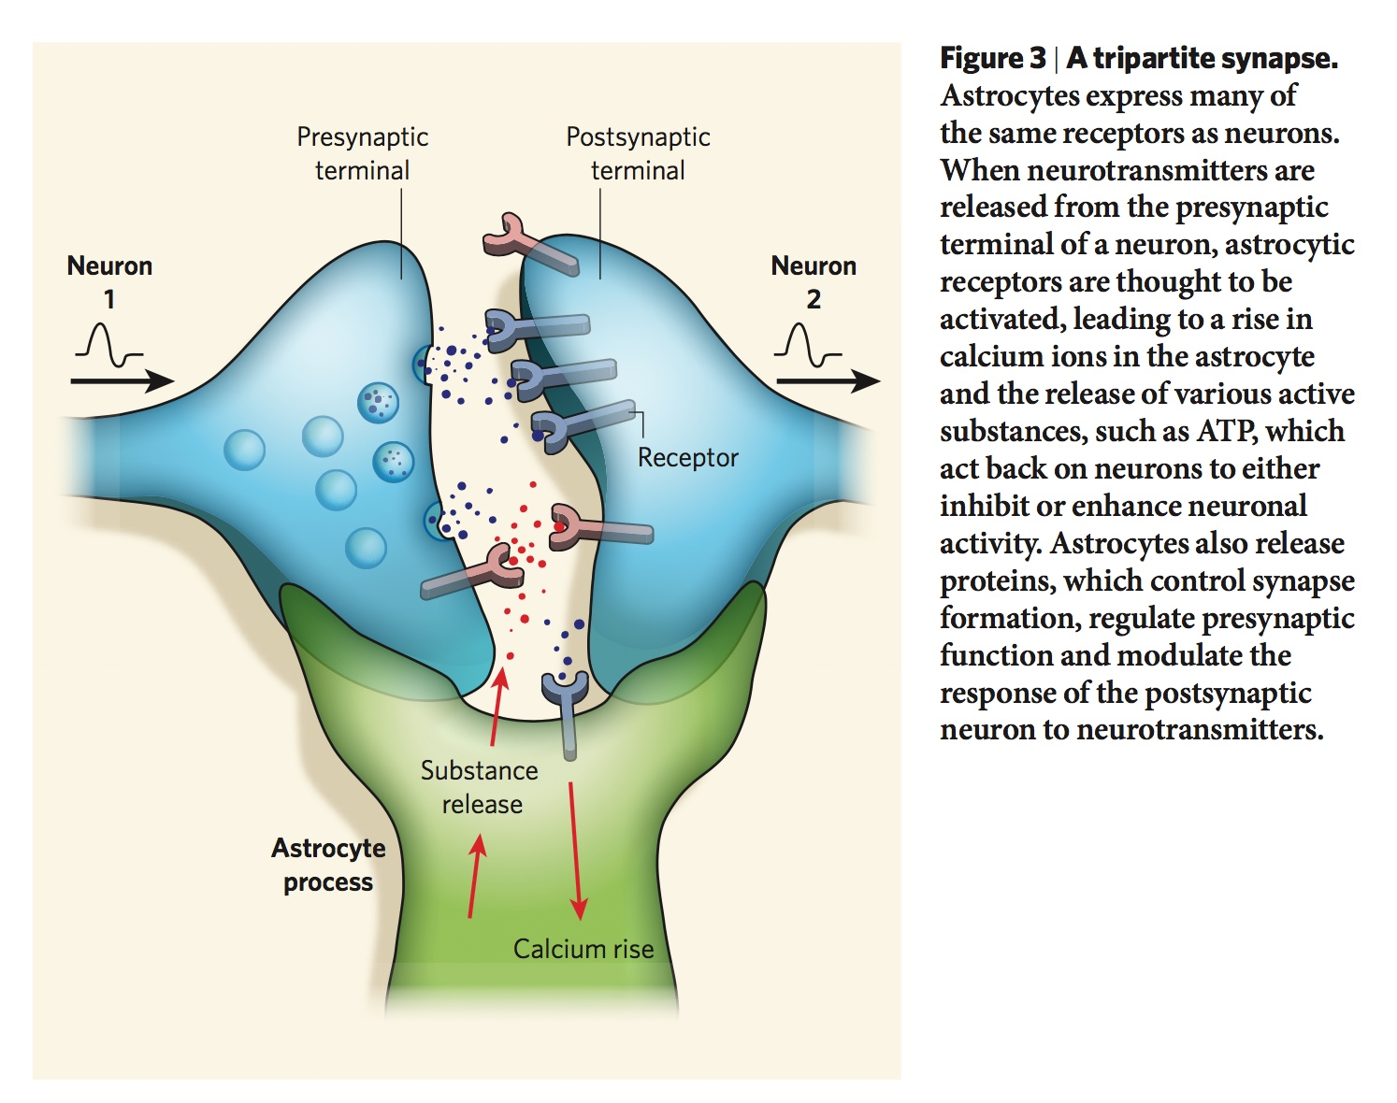
Glia
Non-neuronal cells of CNS & dorsal horn
Far out number neurons by 3:2 - 10:1
Many functions: nutrition, structural support, homeostasis, nerve repair, myelin generation & function & immune function
Macro glia (90%) - astrocytes, oligodendrocytes, schwann cells vs. Microglia (10%)

Slide 13
Who gets central sensitisation?
RA, OA, TMJ disorders
Fibromyalgia
Deep tissue hyperalgesia in back pain
Headaches
Neuropathic pain
Complex regional pain syndrome (CRPS)
Post surgical pain
Visceral hyperalgesia
Opioids

Slide 14
Opioid-induced hyperalgesia
State nociceptive sensitization caused by opioid exposure
Paradoxical response, patients on opioids for pain —> more sensitive to pain stimuli
Type of pain: same or different from original pain
Distinct, definable
Explain loss of opioid efficacy in some patients
Lee M1, Silverman SM, Hansen H, Patel VB, Manchikanti L..A comprehensive review of opioid-induced hyperalgesia/ Pain Physician. 2011 Mar-Apr;14(2):145-61.

Slide 15
Opioid-induced hyperalgesia
Glutaminergic system - glutamate and NMDA
Spinal dynorphins
Decending facilitation
Genetic influences - COMT, polymorphisms
Neurotransmitters - substance P, glutamate, adrenergic receptors, noradrenaline, dopamine
Peripheral / spinal / supra spinal mechanisms
Lee M1, Silverman SM, Hansen H, Patel VB, Manchikanti L..A comprehensive review of opioid-induced hyperalgesia/ Pain Physician. 2011 Mar-Apr;14(2):145-61.

Slide 16
www.sciencemag.org/news/2016/11/why-painkillers-sometimes-make-pain-worse

Slide 17
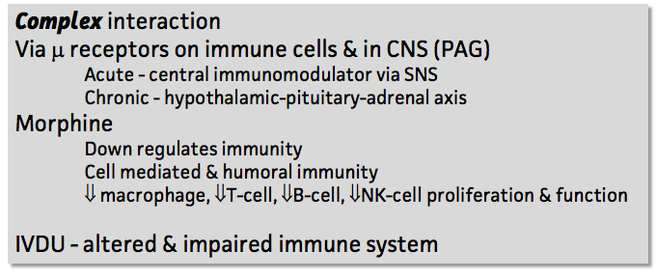
Opio-immuno suppression
Enhanced immunity | No suppression | Little supression | ++ Suppression
Naloxone Tramadol | Oxycodone Buprenorphine Hydromorphone | Methadone Codeine Dihydrocodeine | Morphine Fentanyl Remifentanil Pethidine

Slide 18
Opioid dose conversions
Patch strength | Oral morphine equivalent/24hrs (estimate)
Buprenorphine 5mcg/hr | 10mg/24hrs
Buprenorphine 10mcg/hr | 20mg/24hrs
Buprenorphine 20mcg/hr | 40mg/24hrs
Fentanyl 12mcg/hr = 288mcg/24hrs | 45mg/24hrs
Fentanyl 25mcg/hr = 600mcg/24hrs | 90mg/24hrs
Fentanyl 50mcg/hr = 1200mcg/24hrs | 180mg/24hrs
Fentanyl 75mcg/hr = 1800mcg/24hrs | 225mg/24hrs
Fentanyl 100mcg/hr = 2400mcg/24hrs | 360mg/24hrs

Slide 19
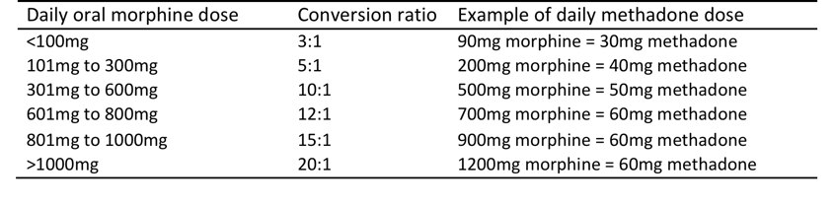
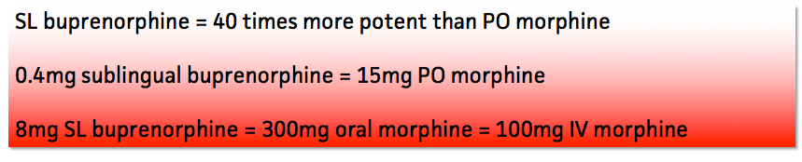
Opioid dose conversions

Slide 20
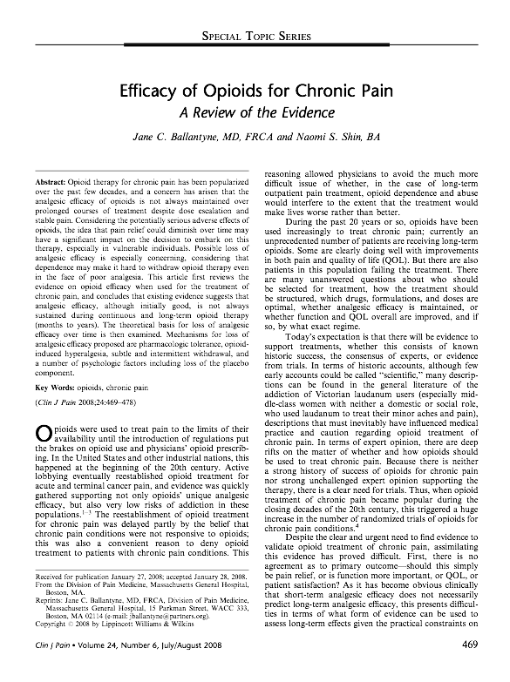
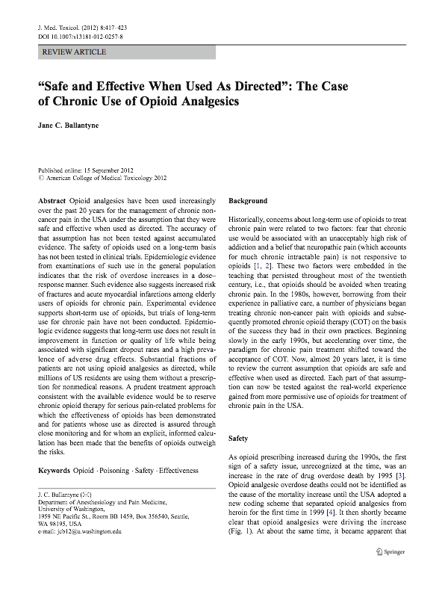
Opioids - the evidence

Slide 21
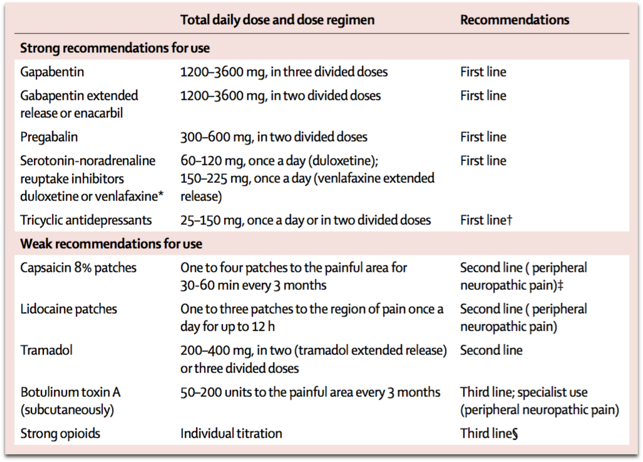
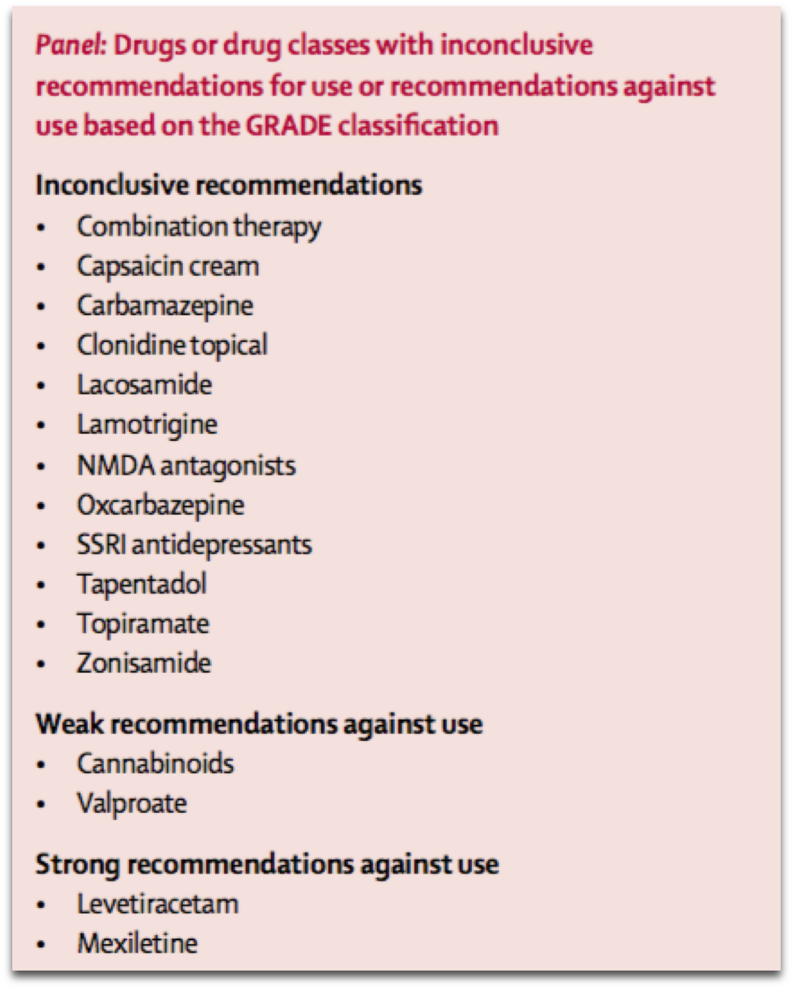
Low-tech treatments
Stop the offending agent
Pharmacotherapy -
      Paracetamol, NSAIDS
      Gabapentinoids, TCA, SNRIs, ketamine
      (Opioids)
      Tramadol
      Tapentadol
Nijs J et al. Treatment of central sensitization in patients with ‘unexplained’ chronic pain: what options do we have? Expert Opin. Pharmacother. 10.1517/14656566.2011.547475 2011 Informa UK, Ltd. ISSN 1465-6566

Slide 22
Low-tech treatments
(Understanding & pain education)
Manual therapy and joint mobilisation (short-term)
Stress management (deals with the emotional and cognitive aspects of sensitisation)
TENS (not sustainable)
Virtual reality
Nijs J et al. Treatment of central sensitization in patients with ‘unexplained’ chronic pain: what options do we have? Expert Opin. Pharmacother. 10.1517/14656566.2011.547475 © 2011 Informa UK, Ltd. ISSN 1465-6566

Slide 23
High-tech treatments
Pulsed radiofrequency
•DRG - cervical radicular pain
Supra scapular nerve
Inguinal heriooraphy pain
Discogenic pain
Testicular pain
Chua NHL, Vissers KC, Sluijter ME. Pulsed radiofrequency treatment in interventional pain management: mechanisms and potential indications—a review. Acta Neurochir (2011) 153:763–771

Slide 24
High-tech treatments
IV - ketamine, lidocaine, bisphosphonates
Nerve blocks - lumbar radiculopathy, cervical radiculopathy
Epidural injections - lumbar & cervical radiculopathy & brachialgia, spinal stenosis, FBSS, CRPS, PHN
Spinal cord stimulation - FBSS, CRPS, traumatic & brachial plexus
Mailis A, Taenzer P. Evidence-based guideline for neuropathic pain interventional treatments: Spinal cord stimulation, intravenous infusions, epidural injections and nerve blocks. Pain Research & Management : The Journal of the Canadian Pain Society. 2012;17(3):150-158.

Slide 25
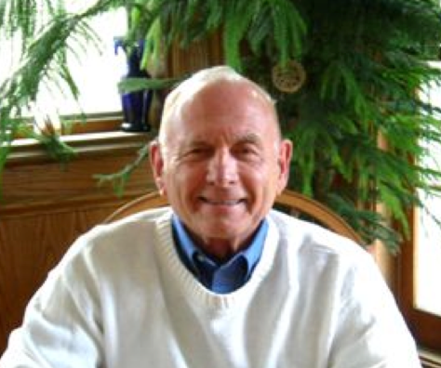
Definition
Technology that acts directly upon nerves
Alteration—or modulation—of nerve activity by delivering electrical or pharmaceutical agents directly to a target area
Shealy CN, Taslitz N, Mortimer JT, Becker DP. Electrical inhibition of pain: Experimental evaluation. Anesthesia and Analgesia 1967; 46: 299-305.

Slide 26
Refractory pain
Multiple evidenced-based biomedical therapies used in clinically appropriate & acceptable fashion have failed to reach treatment goals that may include pain reduction &/or improvement in daily functioning or have resulted in intolerable adverse effects
and when;
Psychiatric disorders & psychosocial factors that could influence pain outcomes have been assessed & appropriately addressed
DeerTR, Caraway DL, Wallace MS. A Definition of Refractory Pain to Help Determine Suitability for Device Implantation. Neuromodulation 2014; 17: 711-715

Slide 27
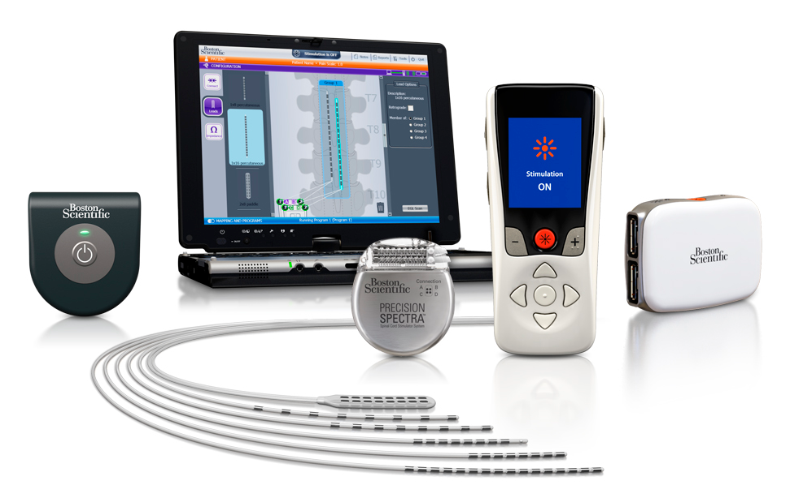

Slide 28
Mechanisms of action
Chronic or neuropathic pain
Not acute or nociceptive pain
Paint over the pain (somatotopographical cover)
Minutes to work and weeks/months to reach full potential
Best for burning and allodynic components of pain
Relief can outlast stimulation
Oakley JC, Prager JP. Spinal cord stimulation: mechanisms of action. Spine (Phila Pa 1976). 2002; 27:2574-83.

Slide 29
Mechanisms of action
Large Aβ fibres
Neurochemistry | ↑GABA, ↑substance-P, ↑serotonin, ↑glyceine
Neurophysiology | ↓Wide-dynamic range responsiveness
Sympathetic nervous system | Bradykinin, CGRP
Supraspinal structures
Ascending / descending inhibition
Antidromic activation
Oakley JC, Prager JP. Spinal cord stimulation: mechanisms of action. Spine (Phila Pa 1976). 2002; 27:2574-83.

Slide 30
Indications
Conditions likely to respond | Failed back surgery syndrome Complex regional pain syndrome Refractory angina pectoris Neuropathic pain secondary
Conditions that may respond | Pain associated with peripheral vascular disease Brachial plexopathy e.g. partial traumatic, post irradiation Axial pain following surgery Intercostal neuralgia e.g. post-thoracotomy Other peripheral neuropathic syndromes e.g. trauma
Conditions that rarely respond | Pain associated with spinal cord damage Central pain of non-spinal cord damage Spinal cord injury
Viceral pain - cardiac
Viceral pain - abdominal, pelvic
Neuromodulation (spinal cord stimulation) in the management of patients with chronic pain. PM9 (2011). Faculty of Pain Medicine of the Australian and New Zealand College of Anaesthetists.

Slide 31
Contraindications
Absolute | Patient refusal Sepsis, coagulopathy or others factors that increase surgical risk Localised infection Anatomical - obliterated spinal canal, stenosis, spina bifida
Relative | Systemic infection Physical, cognitive, psychological disability Unresolved major psychiatric disorders Unmanaged substance abuse or cognitive disorders Pregnancy Cardiac pacemaker or defibrillator

Slide 32
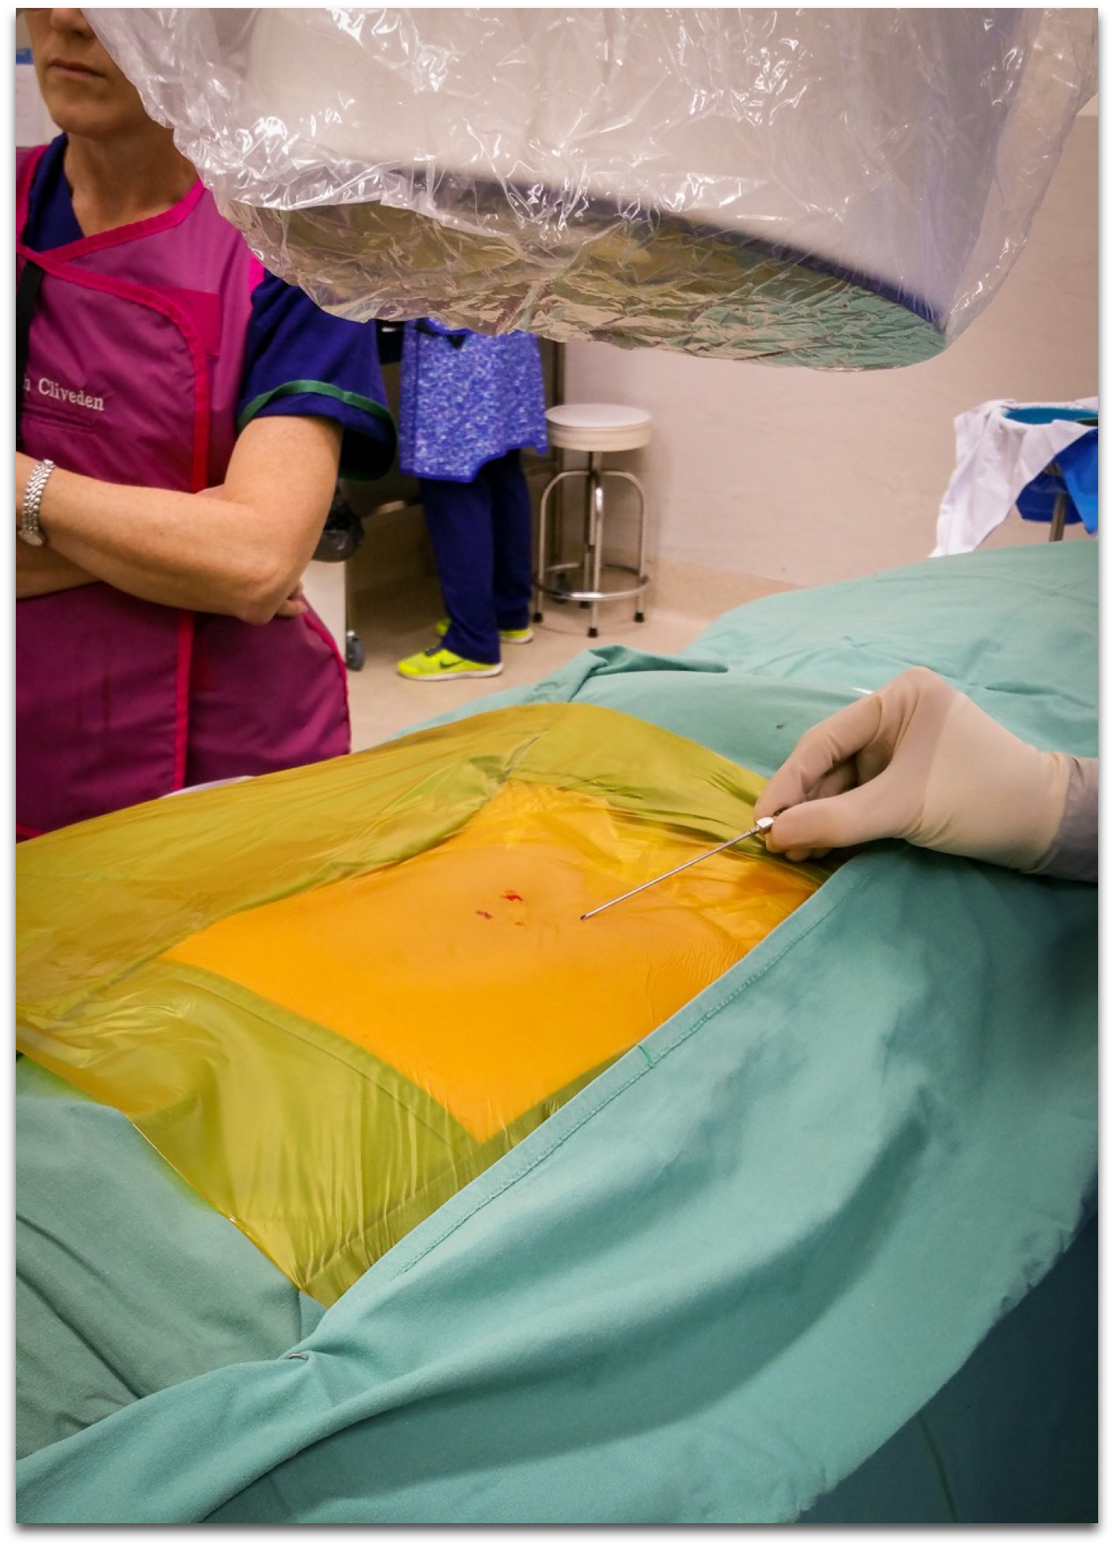
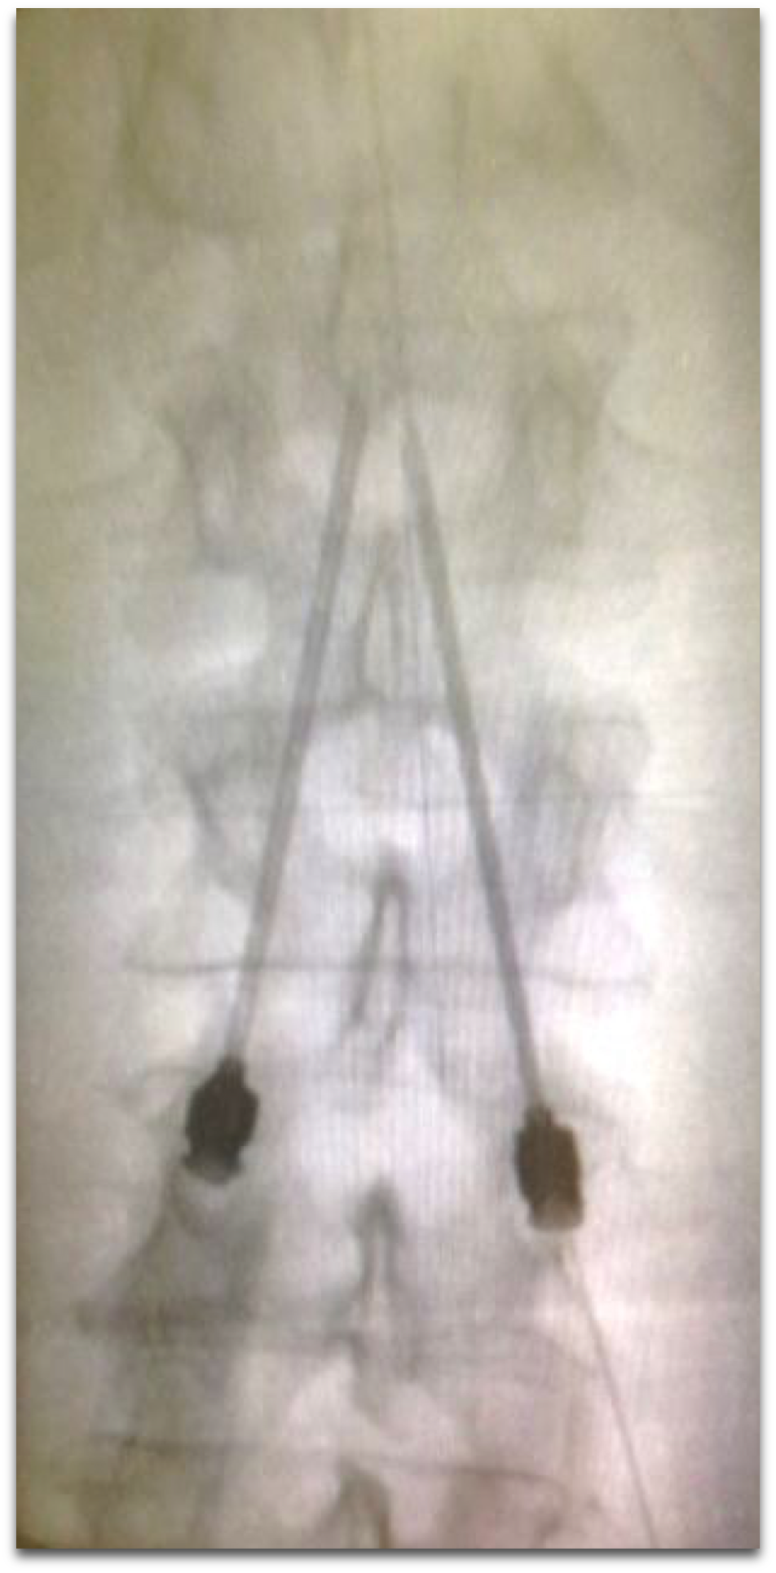

Slide 33
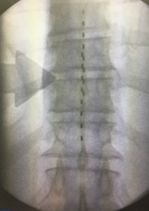
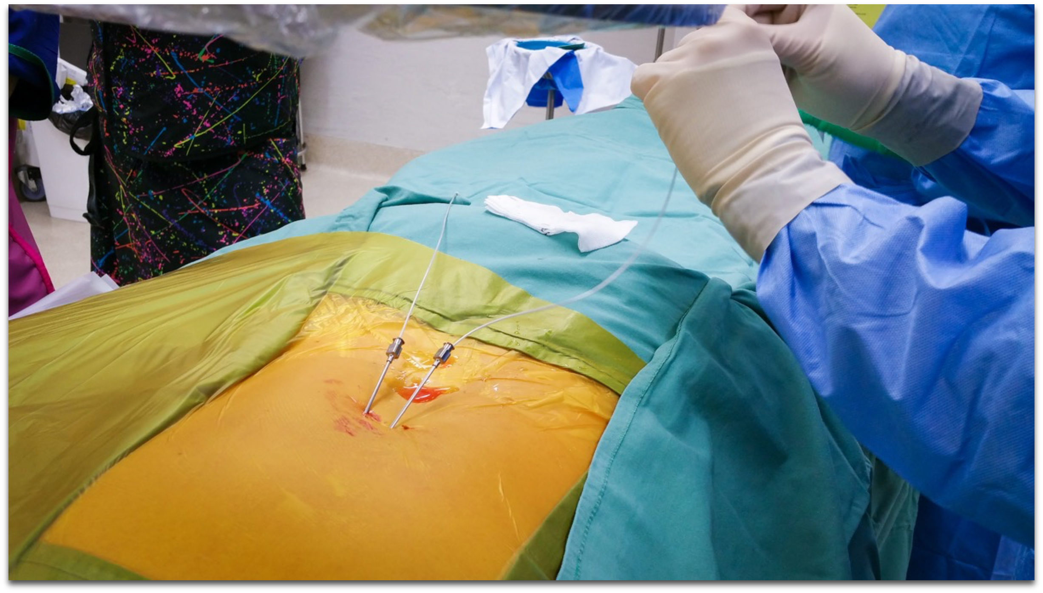

Slide 34
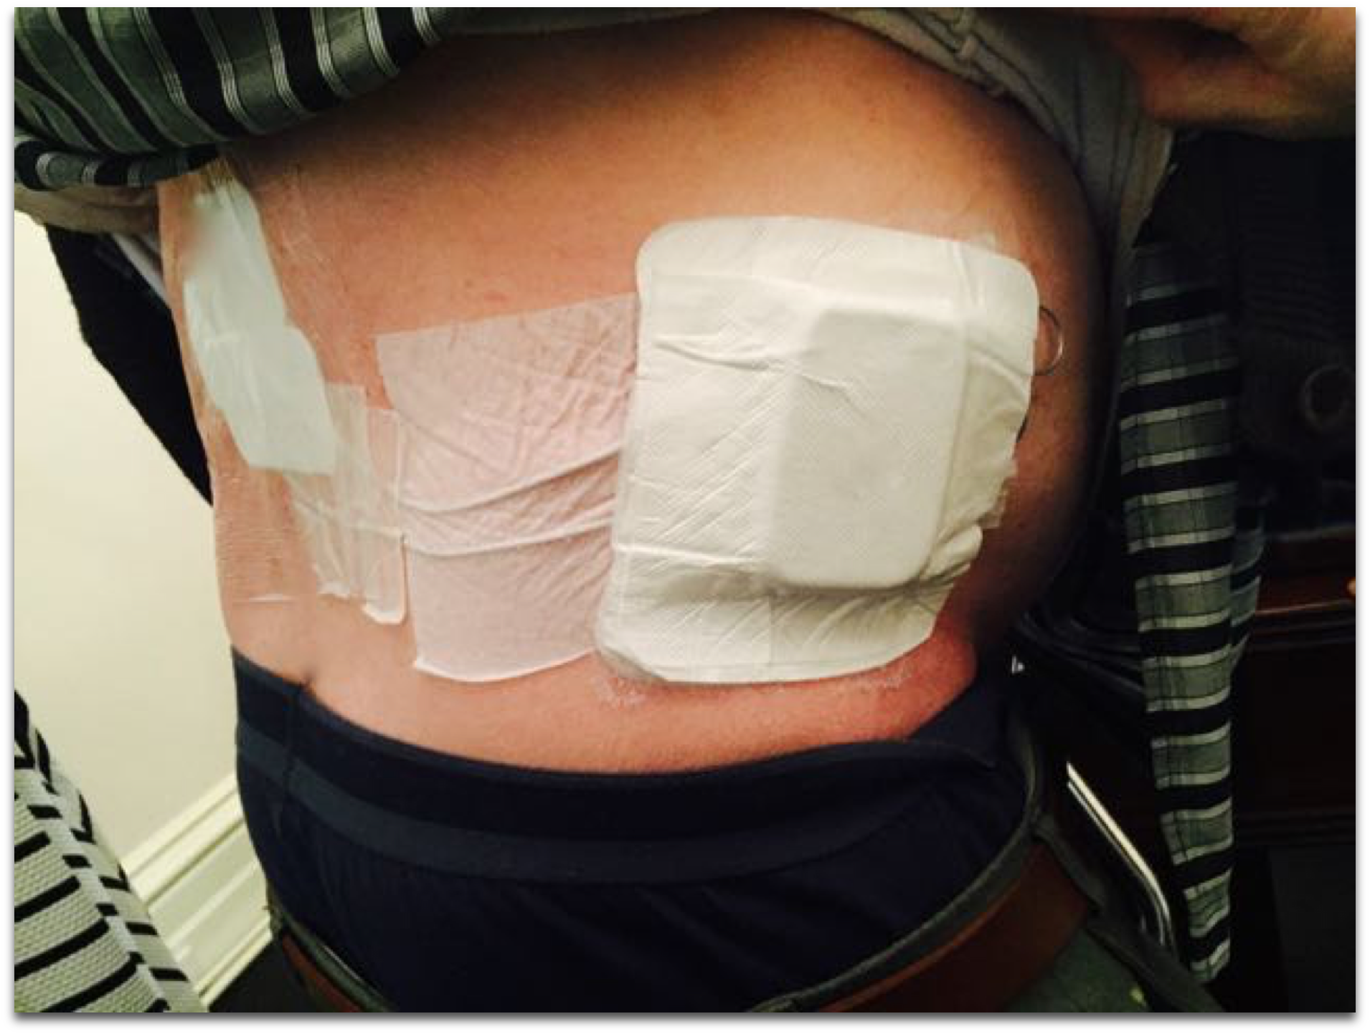

Slide 35
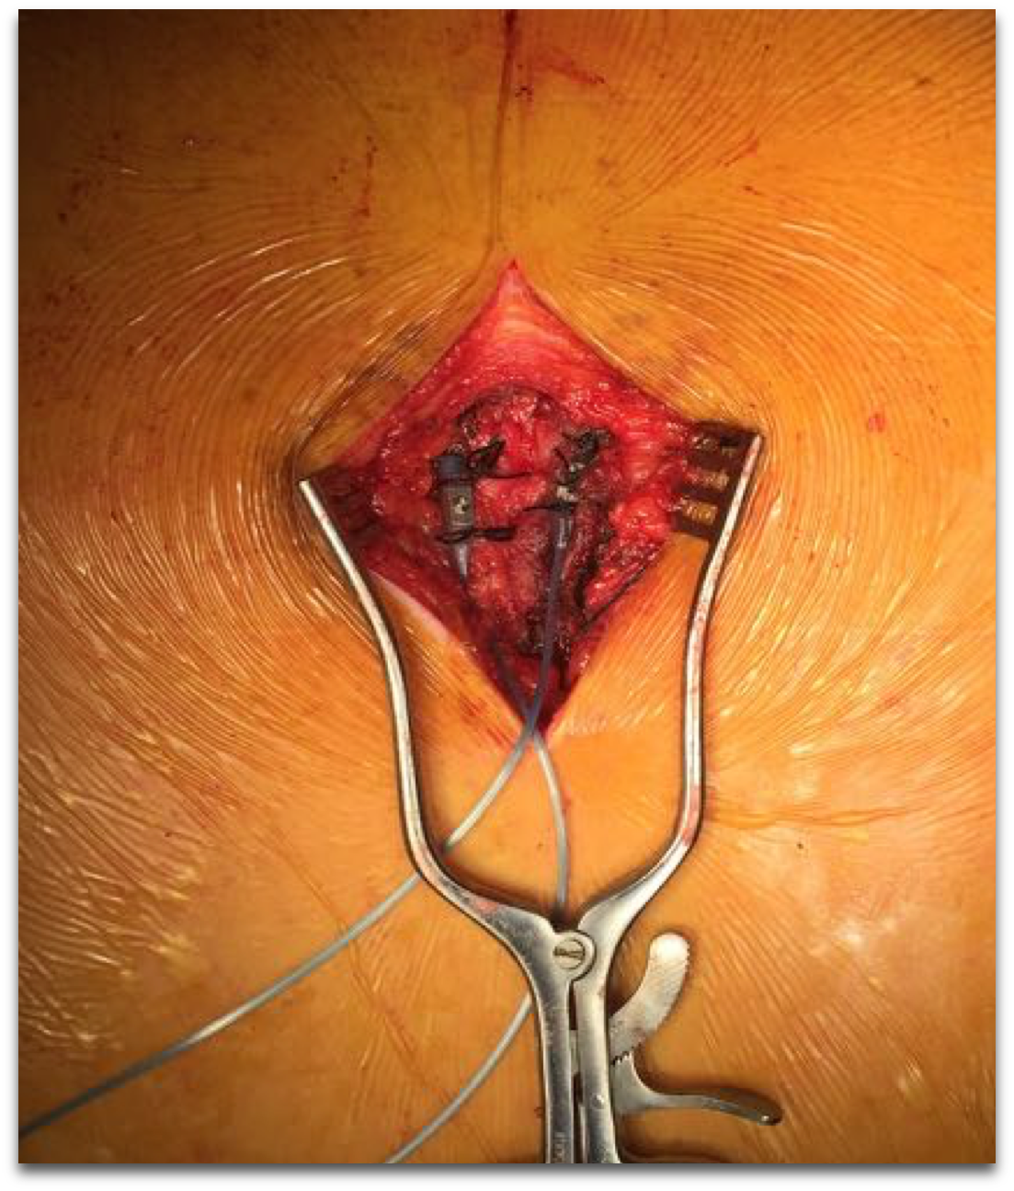
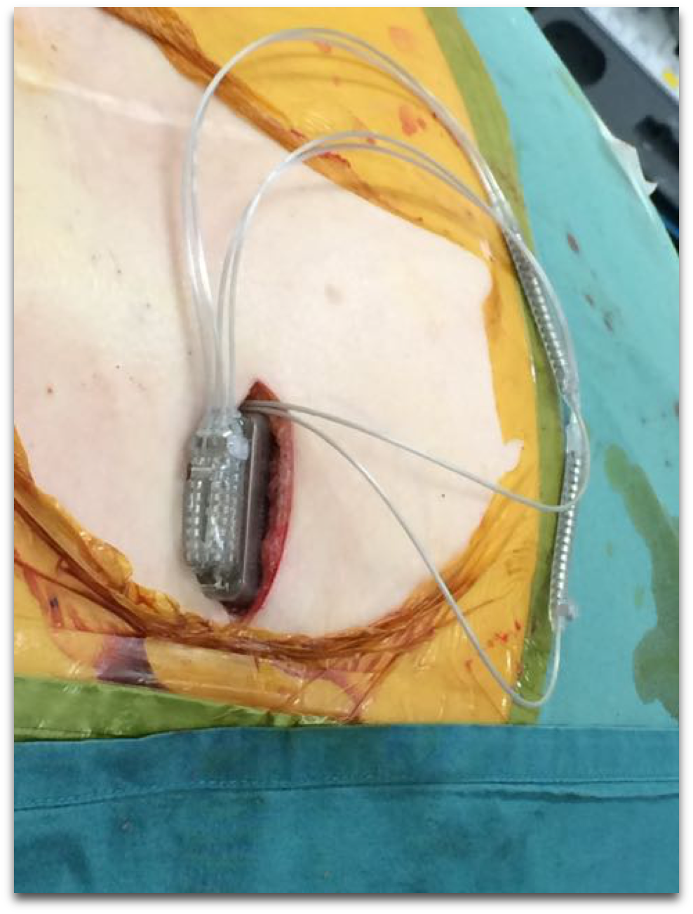

Slide 36
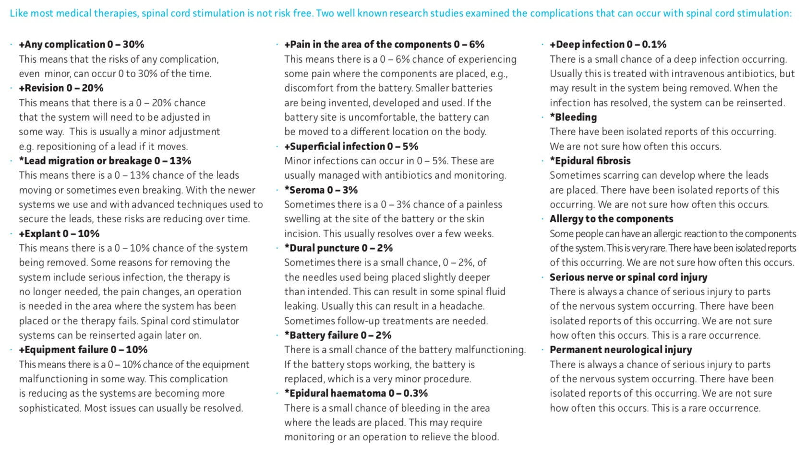
Needle / drug (device)
Early / late
Temporary / permanent
+Turner, JA, Loeser JD, Devon RA, Sanders SB. Spinal cord stimulation for patients with failed back surgery syndrome or complex regional pain syndrome: a systematic review of effectiveness and complications. Pain, 2004; 108: 137-147
*Deer TR etal. 2014. The Appropriate Use of Neurostimulation: Avoidance and Treatment of Complications of Neurostimulation Therapies for the Treatment of Chronic Pain. Neuromodulation 2014; 17: 571–598

Slide 37
Efficacy
Prospective Randomized cOntrolled multiCenter Trial of the Effectiveness of Spinal cord Stimulation (PROCESS) showed SCS superior pain relief, health-related quality of life, and functional capacity
24 months SCS + CMM vs CMM alone
Primary outcome = 50% pain reduction (legs)
47% of SCS vs 7% of CMM
31% surgical revision
Kumar K, Taylor RS, Jacques L et al. The effects of spinal cord stimulation in neuropathic pain are sustained: a 24-month follow-up of the prospective randomized controlled multicenter trial of the effectiveness of spinal cord stimulation. Neurosurgery. 2008 Oct;63(4):762-70.
Notes:
Abstract
OBJECTIVE:
After randomizing 100 failed back surgery syndrome patients to receive spinal cord stimulation (SCS) plus conventional medical management (CMM) or CMM alone, the results of the 6-month Prospective Randomized Controlled Multicenter Trial of the Effectiveness of Spinal Cord Stimulation (i.e., PROCESS) showed that SCS offered superior pain relief, health-related quality of life, and functional capacity. Because the rate of crossover favoring SCS beyond 6 months would bias a long-term randomized group comparison, we present all outcomes in patients who continued SCS from randomization to 24 months and, for illustrative purposes, the primary outcome (>50% leg pain relief) per randomization and final treatment.
METHODS:
Patients provided data on pain, quality of life, function, pain medication use, treatment satisfaction, and employment status. Investigators documented adverse events. Data analysis included inferential comparisons and multivariate regression analyses.
RESULTS:
The 42 patients continuing SCS (of 52 randomized to SCS) reported significantly improved leg pain relief (P < 0.0001), quality of life (P <or= 0.01), and functional capacity (P = 0.0002); and 13 patients (31%) required a device-related surgical revision. At 24 months, of 46 of 52 patients randomized to SCS and 41 of 48 randomized to CMM who were available, the primary outcome was achieved by 17 (37%) randomized to SCS versus 1 (2%) to CMM (P = 0.003) and by 34 (47%) of 72 patients who received SCS as final treatment versus 1 (7%) of 15 for CMM (P = 0.02).
CONCLUSION:
At 24 months of SCS treatment, selected failed back surgery syndrome patients reported sustained pain relief, clinically important improvements in functional capacity and health-related quality of life, and satisfaction with treatment.

Slide 38
Efficacy
Kumar papers - showed 40 -60% pain reduction
Leg pain
Kumar K, Taylor RS, Jacques L et al. The effects of spinal cord stimulation in neuropathic pain are sustained: a 24-month follow-up of the prospective randomized controlled multicenter trial of the effectiveness of spinal cord stimulation. Neurosurgery. 2008 Oct;63(4):762-70.

Slide 39
Efficacy
SCS was more successful than reoperation
9 / 19 (SCS) patients versus 3 / 26 (reoperation) patients (P <0.01)
Less cross over in the SCS group
Reoperation —> more opioids
North RB, et al. Spinal Cord Stimulation Versus Repeated Lumbosacral Spine Surgery for Chronic Pain: A Randomized, Controlled Trial. Neurosurgery 2005;56:98–106.
Notes:
Neurosurgery. 2005;56(1):98-106; discussion 106-7.
Spinal cord stimulation versus repeated lumbosacral spine surgery for chronic pain: a randomized, controlled trial.
North RB1, Kidd DH, Farrokhi F, Piantadosi SA.
Author information
Abstract
OBJECTIVE:
Persistent or recurrent radicular pain after lumbosacral spine surgery is often associated with nerve root compression and is treated by repeated operation or, as a last resort, by spinal cord stimulation (SCS). We conducted a prospective, randomized, controlled trial to test our hypothesis that SCS is more likely than reoperation to result in a successful outcome by standard measures of pain relief and treatment outcome, including subsequent use of health care resources.
METHODS:
For an average of 3 years postoperatively, disinterested third-party interviewers followed 50 patients selected for reoperation by standard criteria and randomized to SCS or reoperation. If the results of the randomized treatment were unsatisfactory, patients could cross over to the alternative. Success was based on self-reported pain relief and patient satisfaction. Crossover to the alternative procedure was an outcome measure. Use of analgesics, activities of daily living, and work status were self-reported.
RESULTS:
Among 45 patients (90%) available for follow-up, SCS was more successful than reoperation (9 of 19 patients versus 3 of 26 patients, P <0.01). Patients initially randomized to SCS were significantly less likely to cross over than were those randomized to reoperation (5 of 24 patients versus 14 of 26 patients, P=0.02). Patients randomized to reoperation required increased opiate analgesics significantly more often than those randomized to SCS (P <0.025). Other measures of activities of daily living and work status did not differ significantly.
CONCLUSION:
SCS is more effective than reoperation as a treatment for persistent radicular pain after lumbosacral spine surgery, and in the great majority of patients, it obviates the need for reoperation.

Slide 40
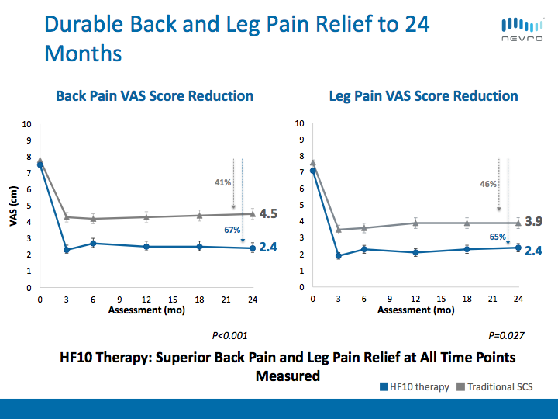
Spinal cord stimulation
Kapural L, et al. Comparison of 10-kHz High-Frequency and Traditional Low-Frequency Spinal Cord Stimulation for the Treatment of Chronic Back and Leg Pain: 24-month Results from a Multicenter, Randomized, Controlled Pivotal Trial. Neurosurgery 79:667-677.

Slide 41
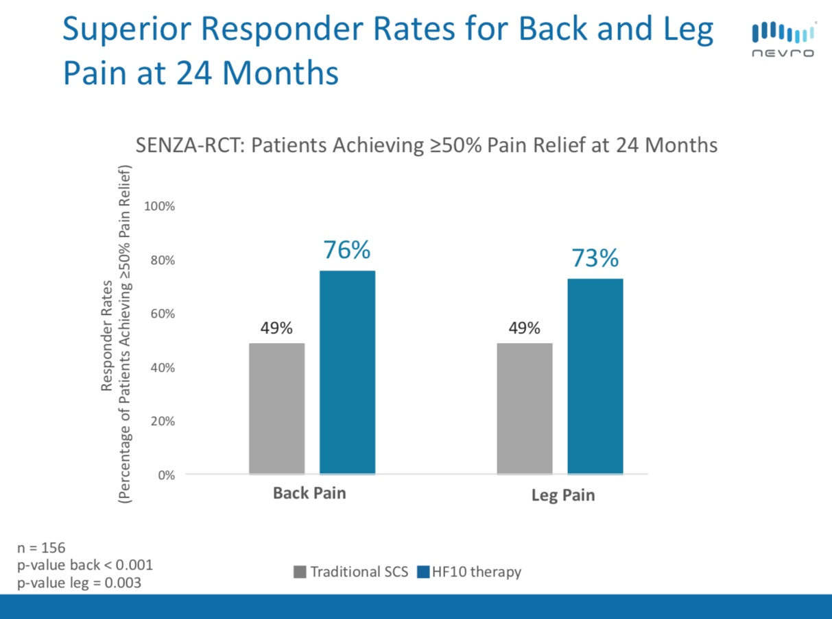

Slide 42
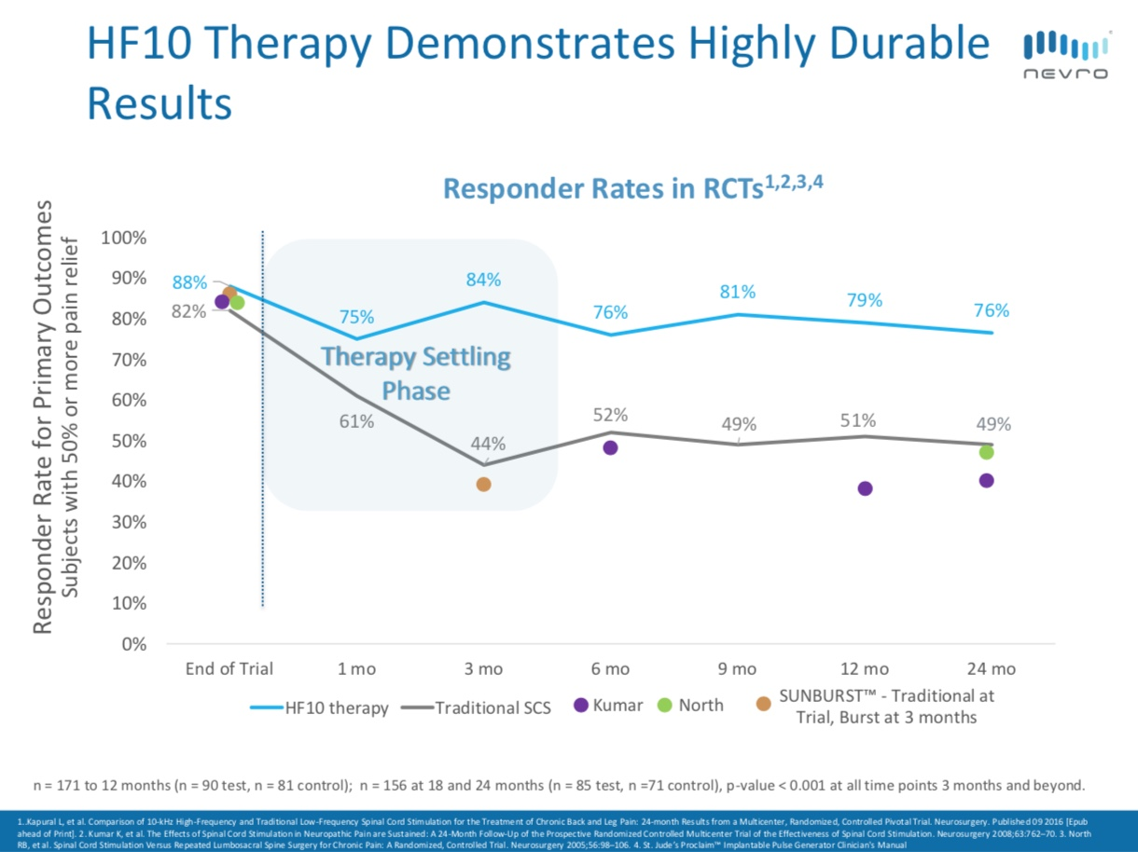
1.Kapural L, et al. Comparison of 10-kHz High-Frequency and Traditional Low-Frequency Spinal Cord Stimulation for the Treatment of Chronic Back and Leg Pain: 24-month Results from a Multicenter, Randomized, Controlled Pivotal Trial. Neurosurgery 79:667-677.
2. Kumar K, et al. The Effects of Spinal Cord Stimulation in Neuropathic Pain are Sustained: A 24-Month Follow-Up of the Prospective Randomized Controlled Multicenter Trial of the Effectiveness of Spinal Cord Stimulation. Neurosurgery 2008;63:762–70.
3. North RB, et al. Spinal Cord Stimulation Versus Repeated Lumbosacral Spine Surgery for Chronic Pain: A Randomized, Controlled Trial. Neurosurgery 2005;56:98–106.
4. St. Jude’s ProclaimTM Implantable Pulse Generator Clinician's Manual

Slide 43
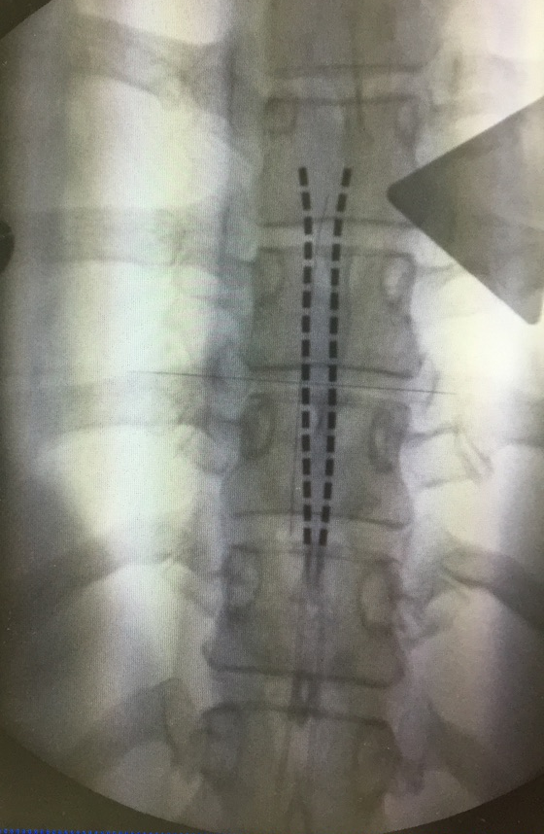
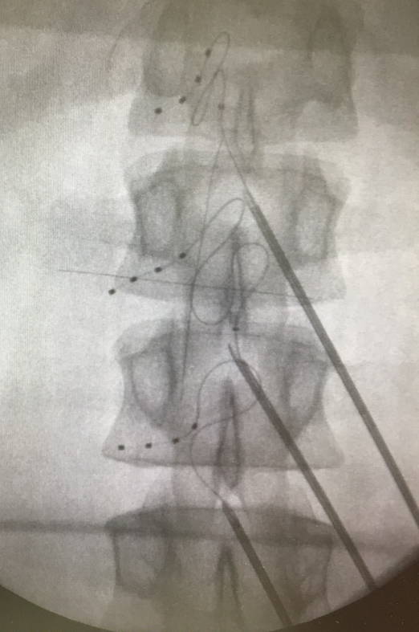

Slide 44
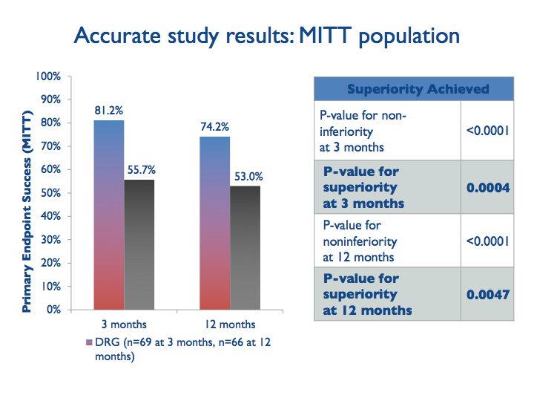
Deer TR, Levy RM, Jeffery Kramer J et al. Dorsal root ganglion stimulation yielded higher treatment success
rate for complex regional pain ;/ / syndrome and causalgia at 3 and 12 months: a randomised comparative trial.
Pain 2017 158:669-681

Slide 45
Van Buyten JP et al. Stimulation of Dorsal Root Ganglia for the Management of Complex Regional Pain Syndrome: A Prospective Case Series. Pain Pract. 2015; 15(3): 208-16

Slide 46
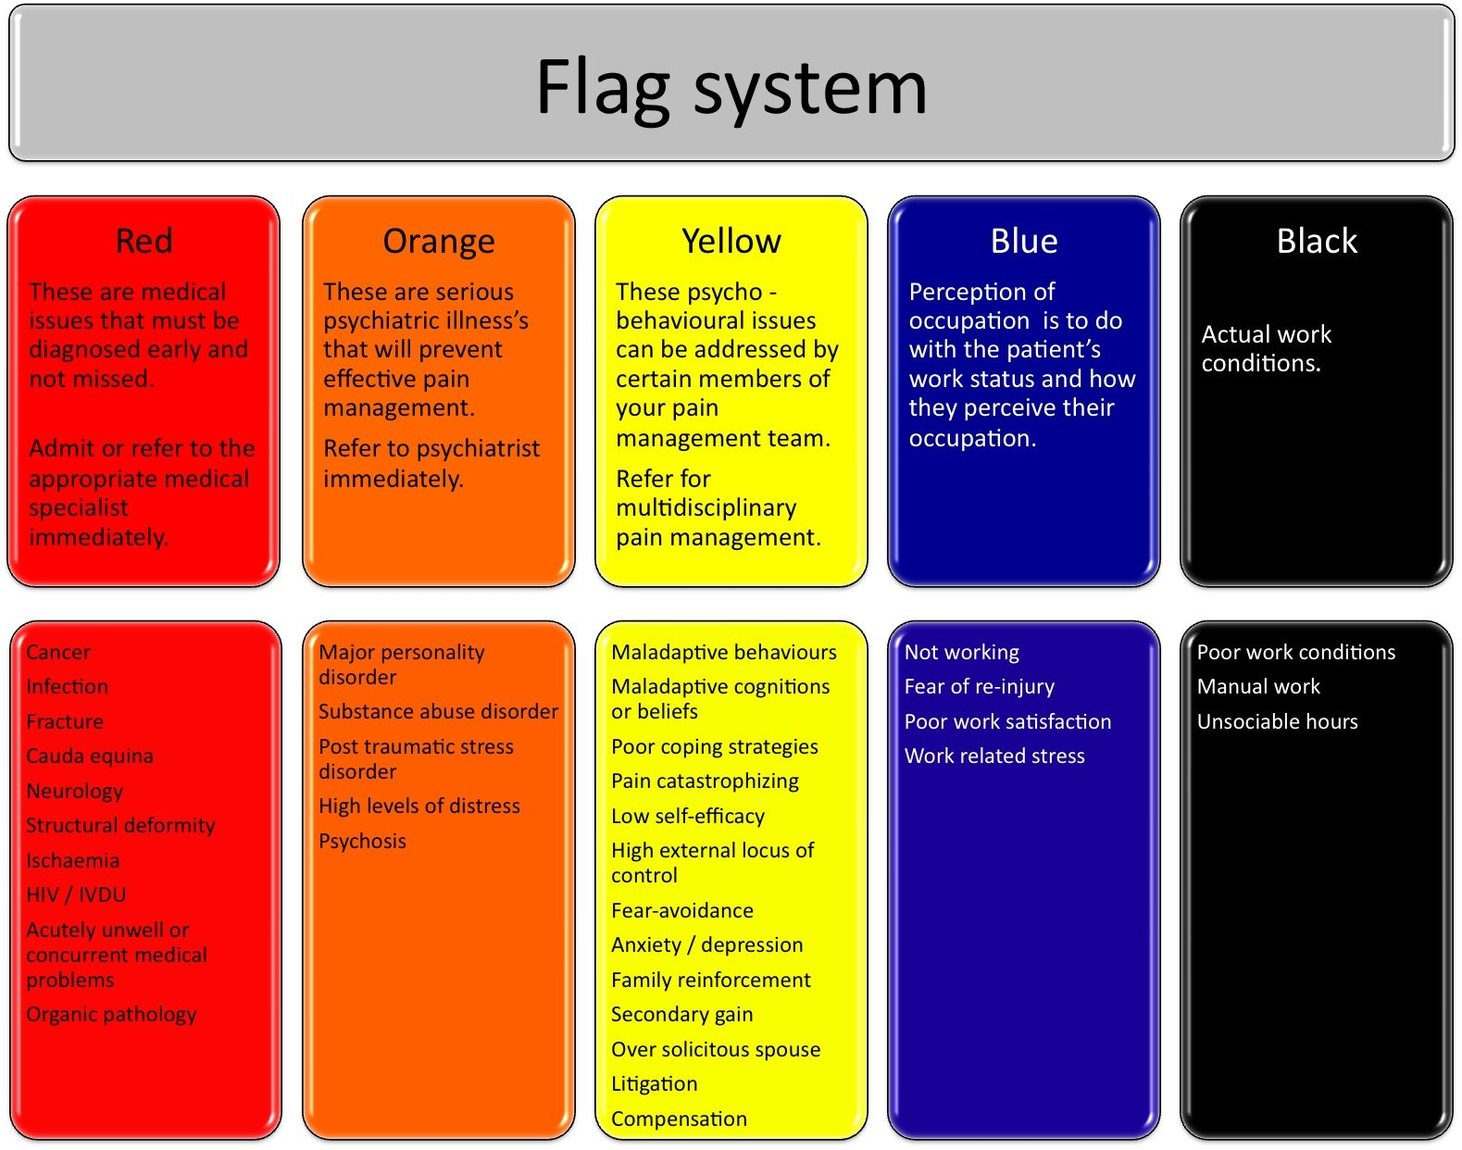
Considerations - assessment
Pain is not pain
Nociceptive vs neuropathic vs mixed
Anatomical considerations
Post spinal surgery persistent pain

Slide 47
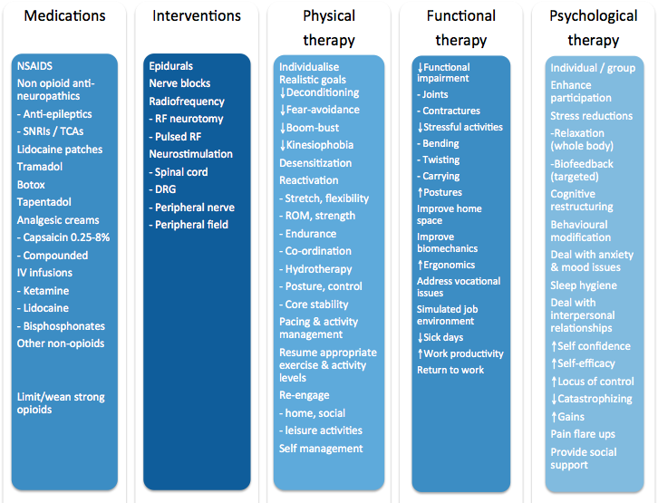

Slide 48
Considerations
Nociceptive
Neuropathic

Slide 49
Considerations
Anatomical considerations
      Midline point
      Midline diffuse
      Paraspinal
      Iliac crest
      High buttock
      Mid buttock
      Leg pain

Slide 50
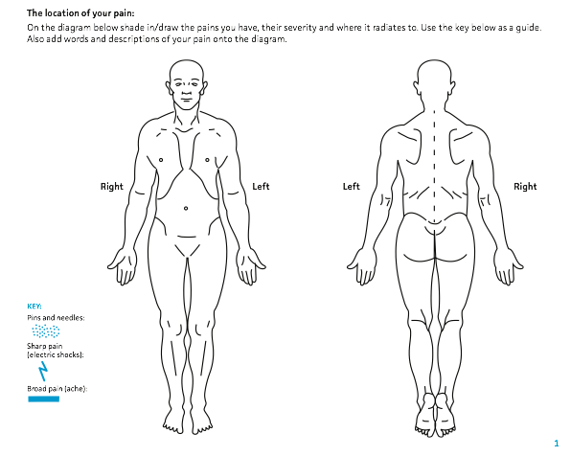

Young vs old

Slide 51
Pain pattern
<55yrs
Pain on supine
MRI changes

Slide 52
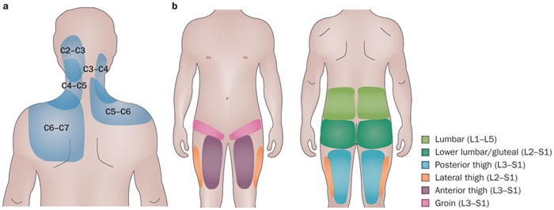


Slide 54
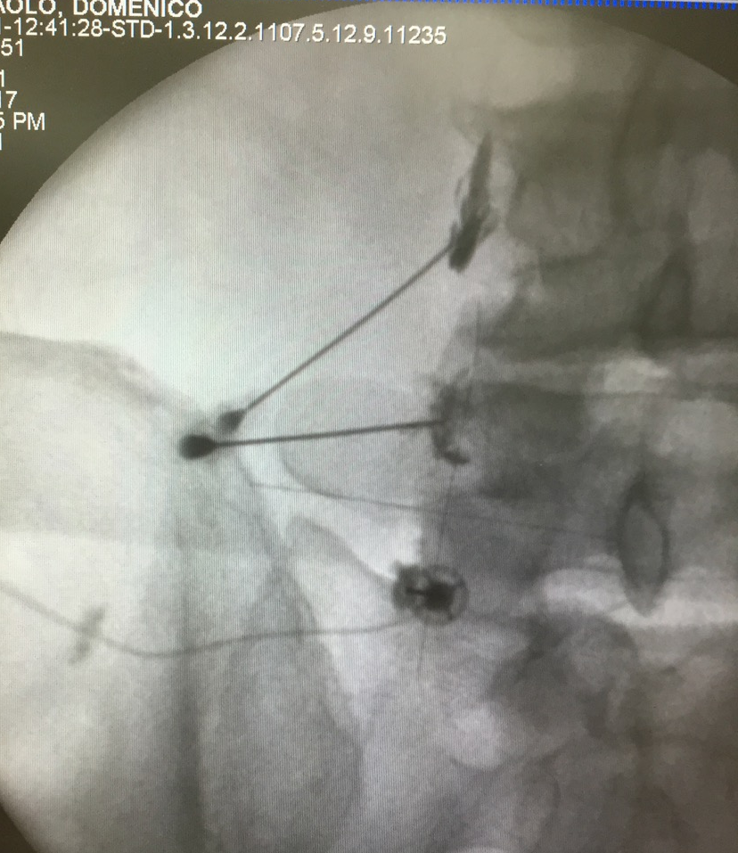
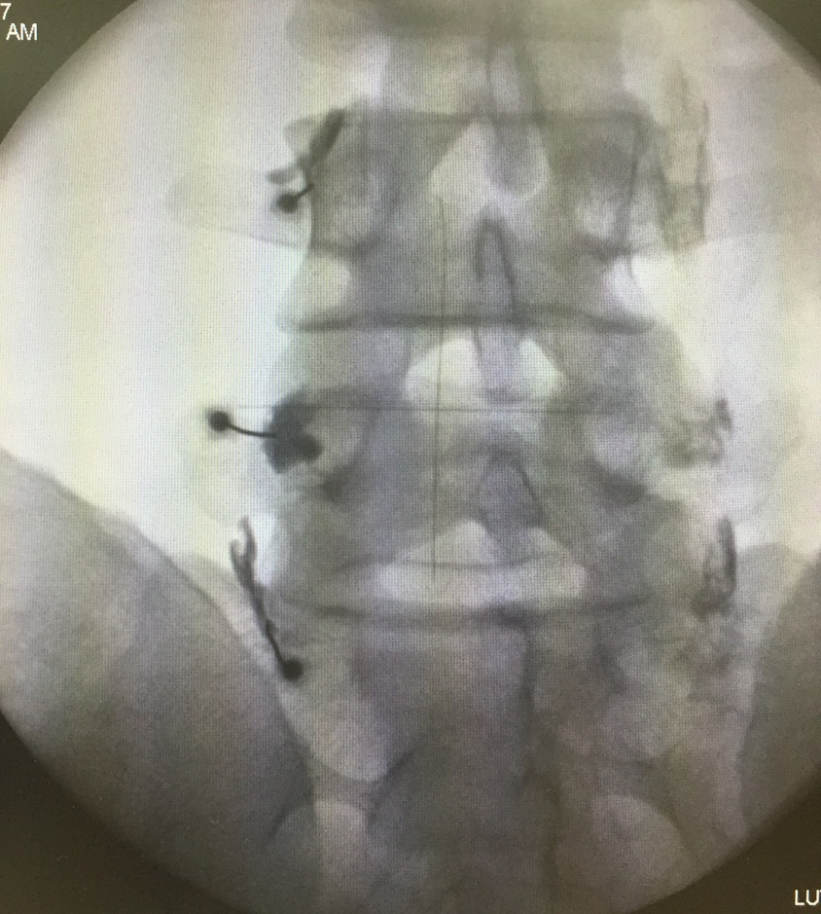

Slide 56
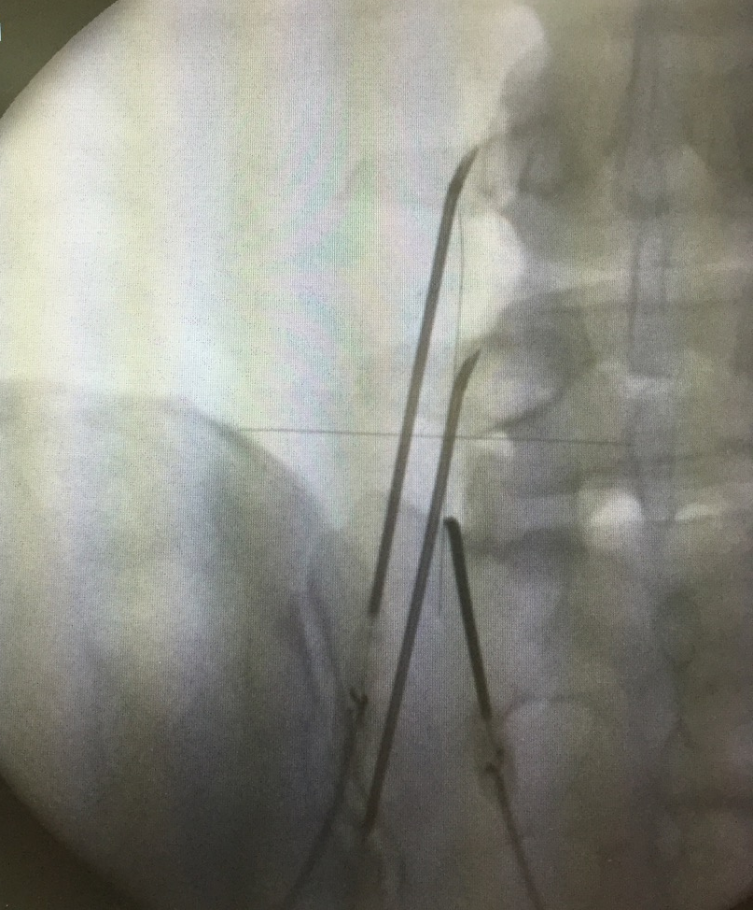
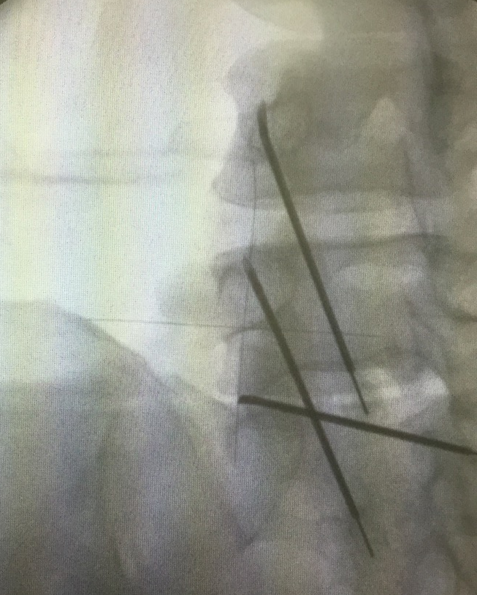

Slide 57


Slide 58



Slide 59
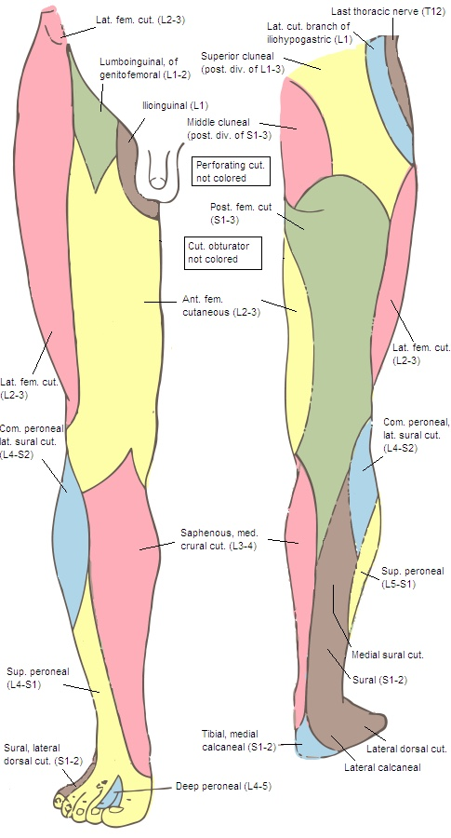
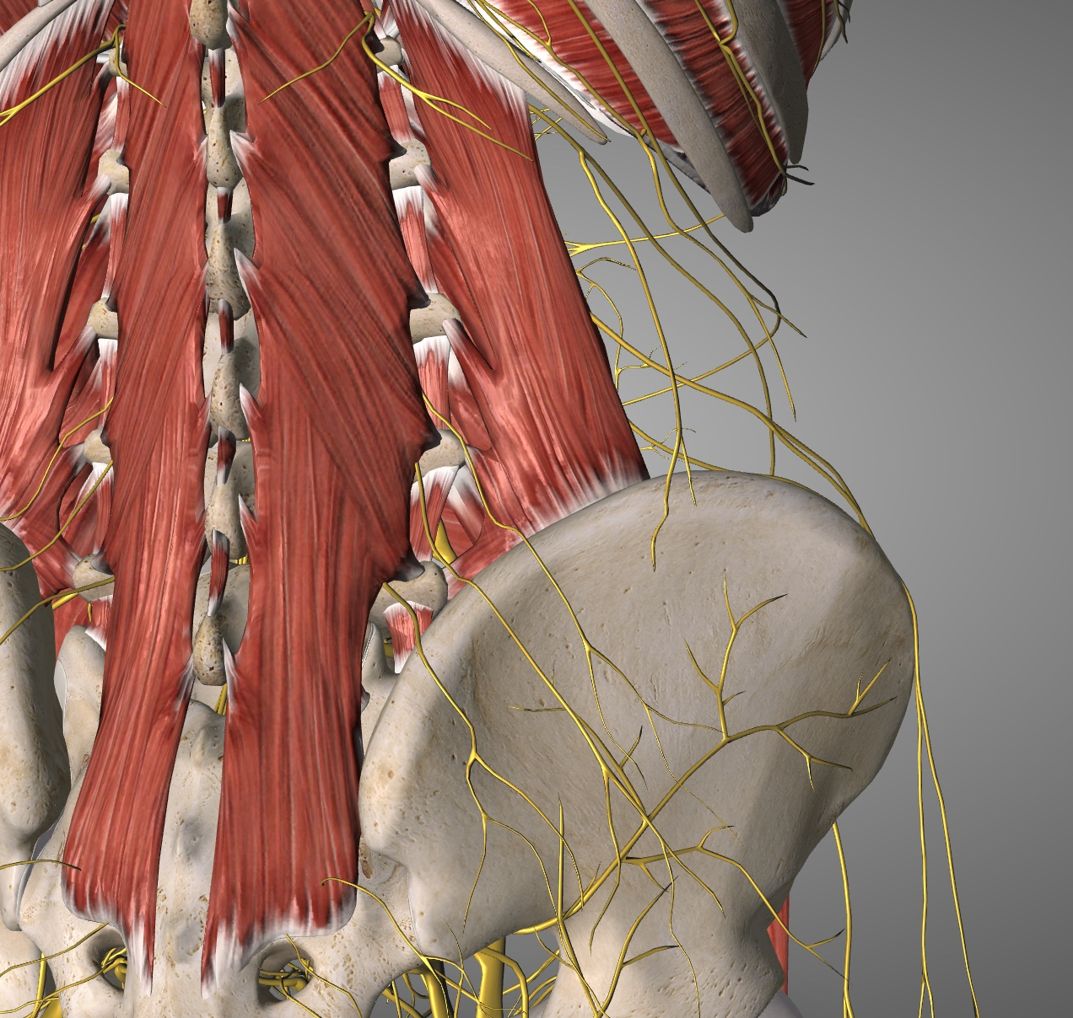

Slide 60
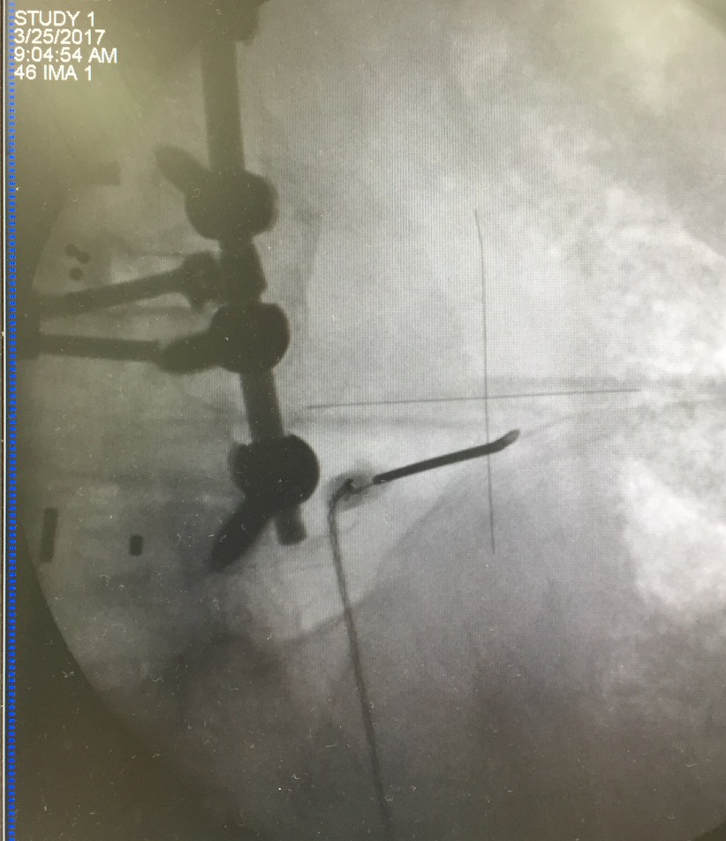
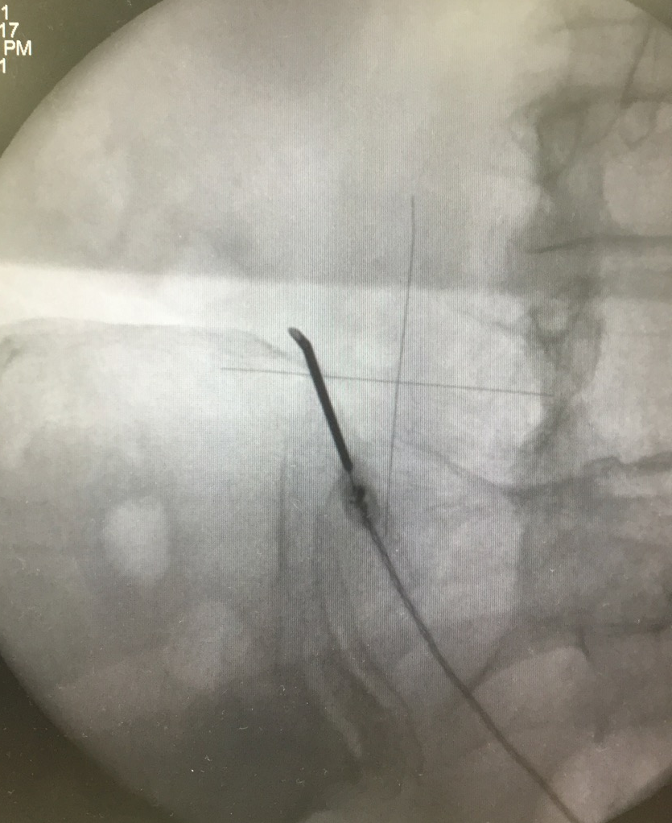

Slide 61
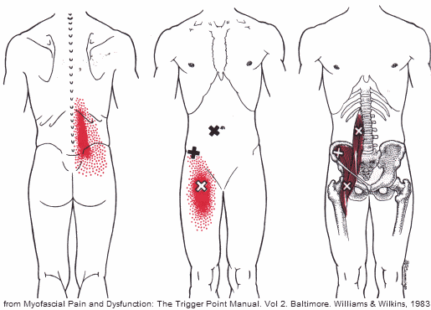

Slide 62
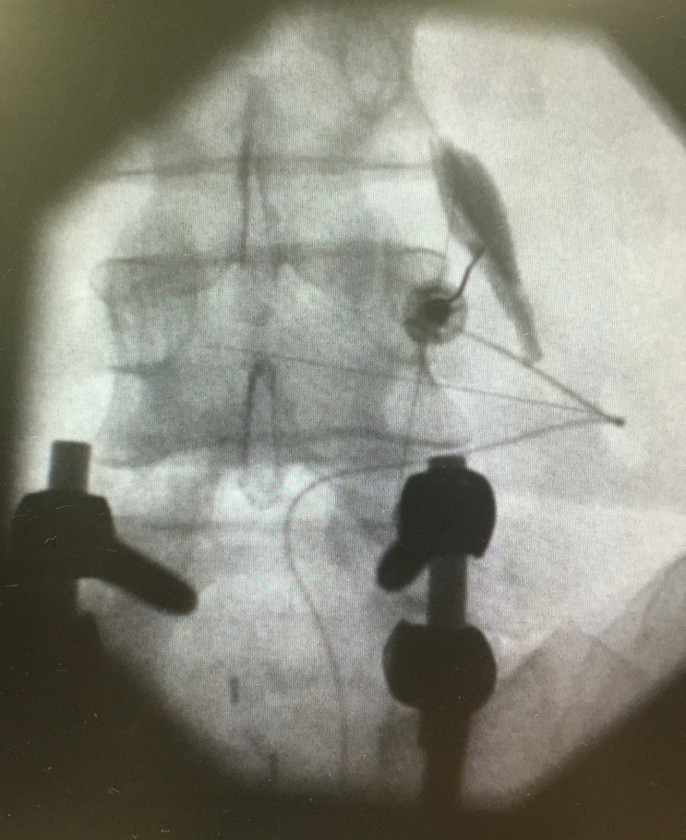

Slide 63
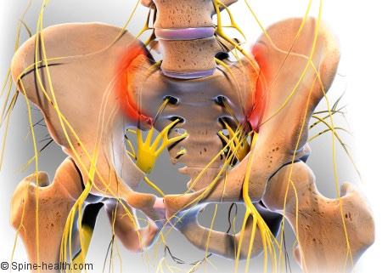
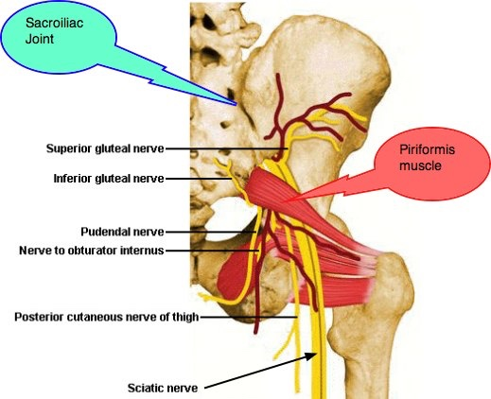
Intraspinal vs extraspinal

Slide 64
Intraspinal vs extraspinal

Slide 66
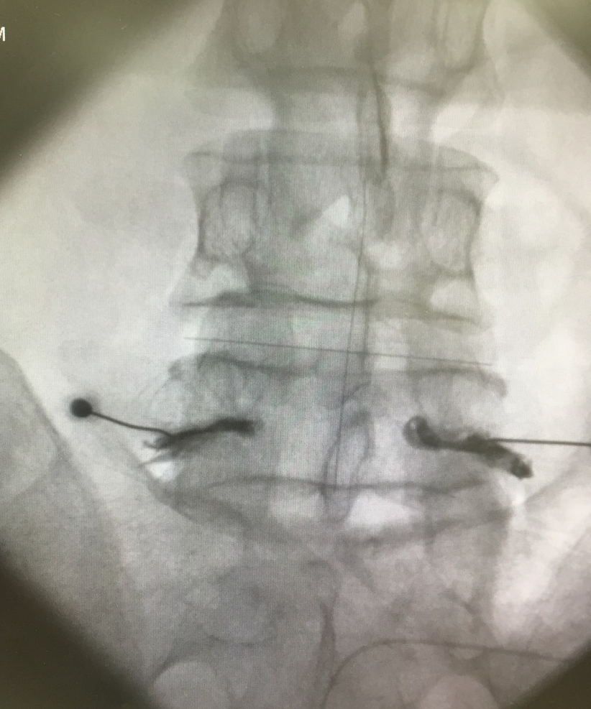

Slide 68
Post Operative Persistent Syndrome
Pain is worse after surgery = surgical complication or issue
Pain has not changed = wrong diagnosis
Pain after 3 months = epidural fibrosis
Pain after 1 year = something new

Slide 69
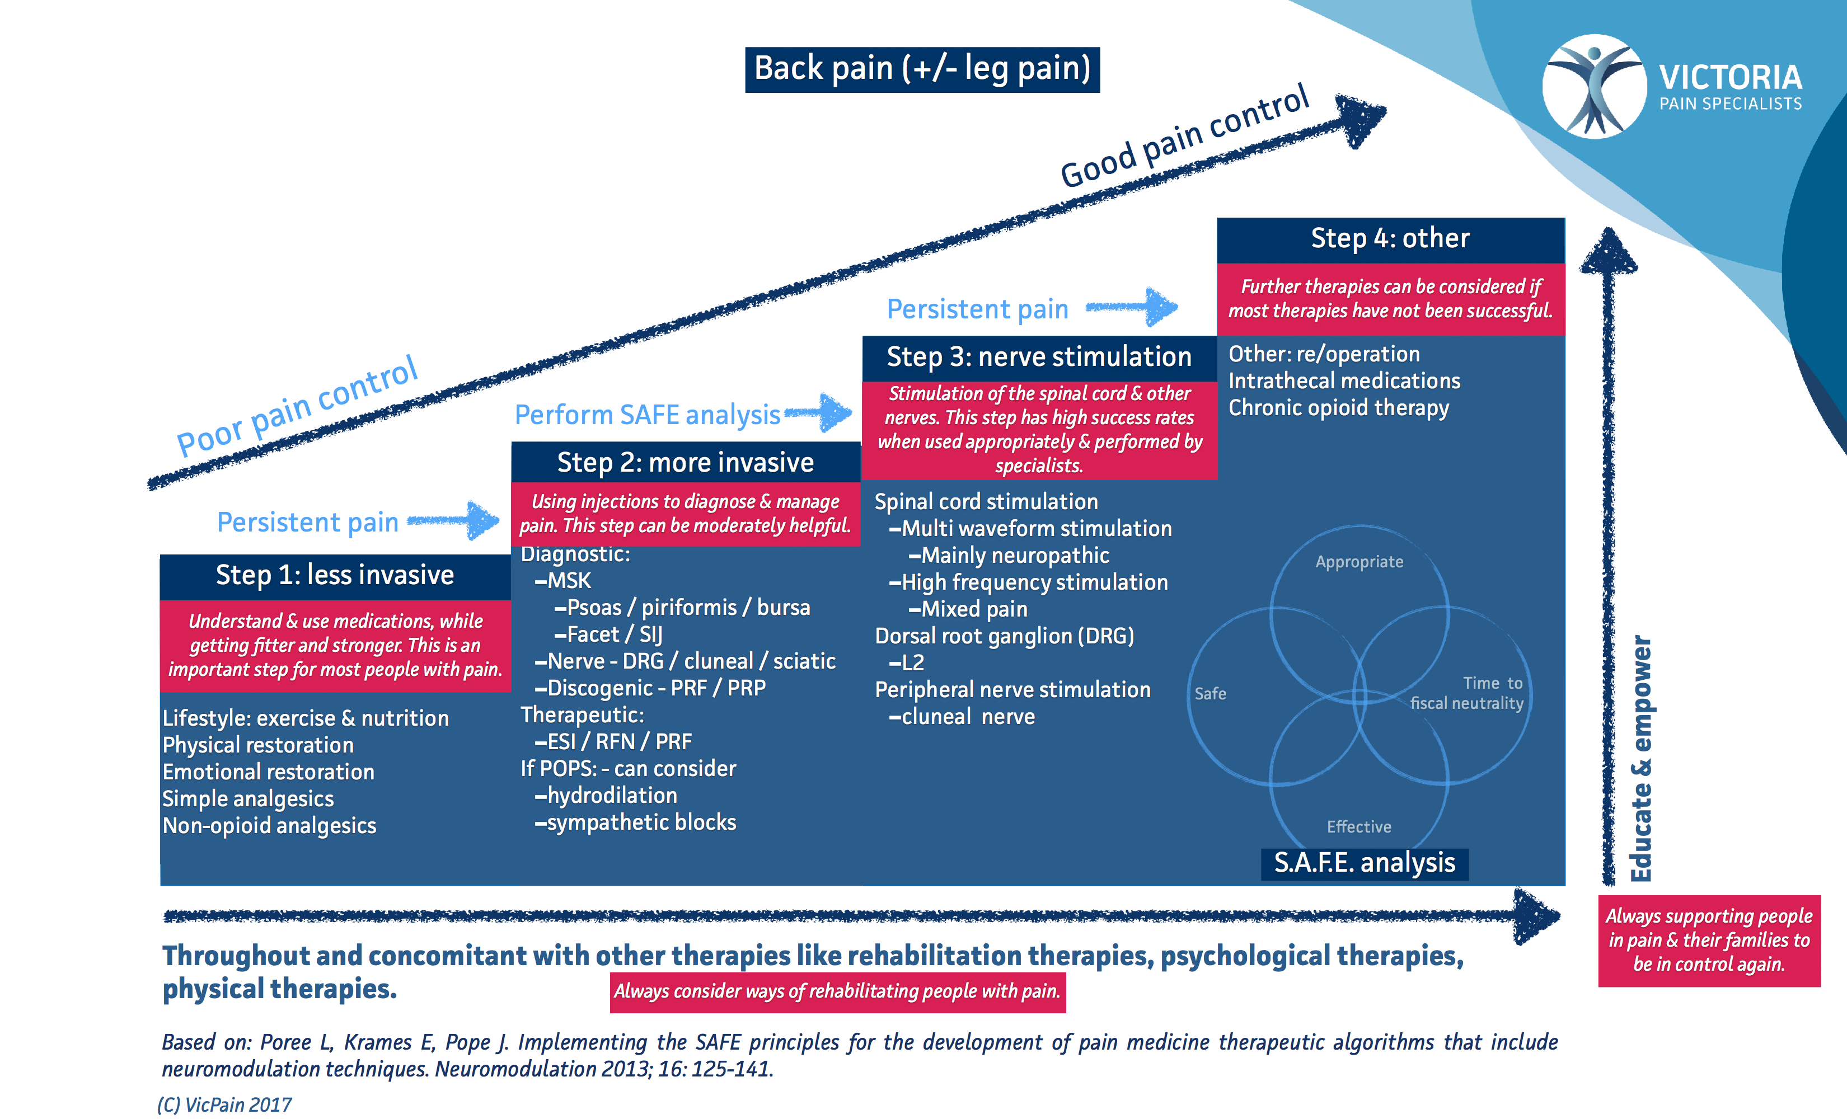

Slide 70
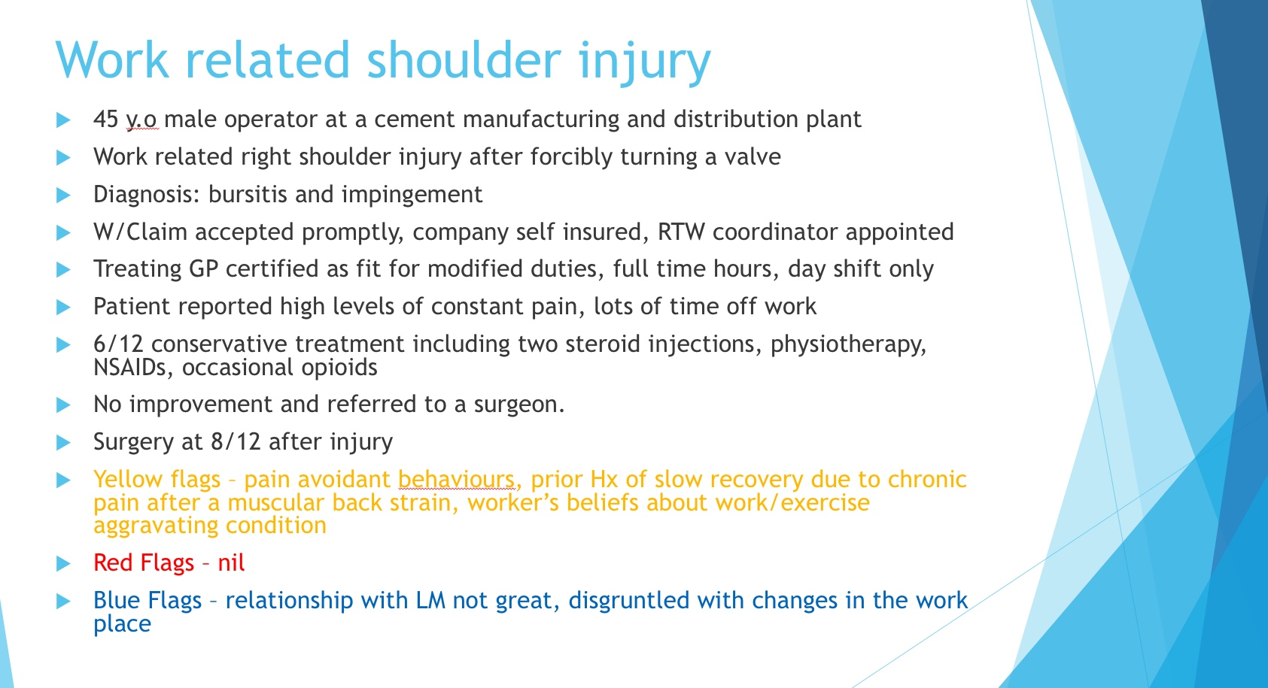

Slide 71
Approach to shoulder pain
Nociceptive
Neck pain?
Ant shoulder
      SA bursitis —> PRP + exercise
      Long head of biceps tendonitis —> local/steroid or PRP
      Corocoid syndrome
Top of shoulder
      AC joint —> e.g. OA —> intraarticular pulsed RF &/or PRP
Broader area
      GH - OA —> local/steroid or supra scapular nerve pulsed radiofrequency
      Frozen shoulder —> EUA / MUA
Myofacial pain
      Pec minor pain
Rotator cuff
      —> PRP + exercise

Slide 72
Approach to shoulder pain
Neuropathic
Top of shoulder
      Functional entrapment of spinal accessory nerve —> pulsed RF + hydrodiscection
      Functional entrapment of brachial plexus —> pulsed RF + botox
      Cervical radicular pain —> pulsed RF
Posterolateral
      Discs and nerves e.g. cervical radicular pain
Posterior
      Impingement
Diffuse
      Central sensitisation
Post surgical pain

Slide 73


Slide 74

Moore JT, Kelz MB. Opiates, Sleep, and Pain: The Adenosinergic Link. Anesthesiology. 2009;111(6):1175-1176. doi:10.1097/ALN.0b013e3181bdfa2e.

Slide 75


Slide 76
When to refer to a pain specialist?

Slide 77

Thanks for your time & attention

