Slide 1

Preparing for a board role

Slide 2
The Nitty Gritty
My Role on AMA Victoria
Considerations:
Interest/ Aims
Suitability
Time
Remuneration
Responsibility
Liability
“Culture Eats Strategy for breakfast”
“Noses In, Fingers Out”
Training
Formal - AICD
Scholarships
How to find positions
Health
Government
Advocacy
Charities
Industry – including Indemnity
Networking – it IS personal

Slide 3


Slide 4
More Nitty Gritty
Interviewing
Advantages:
Decision making
Explaining Rationale
Consensus Decision Making
“Trust no one”
Disadvantages:
Risk averse
“Too Harsh”
Mentors
Fill the holes in Skills matrix
Succession Planning
Duration
Diversity

Slide 5
Useful links
http://aicd.companydirectors.com.au/education/courses-for-the-director
https://www2.health.vic.gov.au/hospitals-and-health-services/boards-and-governance/current-appointment-processes
https://getonboard.vic.gov.au/
https://www.vic.gov.au/guidelines-appointment-remuneration

Slide 6
More
https://boarddirection.com.au/wp-content/uploads/2018/11/18-BD-005-Board-Direction-Resource-Pack-A4-Booklet-web.pdf
https://www.legislation.gov.au/Details/C2018C00031
https://www.scholarships.org.au/supporters/all-supporters/women-on-boards - .XPT9N-szau4
https://www.leadershipvictoria.org/programs/scholarships

Slide 7
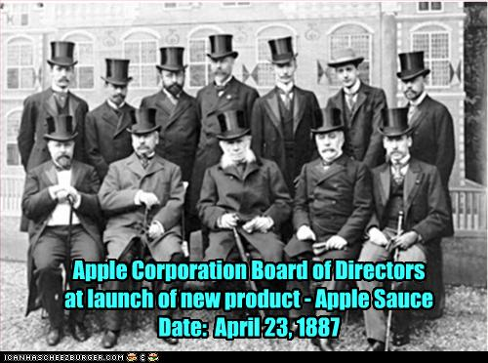

Slide 8
Useful links
http://aicd.companydirectors.com.au/education/courses-for-the-director
https://www2.health.vic.gov.au/hospitals-and-health-services/boards-and-governance/current-appointment-processes
https://getonboard.vic.gov.au/
https://www.vic.gov.au/guidelines-appointment-remuneration

Slide 9
More
https://boarddirection.com.au/wp-content/uploads/2018/11/18-BD-005-Board-Direction-Resource-Pack-A4-Booklet-web.pdf
https://www.legislation.gov.au/Details/C2018C00031
https://www.scholarships.org.au/supporters/all-supporters/women-on-boards#.XPT9N-szau4
https://www.leadershipvictoria.org/programs/scholarships

