Slide 1






Assessing thyroxine dose
Endocrine Society of Australia

Slide 2

Mrs P
Mrs P is presenting with nausea and vomiting likely secondary to urinary tract infection. Thyroid function tests were repeated during her hospital admission due to recent adjustment of her thyroxine dose.
Patient medical history (PMHx)
73-year-old female
Primary hypothyroidism presumed secondary to tyrosine kinase inhibitor
Lamivudine chemoprophylaxis for hep B core antibody positive
Metastatic ALK mutated lung cancer - on second line TKI (alectinib)
Thyroxine dosing
Thyroxine dose adjusted multiple times in past several months
Most recent thyroxine dose 150 microgs daily for past month

Slide 3
Mrs P
Examination
Temperature 37ºC
Blood pressure 103/59
Pulse 58
Old thyroidectomy scar
Visual fields intact
Nil clinical signs hyperthyroidism
Tests / Investigations
TFTs on admission
  TSH 2.2 (0.27-4.2)
  fT4 24.3 (12.0-22.0)
  fT3 1.9 (3.1-6.8)
  Previous antibody testing in community
  Thyroglobulin and thyroid peroxidase negative
  TSH receptor Ab negative
This case study is specific to adults and patient medical history, thyroxine dosing, examination and tests/investigation reflect this patient population.

Slide 4
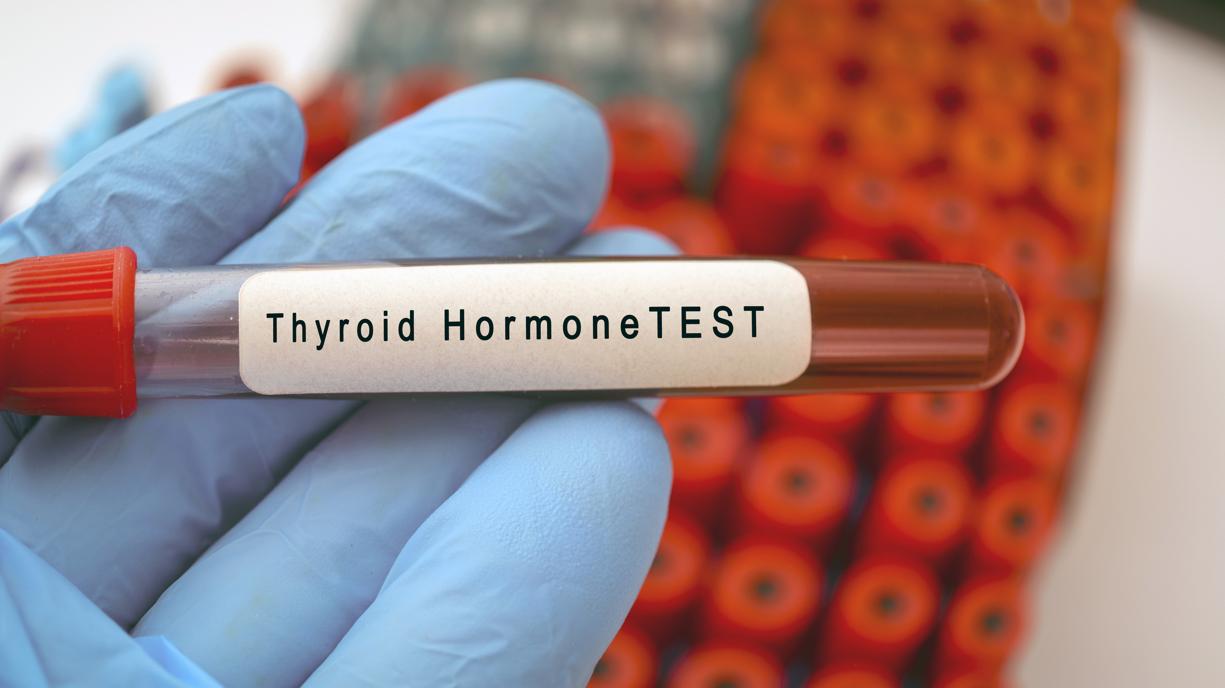
Which investigation should be used to guide the thyroxine dose?
TSH 2.2 (0.27-4.2)
fT4 24.3 (12.0-22.0)
fT3 1.9 (3.1-6.8)
TSH receptor antibody negative

Slide 5
Which investigation should be used to guide the thyroxine dose?
TSH 2.2 (0.27-4.2)
fT4 24.3 (12.0-22.0)
fT3 1.9 (3.1-6.8)
TSH receptor antibody negative

Slide 6
Evolve Recommendation
Don’t order a total or free T3 level when assessing thyroxine dose in hypothyroid patients
The Endocrine Society of Australia
Evolve is facilitated by the Royal Australasian College of Physicians

Slide 7
What is best practice?
Why should we not order a total or free T3 level when assessing thyroxine dose in hypothyroid patients?
TSH level, not T4 or T3 level, is used to guide thyroxine dosing in primary hypothyroidism
Hypothyroid patients taking thyroxine may have higher blood T4 and lower blood T3 levels, so a low total or free T3 level may be misleading
A normal TSH usually indicates appropriate thyroxine dose
TSH level is monitored approximately 6 to 8 weeks after initiating treatment with thyroxine
In non-pregnant patients with primary hypothyroidism, the target range should be the normal range of a third generation TSH assay

Slide 8
What is best practice?
Which investigation is used to guide thyroxine dosing in secondary or tertiary hypothyroidism?
TSH level is used in patients with primary hypothyroidism
TSH level is not reliable in patients with secondary or tertiary hypothyroidism
Free T4 is used to guide thyroxine dosing in patients with secondary or tertiary hypothyroidism
The free T4 level should target values above the mid-normal range for the assay

Slide 9
Patient Care
When a stable dose of thyroxine has been achieved, repeat TSH levels after 4 to 6 months and then every 12 months.
Patients can be directed to the Australian Thyroid Foundation for patient-centred education and support

Slide 10
Patient Care
Shared decision making (SDM) involves discussion and collaboration between a patient/consumer and their healthcare provider to bring together the consumers values, goals and preferences with the best available evidence about benefits, risks and uncertainties of treatment in order to reach the most appropriate healthcare decisions for that person
Person-centred care is widely recognised as a foundation to safe, high-quality health care. It is care that respects and responds to the preferences, needs and values of patients and consumers.
For further information and resources refer to the Australian Commission on Safety and Quality in Healthcare’s Partnering with Consumers website: https://www.safetyandquality.gov.au/our-work/partnering-consumers
“Priority populations often receive less information and ask fewer questions. You may need to do more to engage them in shared decision making"

Slide 11
References
Duntas, Leonidas H., and Jacqueline Jonklaas. "Levothyroxine dose adjustment to optimise therapy throughout a patient’s lifetime." Advances in therapy 36 (2019): 30-46.
Garber, Jeffrey R., et al. "Clinical practice guidelines for hypothyroidism in adults: cosponsored by the American Association of Clinical Endocrinologists and the American Thyroid Association." Thyroid 22.12 (2012): 1200-1235.
Jonklaas, Jacqueline, et al. "Guidelines for the treatment of hypothyroidism: prepared by the american thyroid association task force on thyroid hormone replacement." thyroid 24.12 (2014): 1670-1751.
Schneider, Claudio, et al. "Initial evaluation of thyroid dysfunction-Are simultaneous TSH and fT4 tests necessary?." PLoS One 13.4 (2018): e0196631.
Topliss, Duncan J., and Creswell J. Eastman. "Diagnosis and management of hyperthyroidism and hypothyroidism." The Medical Journal of Australia 180.10 (2004): 541-542.

Slide 12
How this case study was made
This case study was developed by Dr Michael Do as a member of the Endocrine Society of Australia, based on an Evolve recommendation on low-value practices.
This case study was reviewed by the ESA, RACPs Evolve Policy and Advocacy Interest Group, Consumer Advisory Group and the Australian Diabetes Society.
A special thank you to members that provided their feedback.
This case study was approved for publication by the Endocrine Society of Australia Committee in December 2025.

Slide 13
Evaluation
How likely is this Evolve recommendation to change your practice?
Not at all
Somewhat
Significantly
Explain your reasoning

Slide 14
About Evolve
  As part of a global movement, Evolve is a flagship initiative led by physicians, specialties and the Royal Australasian College of Physicians (RACP) to drive high-value, high-quality care in Australia and New Zealand.
  Evolve aims to reduce low-value care by supporting physicians to:
    be leaders in changing clinical behaviour for better patient care
    make better decisions, and
    make better use of resources.
Find out more:
  www.evolve.edu.au
Get in touch:
  evolve@racp.edu.au

