Slide 1





Low Back Pain
Australasian Faculty of Occupational and Environmental Medicine

Slide 2

Genevieve
Genevieve is presenting to you as a treating physician.
Medical history
47-year-old female
Works in traffic management with prolonged standing
Restricted diet – has lost weight over the last 8 weeks
Mild pain in lower back for the last 3 months
Taking Ibuprofen when the pain becomes distracting
No pre-existing conditions
No regular medications
Grandmother has undergone treatment for multiple myeloma
Symptoms
Pain on bending backwards
Lower back pain is generalised across the entire lower back
Pain eased with Ibuprofen and lying down on her back

Slide 3
What is the most appropriate response to Genevieve’s back pain?

Slide 4
What is the next step?
Choose as many options as appropriate:
    Order imaging, e.g., X-ray, CT, MRI, bone scan and/or densitometry of her lower back
    Prescribe stronger anti-inflammatories or an opioid
    Ask her some more questions
    Refer her to a physiotherapist

Slide 5
Inappropriate and Appropriate
Order imaging, e.g., X-ray, CT, MRI, bone scan and/or densitometry of her lower back
Prescribe stronger analgesia including opioids
Ask her some more questions
Refer her to a physiotherapist

Slide 6
Evolve Recommendation
Do not request X-rays or other imaging for acute low back pain, unless there are red flags or other clinical reasons to suspect serious spinal pathology
Australasian Faculty of Occupational and Environmental Medicine
Do not undertake imaging for low back pain in patients without indications of a serious underlying condition
Australian Rheumatology Association
Evolve is facilitated by the Royal Australasian College of Physicians

Slide 7
Additional information required
To determine the optimal management, three key types of information need to be sought from patient, in addition to physical examination.
1. Job tasks, duties, demands and hours
Lifting, pushing, pulling, carrying
Bending, twisting
Climbing ladders and stairs
Safety critical work, work at heights
Driving
Equipment
Overtime, secondary jobs
2. Health and wellbeing
Previous back pain, trauma
Occupational history
Fitness level
Relevant medical history
Psychosocial, work and other factors that may increase the risk of prolonged disability

Slide 8
Additional information required
3. Lower back pain
Trauma
Acute or gradual onset
Frequency, duration
Had it before?
Location, radiation
Radicular symptoms e.g., pins and needles, tingling, numbness, weakness in legs
Presence and duration of early morning stiffness
Presence of other joint/entheseal symptoms e.g., joint swelling, Achilles tendinitis, dactylitis
Systemic symptoms e.g., fever, weight loss, skin, bowel or eye changes
Red flags e.g., bowel and bladder problems, fever, immunocompromised, cancers, aged <18 years, >50 years, weight loss, IV drugs
4. Physical Examination
Body habitus, posture, gait
Low back soft tissue or bony tenderness
Range of motion
Neurology
Joint examination
General health

Slide 9
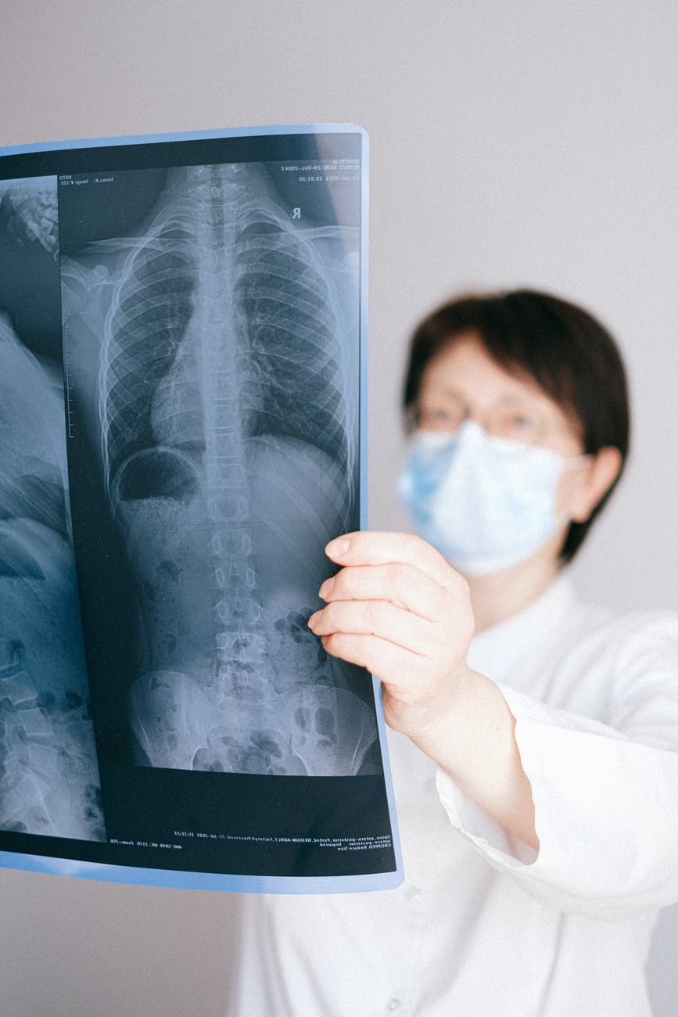
What is best practice?
What are the limitations of x-rays?
As little as 2% of low back pain cases in primary care represent potentially serious conditions requiring surgical or medical intervention.
Most acute low back pain episodes are benign, self-limiting cases that do not require any X-ray or imaging studies.
Plain radiography is insufficiently sensitive and specific for investigation of pain.

Slide 10
What is best practice?
Whether any action is required will depend on findings from the three key categories of questions and physical examination.
Diagnostic imaging is generally not needed:
Single episode of low back pain usually settles spontaneously and requires no further action.
If the problem is recurrent or associated with any other concerns, the patient needs further management depending on your findings e.g., education, medications, consider referral to an exercise program; an occupational physician for work-related management; a rheumatologist and/or rehabilitation physicians for persistent symptoms, and/or other treating providers.
There is NO PLACE for X-rays or imaging in low back pain unless there are red flags or other clinical reasons to suspect serious spinal pathology!

Slide 11
What is best practice?
Possible indication for diagnostic imaging
Concerning neurological deficits e.g., dermatomal or saddle anaesthesia, motor weakness in legs, sphincter dysfunction, frequent falls or ataxia, suggestion of epidural abscess are possible medical emergencies and require urgent specialist referral for follow up and imaging.
Red flags e.g., bowel and bladder problems, immunocompromised, fever, cancers, aged <18 years, >50 years, weight loss, IV drugs, recent trauma and anticoagulation also require specialist referral for follow up and imaging.

Slide 12
References:
Evolve Recommendations:
Graves JM, Fulton-Kehoe D, Martin DP, et al. Factors associated with early magnetic resonance imaging utilization for acute occupational low back pain: a population-based study from Washington State workers' compensation. Spine. 2012; 37(19): 1708–1718
Suri P, Boyko EJ, Goldberg J, et al. Longitudinal associations between incident lumbar spine MRI findings and chronic low back pain or radicular symptoms: retrospective analysis of data from the longitudinal assessment of imaging and disability of the back (LAIDBACK). BMC musculoskeletal disorders. 2014; 15: 152.
Webster BS, Bauer AZ, Choi Y, et al. Iatrogenic consequences of early magnetic resonance imaging in acute, work-related, disabling low back pain. Spine. 2013; 38(22): 1939–1946.
Other References:
T. Hyde, "Swimming and Back Pain," Spine-health, 10 February 2012. [Online]. Available: https://www.spine-health.com/conditions/sports-and-spine-injuries/swimming-and-back-pain.
M. Nyska, N. Constantini, M. Calé-Benzoor, Z. Back, G. Kahn and G. Mann, "Spondylolysis as a cause of low back pain in swimmers," International Journal of Sports Medicine, vol. 21, no. 5, pp. 375-379, July 2000.
American Cancer Society, "Risk Factors for Multiple Myeloma," 28 February 2018. [Online]. Available: https://www.cancer.org/cancer/multiple-myeloma/causes-risks-prevention/risk-factors.html.
F. Spritzler, "8 Signs and Symptoms of Vitamin D Deficiency," Healthline, 23 July 2018. [Online]. Available: https://www.healthline.com/nutrition/vitamin-d-deficiency-symptoms.

Slide 13
References:
Other References:
Morrisroe K, Nakayama A, Soon J, et al. EVOLVE: The Australian Rheumatology Association’s
‘top five’ list of investigations and interventions doctors and patients should question. Intern Med J 2018; 48:135-43.
Hartvigsen J, Hoy D, Smeets R, et al, for the Lancet Low Back Pain Series Working Group. What low back pain is and why we need to pay attention. Lancet 2018; 391(10137): 2356-67.
Foster NE, Koes B, Chou R, et al, for the Lancet Low Back Pain Series Working Group. Prevention and treatment of low back pain: evidence, challenges, and promising directions. Lancet 2018; 391(10137): 2368-83.

Slide 14
How this case study was made
This case study was developed through the RACP Evolve Initiative. It was drafted by Dr Mary Obele and Dr Robin Chase based on an Evolve recommendation on low-value practices.
This case study has been reviewed by the
AFOEM PAC members, in particular Dr Beata Byok, Dr Graeme Edwards, Dr Warren Harrex, and Professor Malcolm Sim
RACP Evolve Policy Reference Group – Dr David Baker, Dr Rodger Laurent and Dr Sern Wei Yeoh
Australian Rheumatology Association, Australian Physiotherapy Association and NPS MedicineWise
This case study was approved for publication by the Australasian Faculty of Occupational and Environmental Medicine on 19 April 2022.

Slide 15
Evaluation
How likely is this Evolve recommendation to change your practice?
Not at all
Somewhat
Significantly
Explain your reasoning

Slide 16
About Evolve
  As part of a global movement, Evolve is a flagship initiative led by physicians, specialties and the Royal Australasian College of Physicians (RACP) to drive high-value, high-quality care in Australia and New Zealand.
  Evolve aims to reduce low-value care by supporting physicians to:
    be leaders in changing clinical behaviour for better patient care
    make better decisions, and
    make better use of resources.
Find out more:
  www.evolve.edu.au
Get in touch:
  evolve@racp.edu.au

