Slide 1





Single vs Multi-Checks
Endocrine Society of Australia

Slide 2
Ali
Patient medical history (PMHx)
68-year old man
T2DM for 5 years
Peripheral vascular disease – previous left 1st toe amputation in April 2019
Hypertension
Dyslipidemia
Symptoms
Referred by GP to High risk foot service (HRFS)
Chronic left plantar foot ulcer under 2nd metatarsophalangeal joint for the last 4 months
Reviewed in HRFS by multidisciplinary teams – vascular, endocrine, infectious disease, podiatry teams

Slide 3
Ali
Current medications:
Sitagliptin/Metformin XR 50mg/1000 mg BD
Atorvastatin 20 mg nocte
Ramipril/Felodipine MR 5 mg/5 mg OD
Aspirin 100 mg OD

Slide 4
Ali
Examination
left plantar foot ulcer under 2nd metatarsophalangeal joint level – clean and dry, 6mmx10mm ulcer improving with off-loading
Faint pedal pulse at dorsalis pedis and posterior tibial arteries
Normal anterior tibial, popliteal and femoral pulses
multiple finger prick scars at the finger tips
Tests / Investigations
HbA1C point of care testing 6.4%
Left second toe pressure measurement = 50 mmHg
Doppler left leg ultrasound = tri-phasic flow at anterior tibial artery

Slide 5
What do we think of his blood glucose control?
Optimal control
Suboptimal control

Slide 6
How often should he be checking his BGL in a day?
Once daily
Twice daily
Four times daily
Not required

Slide 7
Ali
Daily blood glucose check is not required in his case
He has optimal diabetes control with HbA1C of 6.4% and he is not prescribed an agent with a high risk of hypoglycemia such as sulphonylureas or insulin

Slide 8
Evolve Recommendation
Avoid multiple daily glucose self-monitoring in adults with stable type 2 diabetes on agents that do not cause hypoglycaemia
The Endocrine Society of Australia
Evolve is facilitated by the Royal Australasian College of Physicians

Slide 9
What is best practice?
When should you check blood glucose levels?
How often you should check varies depending on each individual, the type of diabetes and the tablets and/or injectable drugs such as GLP1 agonists or insulin being used.
The most valuable times to check blood glucose levels for T2DM patients : Fasting or before meals or 2 hours after meals or before bed or when unwell. Levels at different times of the day give different information about glucose management
However, multiple daily checks are not required if the patients with diabetes are not prescribed medications with a high risk of hypoglycaemia

Slide 10
What is best practice?
How can blood glucose management be assessed for those T2DM patients who are not checking blood glucose multiple times per day?
The HbA1c check reflects the average blood glucose level over the past 10–12 weeks.
It can be checked every 3 – 6 month.
HbA1C is a reliable marker for blood glucose control. However, anaemia, pregnancy and chronic renal disease are the most common conditions among the many other causes of unreliable HbA1C.
The goal for most people with diabetes will be in the 6.5-7 percent (48-53mmol/mol) range, however this may need to be higher for some people including children and the elderly and be lower for pregnancy.
Therefore, HbA1C target needs to be individualized.

Slide 11
What is best practice?
The disadvantages of multiple daily checks in patients with optimal control of diabetes
Daily monitoring can be inconvenient
Monitoring can be expensive with the cost for test strips
Multiple checks may lead to painful finger tips

Slide 12
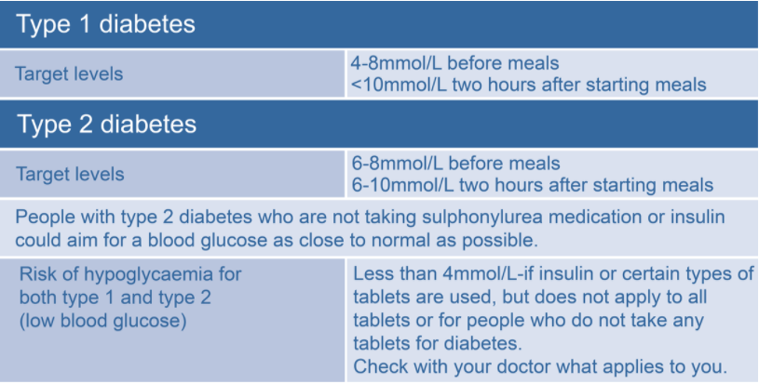
Glucose level targets
Normal blood glucose levels are between 4.0-7.8mmol/L

Slide 13
References
    https://evolve.edu.au/recommendations/esa
    Diabetes Australia
    https://www.diabetesaustralia.com.au/blood-glucose-monitoring

Slide 14
How this case study was made
This case study was developed by Dr Su Win Htike as a member or the RACP Evolve Policy Reference Group.
This case study has been reviewed by the RACP Evolve Policy Reference Group in particular Prof Jane M Andrews, the Australian Diabetes Society, the Endocrine Surgery section of the Royal Australasian College of Surgeons, and NPS MedicineWise.
This case study was approved for publication by the Endocrine Society of Australia Medical Affair Committee in August 2020.

Slide 15
Evaluation
How likely is this Evolve recommendation to change your practice?
Not at all
Somewhat
Significantly
Explain your reasoning

Slide 16
About Evolve
  As part of a global movement, Evolve is a flagship initiative led by physicians, specialties and the Royal Australasian College of Physicians (RACP) to drive high-value, high-quality care in Australia and New Zealand.
  Evolve aims to reduce low-value care by supporting physicians to:
    be leaders in changing clinical behaviour for better patient care
    make better decisions, and
    make better use of resources.
Find out more:
  www.evolve.edu.au
Get in touch:
  evolve@racp.edu.au

