Slide 1


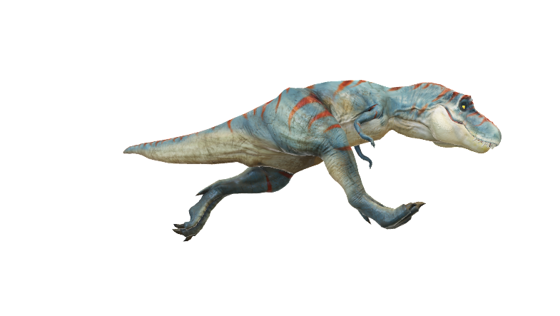
RACP
Janaka Tennakoon
Paediatrician Mildura
June 2020

Slide 2

The Mildura Base Hospital would like to acknowledge all the Traditional Owners throughout the Murray Mallee Region and on whose land we work and live as the first people of this Nation. We also pay respect to all Elders past and present and to honour their culture.

Slide 4
The issues
(Unnecessary interventions)
Undue risk/Emotional stress
Healthcare expenditure
Best available evidence (Knowledge mobilization)
Consumer participation (Doing it with us not for us)

Slide 5


What is

Slide 6
What is evolve?
Evolve works with specialties to identify their ‘Top-Five’ clinical practices that, in particular circumstances, may:
  be overused,
  provide little or no benefit, or
  cause unnecessary harm.

Slide 7
What is evolve?
Evolve works with specialties to identify their ‘Top-Five’ clinical practices that, in particular circumstances, may:
  be overused,
  provide little or no benefit, or
  cause unnecessary harm.

Slide 8
What is evolve?
Evolve works with specialties to identify their ‘Top-Five’ clinical practices that, in particular circumstances, may:
  be overused,
  provide little or no benefit, or
  cause unnecessary harm.

Slide 9
Examples of low-value care in specialist practice
X-rays or other imaging for acute low-back pain without red flags
Using medicines when a safer, more effective non-drug strategy available
Antibiotics for uncomplicated upper respiratory tract infections
Long-term use of proton pump inhibitors (PPIs) without seeking to cut down to lowest-effective dose or ceasing therapy
Abdominal or chest X-rays for diagnosis of non-specific abdominal pain or asthma in children
Testosterone therapy unless evidence of proven deficiency

Slide 10
Examples of low-value care in specialist practice
X-rays or other imaging for acute low-back pain without red flags
Using medicines when a safer, more effective non-drug strategy available
Antibiotics for uncomplicated upper respiratory tract infections
Long-term use of proton pump inhibitors (PPIs) without seeking to cut down to lowest-effective dose or ceasing therapy
Abdominal or chest X-rays for diagnosis of non-specific abdominal pain or asthma in children
Testosterone therapy unless evidence of proven deficiency

Slide 11
Examples of low-value care in specialist practice
X-rays or other imaging for acute low-back pain without red flags
Using medicines when a safer, more effective non-drug strategy available
Antibiotics for uncomplicated upper respiratory tract infections
Long-term use of proton pump inhibitors (PPIs) without seeking to cut down to lowest-effective dose or ceasing therapy
Abdominal or chest X-rays for diagnosis of non-specific abdominal pain or asthma in children
Testosterone therapy unless evidence of proven deficiency

Slide 12
Examples of low-value care in specialist practice
X-rays or other imaging for acute low-back pain without red flags
Using medicines when a safer, more effective non-drug strategy available
Antibiotics for uncomplicated upper respiratory tract infections
Long-term use of proton pump inhibitors (PPIs) without seeking to cut down to lowest-effective dose or ceasing therapy
Abdominal or chest X-rays for diagnosis of non-specific abdominal pain or asthma in children
Testosterone therapy unless evidence of proven deficiency

Slide 13
Examples of low-value care in specialist practice
X-rays or other imaging for acute low-back pain without red flags
Using medicines when a safer, more effective non-drug strategy available
Antibiotics for uncomplicated upper respiratory tract infections
Long-term use of proton pump inhibitors (PPIs) without seeking to cut down to lowest-effective dose or ceasing therapy
Abdominal or chest X-rays for diagnosis of non-specific abdominal pain or asthma in children
Testosterone therapy unless evidence of proven deficiency

Slide 14
Examples of low-value care in specialist practice
X-rays or other imaging for acute low-back pain without red flags
Using medicines when a safer, more effective non-drug strategy available
Antibiotics for uncomplicated upper respiratory tract infections
Long-term use of proton pump inhibitors (PPIs) without seeking to cut down to lowest-effective dose or ceasing therapy
Abdominal or chest X-rays for diagnosis of non-specific abdominal pain or asthma in children
Testosterone therapy unless evidence of proven deficiency

Slide 15
Examples of low-value care in specialist practice
X-rays or other imaging for acute low-back pain without red flags
Using medicines when a safer, more effective non-drug strategy available
Antibiotics for uncomplicated upper respiratory tract infections
Long-term use of proton pump inhibitors (PPIs) without seeking to cut down to lowest-effective dose or ceasing therapy
Abdominal or chest X-rays for diagnosis of non-specific abdominal pain or asthma in children
Testosterone therapy unless evidence of proven deficiency

Slide 16
What is high-value care?
Ensuring patients receive the tests, treatments or procedures they need, and not those they don’t.
Using clinical reasoning to enable patient centred care.
Engaging in joint-decision making.

Slide 17
What is high-value care?
Ensuring patients receive the tests, treatments or procedures they need, and not those they don’t.
Using clinical reasoning to enable patient centred care.
Engaging in joint-decision making.

Slide 18
What is high-value care?
Ensuring patients receive the tests, treatments or procedures they need, and not those they don’t.
Using clinical reasoning to enable patient centred care.
Engaging in joint-decision making.

Slide 19
What does Evolve mean for physicians?
Evolve ‘Top-Five’ recommendations on low-value practices are developed through a rigorous, peer-reviewed process; led by clinical experts, informed by evidence and guided by consultation.
Evolve enables physicians to:
safely and responsibly phase out low-value tests, treatments and procedures, where appropriate
enhance the safety and quality of healthcare
provide high-value care to patients based on evidence and expertise, and
influence the best use of health resources, reducing wasted expenditure and the carbon footprint of the healthcare system
Notes:
Ultimately Evolve is aiming drive high-value, patient centred care that to improves patient safety and patient outcomes.
We want to provide our trainees and fellows with the latest evidence of best practice and empower them to make changes to safely and responsibly phase out low-value tests, treatments and procedures. We want to ensure patients receive the test, treatment and procedure they need, and not those they don’t. This will free up resources for high value care.

Slide 20
What does Evolve mean for physicians?
Evolve ‘Top-Five’ recommendations on low-value practices are developed through a rigorous, peer-reviewed process; led by clinical experts, informed by evidence and guided by consultation.
Evolve enables physicians to:
safely and responsibly phase out low-value tests, treatments and procedures, where appropriate
enhance the safety and quality of healthcare
provide high-value care to patients based on evidence and expertise, and
influence the best use of health resources, reducing wasted expenditure and the carbon footprint of the healthcare system
Notes:
Ultimately Evolve is aiming drive high-value, patient centred care that to improves patient safety and patient outcomes.
We want to provide our trainees and fellows with the latest evidence of best practice and empower them to make changes to safely and responsibly phase out low-value tests, treatments and procedures. We want to ensure patients receive the test, treatment and procedure they need, and not those they don’t. This will free up resources for high value care.

Slide 21
What does Evolve mean for physicians?
Evolve ‘Top-Five’ recommendations on low-value practices are developed through a rigorous, peer-reviewed process; led by clinical experts, informed by evidence and guided by consultation.
Evolve enables physicians to:
safely and responsibly phase out low-value tests, treatments and procedures, where appropriate
enhance the safety and quality of healthcare
provide high-value care to patients based on evidence and expertise, and
influence the best use of health resources, reducing wasted expenditure and the carbon footprint of the healthcare system
Notes:
Ultimately Evolve is aiming drive high-value, patient centred care that to improves patient safety and patient outcomes.
We want to provide our trainees and fellows with the latest evidence of best practice and empower them to make changes to safely and responsibly phase out low-value tests, treatments and procedures. We want to ensure patients receive the test, treatment and procedure they need, and not those they don’t. This will free up resources for high value care.

Slide 22
What does Evolve mean for physicians?
Evolve ‘Top-Five’ recommendations on low-value practices are developed through a rigorous, peer-reviewed process; led by clinical experts, informed by evidence and guided by consultation.
Evolve enables physicians to:
safely and responsibly phase out low-value tests, treatments and procedures, where appropriate
enhance the safety and quality of healthcare
provide high-value care to patients based on evidence and expertise, and
influence the best use of health resources, reducing wasted expenditure and the carbon footprint of the healthcare system
Notes:
Ultimately Evolve is aiming drive high-value, patient centred care that to improves patient safety and patient outcomes.
We want to provide our trainees and fellows with the latest evidence of best practice and empower them to make changes to safely and responsibly phase out low-value tests, treatments and procedures. We want to ensure patients receive the test, treatment and procedure they need, and not those they don’t. This will free up resources for high value care.

Slide 23
What does Evolve mean for physicians?
Evolve ‘Top-Five’ recommendations on low-value practices are developed through a rigorous, peer-reviewed process; led by clinical experts, informed by evidence and guided by consultation.
Evolve enables physicians to:
safely and responsibly phase out low-value tests, treatments and procedures, where appropriate
enhance the safety and quality of healthcare
provide high-value care to patients based on evidence and expertise, and
influence the best use of health resources, reducing wasted expenditure and the carbon footprint of the healthcare system
Notes:
Ultimately Evolve is aiming drive high-value, patient centred care that to improves patient safety and patient outcomes.
We want to provide our trainees and fellows with the latest evidence of best practice and empower them to make changes to safely and responsibly phase out low-value tests, treatments and procedures. We want to ensure patients receive the test, treatment and procedure they need, and not those they don’t. This will free up resources for high value care.

Slide 24
Evolve is patient centred and evidence based, with rigorous and transparent processes. Its focus is to stimulate clinical conversations – between colleagues, across specialties, and with patients – to ensure the care that’s delivered is the best for each patient
Evolve is a physician led initiative to ensure the highest quality patient care through the identification and reduction of low value practices and interventions.
Evolve is part of a worldwide movement to analyse medical practices and reduce unnecessary interventions. It is an initiative in partnership between the RACP and the Specialty Societies, Divisions, Faculties and Chapters
Source

Slide 25
Evolve is patient centred and evidence based, with rigorous and transparent processes. Its focus is to stimulate clinical conversations – between colleagues, across specialties, and with patients – to ensure the care that’s delivered is the best for each patient
Evolve is a physician led initiative to ensure the highest quality patient care through the identification and reduction of low value practices and interventions.
Evolve is part of a worldwide movement to analyse medical practices and reduce unnecessary interventions. It is an initiative in partnership between the RACP and the Specialty Societies, Divisions, Faculties and Chapters
Source

Slide 26
Evolve is patient centred and evidence based, with rigorous and transparent processes. Its focus is to stimulate clinical conversations – between colleagues, across specialties, and with patients – to ensure the care that’s delivered is the best for each patient
Evolve is a physician led initiative to ensure the highest quality patient care through the identification and reduction of low value practices and interventions.
Evolve is part of a worldwide movement to analyse medical practices and reduce unnecessary interventions. It is an initiative in partnership between the RACP and the Specialty Societies, Divisions, Faculties and Chapters
Source

Slide 27
Evolve is patient centred and evidence based, with rigorous and transparent processes. Its focus is to stimulate clinical conversations – between colleagues, across specialties, and with patients – to ensure the care that’s delivered is the best for each patient
Evolve is a physician led initiative to ensure the highest quality patient care through the identification and reduction of low value practices and interventions.
Evolve is part of a worldwide movement to analyse medical practices and reduce unnecessary interventions. It is an initiative in partnership between the RACP and the Specialty Societies, Divisions, Faculties and Chapters
Source

Slide 28
Evolve is patient centred and evidence based, with rigorous and transparent processes. Its focus is to stimulate clinical conversations – between colleagues, across specialties, and with patients – to ensure the care that’s delivered is the best for each patient
Evolve is a physician led initiative to ensure the highest quality patient care through the identification and reduction of low value practices and interventions.
Evolve is part of a worldwide movement to analyse medical practices and reduce unnecessary interventions. It is an initiative in partnership between the RACP and the Specialty Societies, Divisions, Faculties and Chapters
Source

Slide 29
Evolve is patient centred and evidence based, with rigorous and transparent processes. Its focus is to stimulate clinical conversations – between colleagues, across specialties, and with patients – to ensure the care that’s delivered is the best for each patient
Evolve is a physician led initiative to ensure the highest quality patient care through the identification and reduction of low value practices and interventions.
Evolve is part of a worldwide movement to analyse medical practices and reduce unnecessary interventions. It is an initiative in partnership between the RACP and the Specialty Societies, Divisions, Faculties and Chapters
Source

Slide 30
Evolve is patient centred and evidence based, with rigorous and transparent processes. Its focus is to stimulate clinical conversations – between colleagues, across specialties, and with patients – to ensure the care that’s delivered is the best for each patient
Evolve is a physician led initiative to ensure the highest quality patient care through the identification and reduction of low value practices and interventions.
Evolve is part of a worldwide movement to analyse medical practices and reduce unnecessary interventions. It is an initiative in partnership between the RACP and the Specialty Societies, Divisions, Faculties and Chapters
Source

Slide 31
What is

Slide 32
Important conversations about tests, treatments and procedures where evidence shows they provide no benefit and, in some cases, lead to harm – challenging the notion that ‘more is always better’
‘Tests, treatments and procedures healthcare providers and consumers should question’. These are shared among the health community and general public.
Choosing Wisely began in 2012 (USA)
Operate in 20 Countries

Slide 33
Important conversations about tests, treatments and procedures where evidence shows they provide no benefit and, in some cases, lead to harm – challenging the notion that ‘more is always better’
‘Tests, treatments and procedures healthcare providers and consumers should question’. These are shared among the health community and general public.
Choosing Wisely began in 2012 (USA)
Operate in 20 Countries

Slide 34
Important conversations about tests, treatments and procedures where evidence shows they provide no benefit and, in some cases, lead to harm – challenging the notion that ‘more is always better’
‘Tests, treatments and procedures healthcare providers and consumers should question’. These are shared among the health community and general public.
Choosing Wisely began in 2012 (USA)
Operate in 20 Countries

Slide 35
Important conversations about tests, treatments and procedures where evidence shows they provide no benefit and, in some cases, lead to harm – challenging the notion that ‘more is always better’
‘Tests, treatments and procedures healthcare providers and consumers should question’. These are shared among the health community and general public.
Choosing Wisely began in 2012 (USA)
Operate in 20 Countries

Slide 36
Knowledge mobilisation

Slide 37

‘More is always better’

Slide 38


Slide 39

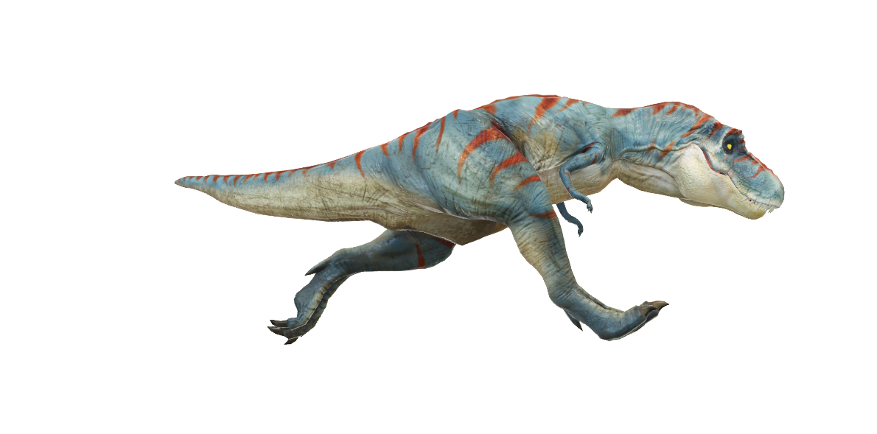
evolution

Slide 40
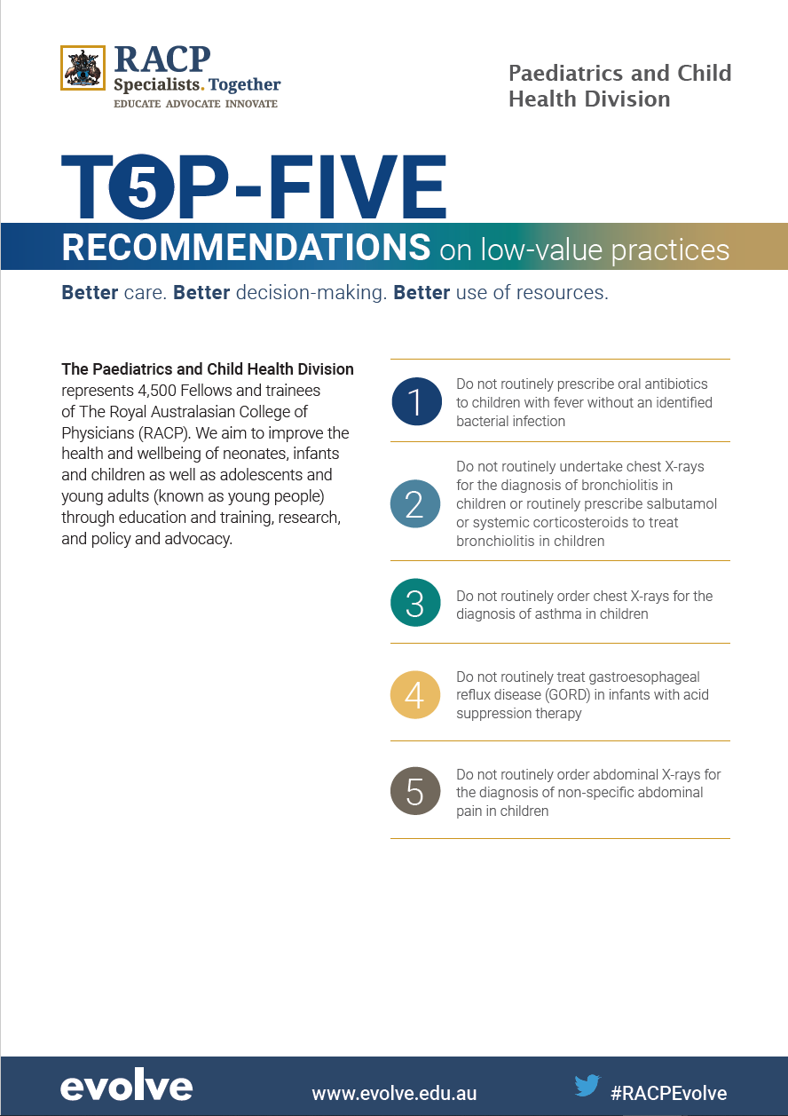
What is there for pediatricians?

Slide 41
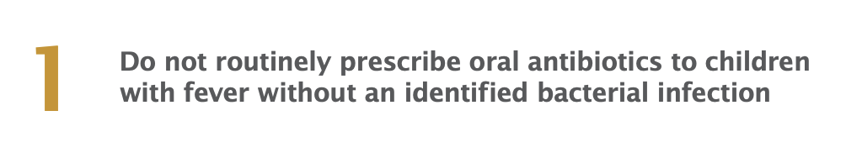
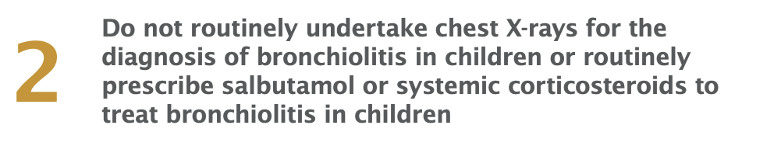
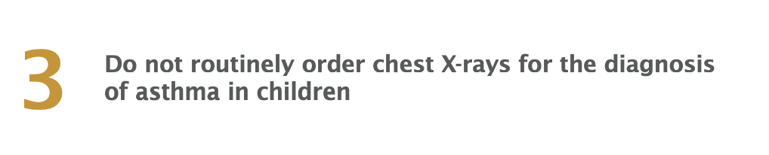
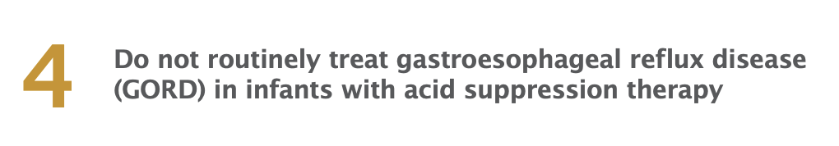
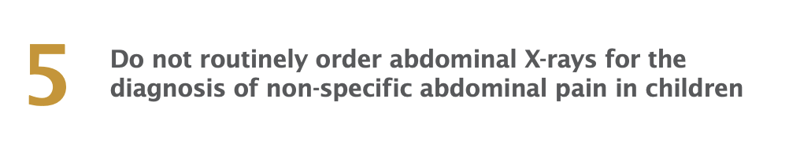

Slide 42
Rationale
The vast majority of children presenting with fever do not have a bacterial infection and therefore will not benefit from being prescribed oral antibiotics. For instance, one study of febrile infants found overall bacteraemia frequency of well below 1%. Sometimes, in exception to this, oral antibiotics are prescribed to treat an unapparent bacterial infection or prevent development of severe bacterial infection and appear to have beneficial effects, though even the significance of these effects is disputed. Given that inappropriate prescribing of antibiotics is a major cause of antibiotic resistance and antibiotics have adverse effects, it is not considered good clinical practice to prescribe antibiotics in children without a specific bacterial infection

Slide 43
Rationale
The vast majority of children presenting with fever do not have a bacterial infection and therefore will not benefit from being prescribed oral antibiotics. For instance, one study of febrile infants found overall bacteraemia frequency of well below 1%. Sometimes, in exception to this, oral antibiotics are prescribed to treat an unapparent bacterial infection or prevent development of severe bacterial infection and appear to have beneficial effects, though even the significance of these effects is disputed. Given that inappropriate prescribing of antibiotics is a major cause of antibiotic resistance and antibiotics have adverse effects, it is not considered good clinical practice to prescribe antibiotics in children without a specific bacterial infection

Slide 44
Rationale
The vast majority of children presenting with fever do not have a bacterial infection and therefore will not benefit from being prescribed oral antibiotics. For instance, one study of febrile infants found overall bacteraemia frequency of well below 1%. Sometimes, in exception to this, oral antibiotics are prescribed to treat an unapparent bacterial infection or prevent development of severe bacterial infection and appear to have beneficial effects, though even the significance of these effects is disputed. Given that inappropriate prescribing of antibiotics is a major cause of antibiotic resistance and antibiotics have adverse effects, it is not considered good clinical practice to prescribe antibiotics in children without a specific bacterial infection

Slide 45
Rationale
The vast majority of children presenting with fever do not have a bacterial infection and therefore will not benefit from being prescribed oral antibiotics. For instance, one study of febrile infants found overall bacteraemia frequency of well below 1%. Sometimes, in exception to this, oral antibiotics are prescribed to treat an unapparent bacterial infection or prevent development of severe bacterial infection and appear to have beneficial effects, though even the significance of these effects is disputed. Given that inappropriate prescribing of antibiotics is a major cause of antibiotic resistance and antibiotics have adverse effects, it is not considered good clinical practice to prescribe antibiotics in children without a specific bacterial infection

Slide 46
Rationale
The vast majority of children presenting with fever do not have a bacterial infection and therefore will not benefit from being prescribed oral antibiotics. For instance, one study of febrile infants found overall bacteraemia frequency of well below 1%. Sometimes, in exception to this, oral antibiotics are prescribed to treat an unapparent bacterial infection or prevent development of severe bacterial infection and appear to have beneficial effects, though even the significance of these effects is disputed. Given that inappropriate prescribing of antibiotics is a major cause of antibiotic resistance and antibiotics have adverse effects, it is not considered good clinical practice to prescribe antibiotics in children without a specific bacterial infection

Slide 47
Rationale
The vast majority of children presenting with fever do not have a bacterial infection and therefore will not benefit from being prescribed oral antibiotics. For instance, one study of febrile infants found overall bacteraemia frequency of well below 1%. Sometimes, in exception to this, oral antibiotics are prescribed to treat an unapparent bacterial infection or prevent development of severe bacterial infection and appear to have beneficial effects, though even the significance of these effects is disputed. Given that inappropriate prescribing of antibiotics is a major cause of antibiotic resistance and antibiotics have adverse effects, it is not considered good clinical practice to prescribe antibiotics in children without a specific bacterial infection

Slide 48
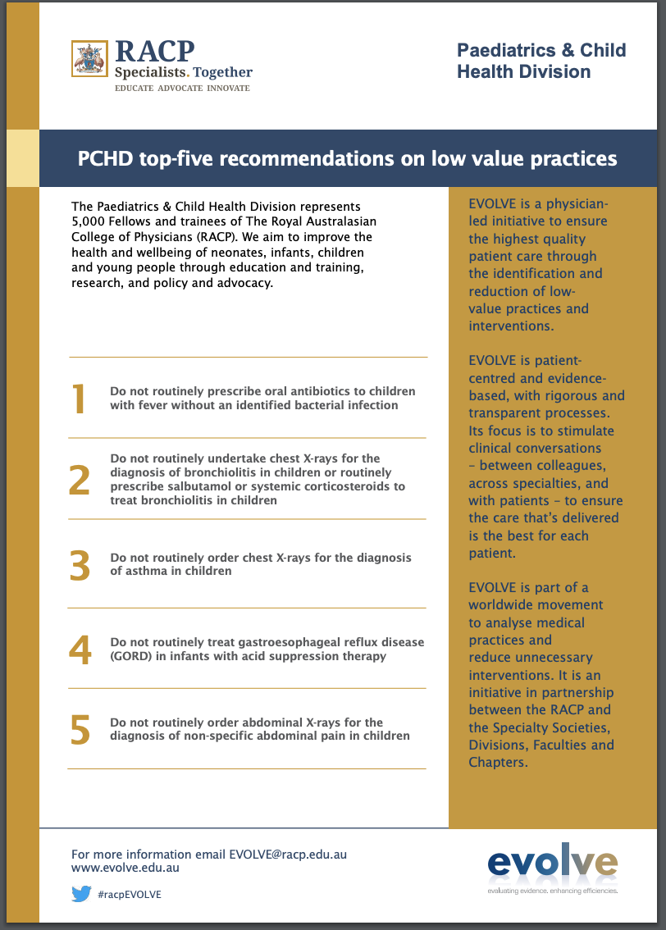

Rationale
The vast majority of children presenting with fever do not have a bacterial infection and therefore will not benefit from being prescribed oral antibiotics. For instance, one study of febrile infants found overall bacteraemia frequency of well below 1%. Sometimes, in exception to this, oral antibiotics are prescribed to treat an unapparent bacterial infection or prevent development of severe bacterial infection and appear to have beneficial effects, though even the significance of these effects is disputed. Given that inappropriate prescribing of antibiotics is a major cause of antibiotic resistance and antibiotics have adverse effects, it is not considered good clinical practice to prescribe antibiotics in children without a specific bacterial infection

Slide 49
Evidence
Australian Commission on Safety and Quality in Health Care (ACSQHC). AURA 2016: first Australian report on antimicrobial use and resistance in human health. Sydney: ACSQHC, 2016.
Hahné SJM, Charlett A, Purcell B, et al. Effectiveness of antibiotics given before admission in reducing mortality from meningococcal disease: systematic review. British Medical Journal. 2006; 332(7553):1299-1303.
Rothrock SG, Harper MB, Green SM, et al. Do oral antibiotics prevent meningitis and serious bacterial infections in children with Streptococcus pneumoniae occult bacteremia? A meta-analysis. Pediatrics. 1997;99(3):438.
Rudinsky SL, Carstairs KL, Reardon JM, et al. Serious bacterial infections in febrile infants in the post-pneumococcal conjugate vaccine era. Academic Emergency Medicine. 2009; 16(7):585-90..

Slide 51
Chest X-rays
Chest X-rays for patients with acute lower respiratory tract infections rarely affect clinical treatments and outcomes. Chest X-ray films do not discriminate well between bronchiolitis and other forms of lower respiratory tract infection and in mild cases do not offer information that is likely to affect treatment. It is estimated that 133 children with typical bronchiolitis would have to undergo radiography to identify 1 radiograph that is suggestive of an alternate diagnosis.

Slide 52
Chest X-rays
Chest X-rays for patients with acute lower respiratory tract infections rarely affect clinical treatments and outcomes. Chest X-ray films do not discriminate well between bronchiolitis and other forms of lower respiratory tract infection and in mild cases do not offer information that is likely to affect treatment. It is estimated that 133 children with typical bronchiolitis would have to undergo radiography to identify 1 radiograph that is suggestive of an alternate diagnosis.

Slide 53
Chest X-rays
Chest X-rays for patients with acute lower respiratory tract infections rarely affect clinical treatments and outcomes. Chest X-ray films do not discriminate well between bronchiolitis and other forms of lower respiratory tract infection and in mild cases do not offer information that is likely to affect treatment. It is estimated that 133 children with typical bronchiolitis would have to undergo radiography to identify 1 radiograph that is suggestive of an alternate diagnosis.

Slide 54
Chest X-rays
Chest X-rays for patients with acute lower respiratory tract infections rarely affect clinical treatments and outcomes. Chest X-ray films do not discriminate well between bronchiolitis and other forms of lower respiratory tract infection and in mild cases do not offer information that is likely to affect treatment. It is estimated that 133 children with typical bronchiolitis would have to undergo radiography to identify 1 radiograph that is suggestive of an alternate diagnosis.

Slide 55
Salbutamol
With the exception of improving clinical scores in infants treated as outpatients, the evidence overwhelmingly shows that bronchodilators, including salbutamol, do not improve oxygen saturation, reduce hospital admissions or shorten the duration of hospitalisation and time to resolution of illness in children with bronchiolitis. Compared with these minimal benefits, salbutamol is associated with adverse impacts such as tachycardia, oxygen desaturation and tremors. If a bronchodilator is required, epinephrine appears to be a superior alternative to salbutamol in reducing the severity of bronchiolitis.

Slide 56
Salbutamol
With the exception of improving clinical scores in infants treated as outpatients, the evidence overwhelmingly shows that bronchodilators, including salbutamol, do not improve oxygen saturation, reduce hospital admissions or shorten the duration of hospitalisation and time to resolution of illness in children with bronchiolitis. Compared with these minimal benefits, salbutamol is associated with adverse impacts such as tachycardia, oxygen desaturation and tremors. If a bronchodilator is required, epinephrine appears to be a superior alternative to salbutamol in reducing the severity of bronchiolitis.

Slide 57
Salbutamol
With the exception of improving clinical scores in infants treated as outpatients, the evidence overwhelmingly shows that bronchodilators, including salbutamol, do not improve oxygen saturation, reduce hospital admissions or shorten the duration of hospitalisation and time to resolution of illness in children with bronchiolitis. Compared with these minimal benefits, salbutamol is associated with adverse impacts such as tachycardia, oxygen desaturation and tremors. If a bronchodilator is required, epinephrine appears to be a superior alternative to salbutamol in reducing the severity of bronchiolitis.

Slide 58
Salbutamol
With the exception of improving clinical scores in infants treated as outpatients, the evidence overwhelmingly shows that bronchodilators, including salbutamol, do not improve oxygen saturation, reduce hospital admissions or shorten the duration of hospitalisation and time to resolution of illness in children with bronchiolitis. Compared with these minimal benefits, salbutamol is associated with adverse impacts such as tachycardia, oxygen desaturation and tremors. If a bronchodilator is required, epinephrine appears to be a superior alternative to salbutamol in reducing the severity of bronchiolitis.

Slide 59
Steroid
The majority of randomised controlled trials have not found a clinically relevant, sustained impact of systemic or inhaled glucocorticoids on admissions or length of hospitalisation in children with bronchiolitis or other forms of lower respiratory tract infection.

Slide 60
Steroid
The majority of randomised controlled trials have not found a clinically relevant, sustained impact of systemic or inhaled glucocorticoids on admissions or length of hospitalisation in children with bronchiolitis or other forms of lower respiratory tract infection.

Slide 61
Steroid
The majority of randomised controlled trials have not found a clinically relevant, sustained impact of systemic or inhaled glucocorticoids on admissions or length of hospitalisation in children with bronchiolitis or other forms of lower respiratory tract infection.

Slide 62
Steroid
The majority of randomised controlled trials have not found a clinically relevant, sustained impact of systemic or inhaled glucocorticoids on admissions or length of hospitalisation in children with bronchiolitis or other forms of lower respiratory tract infection.
Do not routinely undertake chest X-rays for the diagnosis of bronchiolitis in children or routinely prescribe salbutamol or systemic corticosteroids to treat bronchiolitis in children

Slide 63
evidence
Beigelman A, King TS, Mauger D, et al. Do oral corticosteroids reduce the severity of acute lower respiratory tract illnesses in preschool children with recurrent wheezing? Journal of Allergy and Clinical Immunology. 2013; 131(6):1518-25.
Bordley WC, Viswanathan M, King VJ, et al. Diagnosis and testing in bronchiolitis: a systematic review. Archives of Pediatric Adolescent Medicine. 2004; 158(2):119-26.
Cao AY, Choy JP, Mohanakrishnan L, Bain RF, van Driel M. Chest radiographs for acute lower respiratory tract infections. Cochrane Database of Systematic Reviews. 2013; 12: CD009119.
Fernandes RM, Bialy LM, Vandermeer B, et al. Glucocorticoids for acute viral bronchiolitis in infants and young children. Cochrane Database of Systematic Reviews. 2013; 6:CD004878.
Gadomski AM, Scribani MB. Bronchodilators for bronchiolitis. Cochrane Database of Systematic Reviews. 2014; 6:CD001266.
Hartling L, Fernandes RM, Bialy L, et al. Steroids and bronchodilators for acute bronchiolitis in the first two years of life: systematic review and meta-analysis. British Medical Journal. 2011; 342:d171.
Modaressi MR, Asadian A, Faghihinia J, et al. Comparison of epinephrine to salbutamol in acute bronchiolitis. Iranian Journal of Pediatrics. 2012; 22(2):241-4.
Schuh S, Lalani A, Allen U, et al. Evaluation of the utility of radiography in acute bronchiolitis. Journal of Pediatrics. 2007; 150(4):429-33.
Yong JH, Schuh S, Rashidi R et al. A cost effectiveness analysis of omitting radiography in diagnosis of acute bronchiolitis. Pediatric Pulmonology. 2009; 44(2):122-7.

Slide 65
There is extensive evidence that the majority of X-rays ordered for children admitted for asthma and wheezing disorders do not provide clinically relevant information and therefore do not contribute to their diagnosis and management.
Clear clinical criteria outlining the indications for X-rays in asthma should be defined to avoid unwarranted chest X-rays in children with acute wheeze.

Slide 66
There is extensive evidence that the majority of X-rays ordered for children admitted for asthma and wheezing disorders do not provide clinically relevant information and therefore do not contribute to their diagnosis and management.
Clear clinical criteria outlining the indications for X-rays in asthma should be defined to avoid unwarranted chest X-rays in children with acute wheeze.

Slide 67
There is extensive evidence that the majority of X-rays ordered for children admitted for asthma and wheezing disorders do not provide clinically relevant information and therefore do not contribute to their diagnosis and management.
Clear clinical criteria outlining the indications for X-rays in asthma should be defined to avoid unwarranted chest X-rays in children with acute wheeze.

Slide 69
Gastroesophageal reflux is common in preterm infants, infants and children and uncomplicated gastroesophageal reflux typically does not require medical therapy. However, gastroesophageal reflux may evolve into gastroesophageal reflux disease (GORD), a condition where the persistent leaking of stomach contents back into the oesophagus results in heartburn and other troublesome symptoms. Proton pump inhibitors (PPI) are sometimes prescribed in cases of GORD to achieve a pronounced and long-lasting reduction of gastric acid production.
However, numerous randomised controlled trials have concluded that PPIs are no more effective than placebo in treating GORD in infants, though there is some evidence (of moderate quality) of their effectiveness in treating GORD in older children. Moreover, there is still a paucity of trials confirming the long term safety of PPI use in children more generally while there is considerable evidence that PPIs have significant negative side effects such headache, diarrhoea, constipation, nausea, increased rates of infection and increased rates of food allergy.

Slide 70
Gastroesophageal reflux is common in preterm infants, infants and children and uncomplicated gastroesophageal reflux typically does not require medical therapy. However, gastroesophageal reflux may evolve into gastroesophageal reflux disease (GORD), a condition where the persistent leaking of stomach contents back into the oesophagus results in heartburn and other troublesome symptoms. Proton pump inhibitors (PPI) are sometimes prescribed in cases of GORD to achieve a pronounced and long-lasting reduction of gastric acid production.
However, numerous randomised controlled trials have concluded that PPIs are no more effective than placebo in treating GORD in infants, though there is some evidence (of moderate quality) of their effectiveness in treating GORD in older children. Moreover, there is still a paucity of trials confirming the long term safety of PPI use in children more generally while there is considerable evidence that PPIs have significant negative side effects such headache, diarrhoea, constipation, nausea, increased rates of infection and increased rates of food allergy.

Slide 71
Gastroesophageal reflux is common in preterm infants, infants and children and uncomplicated gastroesophageal reflux typically does not require medical therapy. However, gastroesophageal reflux may evolve into gastroesophageal reflux disease (GORD), a condition where the persistent leaking of stomach contents back into the oesophagus results in heartburn and other troublesome symptoms. Proton pump inhibitors (PPI) are sometimes prescribed in cases of GORD to achieve a pronounced and long-lasting reduction of gastric acid production.
However, numerous randomised controlled trials have concluded that PPIs are no more effective than placebo in treating GORD in infants, though there is some evidence (of moderate quality) of their effectiveness in treating GORD in older children. Moreover, there is still a paucity of trials confirming the long term safety of PPI use in children more generally while there is considerable evidence that PPIs have significant negative side effects such headache, diarrhoea, constipation, nausea, increased rates of infection and increased rates of food allergy.

Slide 72
Gastroesophageal reflux is common in preterm infants, infants and children and uncomplicated gastroesophageal reflux typically does not require medical therapy. However, gastroesophageal reflux may evolve into gastroesophageal reflux disease (GORD), a condition where the persistent leaking of stomach contents back into the oesophagus results in heartburn and other troublesome symptoms. Proton pump inhibitors (PPI) are sometimes prescribed in cases of GORD to achieve a pronounced and long-lasting reduction of gastric acid production.
However, numerous randomised controlled trials have concluded that PPIs are no more effective than placebo in treating GORD in infants, though there is some evidence (of moderate quality) of their effectiveness in treating GORD in older children. Moreover, there is still a paucity of trials confirming the long term safety of PPI use in children more generally while there is considerable evidence that PPIs have significant negative side effects such headache, diarrhoea, constipation, nausea, increased rates of infection and increased rates of food allergy.

Slide 73
Gastroesophageal reflux is common in preterm infants, infants and children and uncomplicated gastroesophageal reflux typically does not require medical therapy. However, gastroesophageal reflux may evolve into gastroesophageal reflux disease (GORD), a condition where the persistent leaking of stomach contents back into the oesophagus results in heartburn and other troublesome symptoms. Proton pump inhibitors (PPI) are sometimes prescribed in cases of GORD to achieve a pronounced and long-lasting reduction of gastric acid production.
However, numerous randomised controlled trials have concluded that PPIs are no more effective than placebo in treating GORD in infants, though there is some evidence (of moderate quality) of their effectiveness in treating GORD in older children. Moreover, there is still a paucity of trials confirming the long term safety of PPI use in children more generally while there is considerable evidence that PPIs have significant negative side effects such headache, diarrhoea, constipation, nausea, increased rates of infection and increased rates of food allergy.

Slide 74
Gastroesophageal reflux is common in preterm infants, infants and children and uncomplicated gastroesophageal reflux typically does not require medical therapy. However, gastroesophageal reflux may evolve into gastroesophageal reflux disease (GORD), a condition where the persistent leaking of stomach contents back into the oesophagus results in heartburn and other troublesome symptoms. Proton pump inhibitors (PPI) are sometimes prescribed in cases of GORD to achieve a pronounced and long-lasting reduction of gastric acid production.
However, numerous randomised controlled trials have concluded that PPIs are no more effective than placebo in treating GORD in infants, though there is some evidence (of moderate quality) of their effectiveness in treating GORD in older children. Moreover, there is still a paucity of trials confirming the long term safety of PPI use in children more generally while there is considerable evidence that PPIs have significant negative side effects such headache, diarrhoea, constipation, nausea, increased rates of infection and increased rates of food allergy.

Slide 75
Gastroesophageal reflux is common in preterm infants, infants and children and uncomplicated gastroesophageal reflux typically does not require medical therapy. However, gastroesophageal reflux may evolve into gastroesophageal reflux disease (GORD), a condition where the persistent leaking of stomach contents back into the oesophagus results in heartburn and other troublesome symptoms. Proton pump inhibitors (PPI) are sometimes prescribed in cases of GORD to achieve a pronounced and long-lasting reduction of gastric acid production.
However, numerous randomised controlled trials have concluded that PPIs are no more effective than placebo in treating GORD in infants, though there is some evidence (of moderate quality) of their effectiveness in treating GORD in older children. Moreover, there is still a paucity of trials confirming the long term safety of PPI use in children more generally while there is considerable evidence that PPIs have significant negative side effects such headache, diarrhoea, constipation, nausea, increased rates of infection and increased rates of food allergy.

Slide 76
Gastroesophageal reflux is common in preterm infants, infants and children and uncomplicated gastroesophageal reflux typically does not require medical therapy. However, gastroesophageal reflux may evolve into gastroesophageal reflux disease (GORD), a condition where the persistent leaking of stomach contents back into the oesophagus results in heartburn and other troublesome symptoms. Proton pump inhibitors (PPI) are sometimes prescribed in cases of GORD to achieve a pronounced and long-lasting reduction of gastric acid production.
However, numerous randomised controlled trials have concluded that PPIs are no more effective than placebo in treating GORD in infants, though there is some evidence (of moderate quality) of their effectiveness in treating GORD in older children. Moreover, there is still a paucity of trials confirming the long term safety of PPI use in children more generally while there is considerable evidence that PPIs have significant negative side effects such headache, diarrhoea, constipation, nausea, increased rates of infection and increased rates of food allergy.
Do not routinely treat gastroesophageal reflux disease (GORD) in infants with acid suppression therapy

Slide 77
evidence
Davidson G, Wenzl TG, Thomson M, et al. Efficacy and Safety of Once-Daily Esomeprazole for the Treatment of Gastroesophageal Reflux Disease in Neonatal Patients. Journal of Pediatrics. 2013; 163(3):692-8.
Tighe M, Afzal NA, Bevan A, et al. Pharmacological treatment of children with gastro-oesophageal reflux. Cochrane Database of Systematic Reviews. 2014; 11:CD008550.
van der Pol RJ, Smits MJ, van Wijk MP, et al. Efficacy of proton-pump inhibitors in children with gastroesophageal reflux disease: a systematic review. Pediatrics 2011; 127(5):925-35.

Slide 79
Retrospective studies of medical records of children and adults admitted for constipation and other forms of non-specific abdominal pain conclude that in only a very small minority (under 5%) of cases do abdominal X-rays make a difference in patient treatment. A recent study also showed that abdominal X-rays were performed more frequently in misdiagnosed children. Numerous studies yield significantly varying estimates of the sensitivity and specificity of abdominal x-rays and insufficient evidence of a diagnostic association between symptoms of constipation and faecal loading seen on abdominal radiographs. There is significant scope for reducing the number of abdominal X-rays performed without sacrificing diagnostic accuracy for children with abdominal pain.

Slide 80
Retrospective studies of medical records of children and adults admitted for constipation and other forms of non-specific abdominal pain conclude that in only a very small minority (under 5%) of cases do abdominal X-rays make a difference in patient treatment. A recent study also showed that abdominal X-rays were performed more frequently in misdiagnosed children. Numerous studies yield significantly varying estimates of the sensitivity and specificity of abdominal x-rays and insufficient evidence of a diagnostic association between symptoms of constipation and faecal loading seen on abdominal radiographs. There is significant scope for reducing the number of abdominal X-rays performed without sacrificing diagnostic accuracy for children with abdominal pain.

Slide 81
Retrospective studies of medical records of children and adults admitted for constipation and other forms of non-specific abdominal pain conclude that in only a very small minority (under 5%) of cases do abdominal X-rays make a difference in patient treatment. A recent study also showed that abdominal X-rays were performed more frequently in misdiagnosed children. Numerous studies yield significantly varying estimates of the sensitivity and specificity of abdominal x-rays and insufficient evidence of a diagnostic association between symptoms of constipation and faecal loading seen on abdominal radiographs. There is significant scope for reducing the number of abdominal X-rays performed without sacrificing diagnostic accuracy for children with abdominal pain.

Slide 82
Retrospective studies of medical records of children and adults admitted for constipation and other forms of non-specific abdominal pain conclude that in only a very small minority (under 5%) of cases do abdominal X-rays make a difference in patient treatment. A recent study also showed that abdominal X-rays were performed more frequently in misdiagnosed children. Numerous studies yield significantly varying estimates of the sensitivity and specificity of abdominal x-rays and insufficient evidence of a diagnostic association between symptoms of constipation and faecal loading seen on abdominal radiographs. There is significant scope for reducing the number of abdominal X-rays performed without sacrificing diagnostic accuracy for children with abdominal pain.

Slide 83
evidence
Berger MY, Tabbers MM, Kurver MJ, et al. Value of abdominal radiography, colonic transit time, and rectal ultrasound scanning in the diagnosis of idiopathic constipation in children: a systematic review. Journal of Pediatrics. 2012; 161(1):44-50.
Freedman SB, Thull-Freedman J, Manson D, et al. Pediatric abdominal radiograph use, constipation, and significant misdiagnoses. Journal of Pediatrics. 2014; 164(1):83-88.
Kellow Z, MacInnes M, Kurzencwyg D, et al. The Role of Abdominal Radiography in the Evaluation of the Nontrauma Emergency Patient. Radiology. 2008; 248(3):887-93.

Slide 85
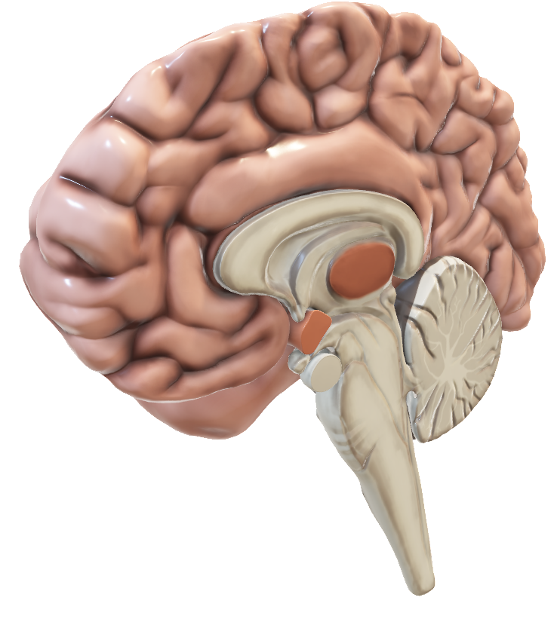
What is there for pediatricians?

Slide 86
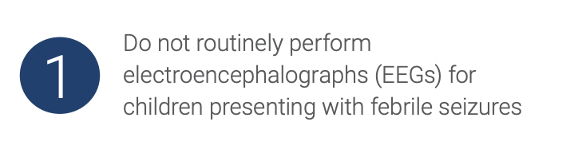
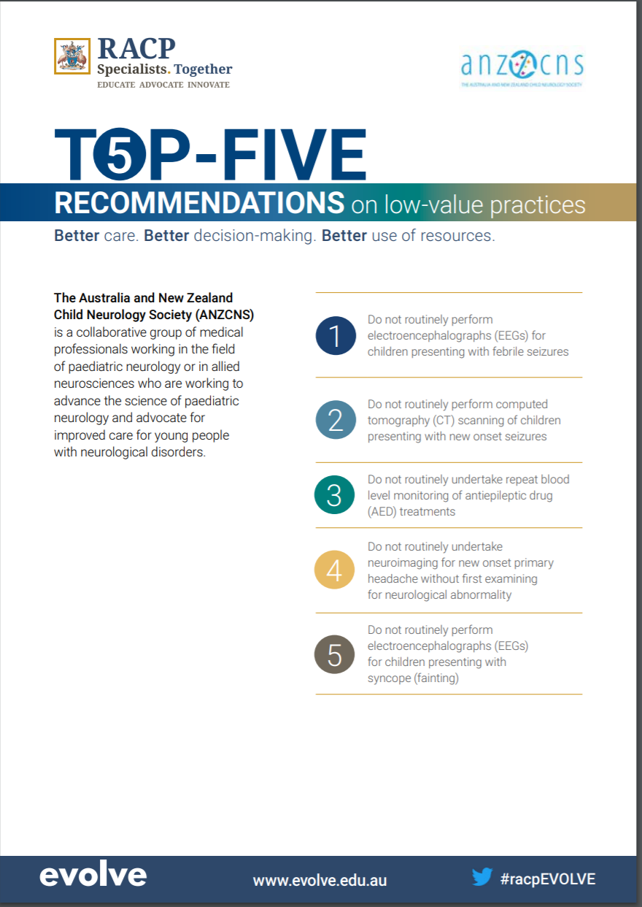
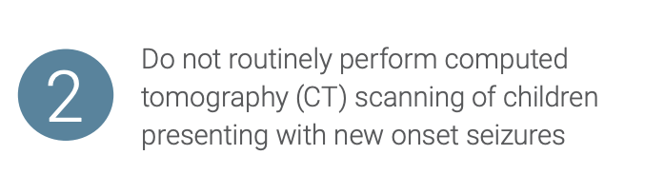
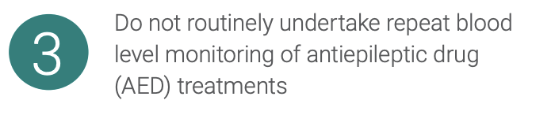
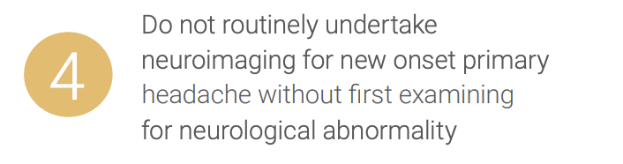
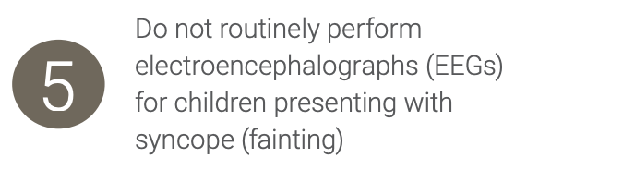

Slide 87
rationale
Do not routinely perform electroencephalographs (EEGs) for children presenting with febrile seizures. Febrile seizures are seizures associated with fever, but without evidence of central nervous system infection. There is no evidence that epileptiform discharges (i.e. distinctive electroencephalograph patterns associated with epileptic disorders) in children with febrile seizures have any diagnostic or prognostic implications. For instance, even among otherwise neurodevelopmentally normal children with a first complex febrile seizure (febrile seizures which are prolonged or occur multiple times within 24 hours or are confined to one side of the body) these EEG patterns are a poor predictor for epilepsy. Therefore, an EEG test should not be a routine investigation for these and other patients presenting with febrile seizures

Slide 88
rationale
Do not routinely perform electroencephalographs (EEGs) for children presenting with febrile seizures. Febrile seizures are seizures associated with fever, but without evidence of central nervous system infection. There is no evidence that epileptiform discharges (i.e. distinctive electroencephalograph patterns associated with epileptic disorders) in children with febrile seizures have any diagnostic or prognostic implications. For instance, even among otherwise neurodevelopmentally normal children with a first complex febrile seizure (febrile seizures which are prolonged or occur multiple times within 24 hours or are confined to one side of the body) these EEG patterns are a poor predictor for epilepsy. Therefore, an EEG test should not be a routine investigation for these and other patients presenting with febrile seizures

Slide 90
evidence
Harini C, Nagarajan E, Kimia AA, et al. Utility of initial EEG in first complex febrile seizure. Epilepsy Behav. 2015;52(Pt A):200-4.
Kuturec M, Emoto SE, Sofijanov N, et al. Febrile seizures: is the EEG a useful predictor of recurrences? Clin Pediatr (Phila). 1997;36(1):31-6.
Sadleir LG, Scheffer IE. Febrile seizures. BMJ. 2007 10;334(7588):307-11.
Shah PB, James S, Elayaraja S. EEG for children with complex febrile seizures. Cochrane Database Syst Rev. 2015 8;(12):CD009196.

Slide 92
rationale
The yield from neuroimaging of children presenting with new onset afebrile seizures is typically low, with one study finding that it led to a change in clinical management for only four percent of patients. As there are already a well-tested set of indicators for determining the likelihood of intracranial abnormalities in children with new onset unprovoked seizures, a combination of clinical history, examination, and electroencephalograph (where relevant) should first be used to determine whether the condition warrants neuroimaging. Clinical indicators for intracranial abnormalities, which are likely to change initial patient management, include (i) a focal seizure in children aged less than three years, (ii) abnormal neurological examination, (iii) Todd’s post-ictal paresis, or (iv) presence of a condition predisposing to seizures. In children where an intracranial abnormality is considered likely, and neuroimaging is indicated, magnetic resonance imaging (MRI) is recommended over computed tomography (CT) because (i) there is superior anatomic resolution and characterisation of pathologic processes from using MRI, and (ii) there is radiation exposure and escalated future cancer risk associated with CT.

Slide 93
rationale
The yield from neuroimaging of children presenting with new onset afebrile seizures is typically low, with one study finding that it led to a change in clinical management for only four percent of patients. As there are already a well-tested set of indicators for determining the likelihood of intracranial abnormalities in children with new onset unprovoked seizures, a combination of clinical history, examination, and electroencephalograph (where relevant) should first be used to determine whether the condition warrants neuroimaging. Clinical indicators for intracranial abnormalities, which are likely to change initial patient management, include (i) a focal seizure in children aged less than three years, (ii) abnormal neurological examination, (iii) Todd’s post-ictal paresis, or (iv) presence of a condition predisposing to seizures. In children where an intracranial abnormality is considered likely, and neuroimaging is indicated, magnetic resonance imaging (MRI) is recommended over computed tomography (CT) because (i) there is superior anatomic resolution and characterisation of pathologic processes from using MRI, and (ii) there is radiation exposure and escalated future cancer risk associated with CT.

Slide 94
rationale
The yield from neuroimaging of children presenting with new onset afebrile seizures is typically low, with one study finding that it led to a change in clinical management for only four percent of patients. As there are already a well-tested set of indicators for determining the likelihood of intracranial abnormalities in children with new onset unprovoked seizures, a combination of clinical history, examination, and electroencephalograph (where relevant) should first be used to determine whether the condition warrants neuroimaging. Clinical indicators for intracranial abnormalities, which are likely to change initial patient management, include (i) a focal seizure in children aged less than three years, (ii) abnormal neurological examination, (iii) Todd’s post-ictal paresis, or (iv) presence of a condition predisposing to seizures. In children where an intracranial abnormality is considered likely, and neuroimaging is indicated, magnetic resonance imaging (MRI) is recommended over computed tomography (CT) because (i) there is superior anatomic resolution and characterisation of pathologic processes from using MRI, and (ii) there is radiation exposure and escalated future cancer risk associated with CT.

Slide 95
rationale
The yield from neuroimaging of children presenting with new onset afebrile seizures is typically low, with one study finding that it led to a change in clinical management for only four percent of patients. As there are already a well-tested set of indicators for determining the likelihood of intracranial abnormalities in children with new onset unprovoked seizures, a combination of clinical history, examination, and electroencephalograph (where relevant) should first be used to determine whether the condition warrants neuroimaging. Clinical indicators for intracranial abnormalities, which are likely to change initial patient management, include (i) a focal seizure in children aged less than three years, (ii) abnormal neurological examination, (iii) Todd’s post-ictal paresis, or (iv) presence of a condition predisposing to seizures. In children where an intracranial abnormality is considered likely, and neuroimaging is indicated, magnetic resonance imaging (MRI) is recommended over computed tomography (CT) because (i) there is superior anatomic resolution and characterisation of pathologic processes from using MRI, and (ii) there is radiation exposure and escalated future cancer risk associated with CT.

Slide 96
rationale
The yield from neuroimaging of children presenting with new onset afebrile seizures is typically low, with one study finding that it led to a change in clinical management for only four percent of patients. As there are already a well-tested set of indicators for determining the likelihood of intracranial abnormalities in children with new onset unprovoked seizures, a combination of clinical history, examination, and electroencephalograph (where relevant) should first be used to determine whether the condition warrants neuroimaging. Clinical indicators for intracranial abnormalities, which are likely to change initial patient management, include (i) a focal seizure in children aged less than three years, (ii) abnormal neurological examination, (iii) Todd’s post-ictal paresis, or (iv) presence of a condition predisposing to seizures. In children where an intracranial abnormality is considered likely, and neuroimaging is indicated, magnetic resonance imaging (MRI) is recommended over computed tomography (CT) because (i) there is superior anatomic resolution and characterisation of pathologic processes from using MRI, and (ii) there is radiation exposure and escalated future cancer risk associated with CT.

Slide 98
evidence
Aprahamian N, Harper MB, Prabhu SP, Monuteaux MC, Sadiq Z, Torres A, Kimia AA. Pediatric first time non-febrile seizure with focal manifestations: is emergent imaging indicated?. Seizure. 2014;23(9):740-5 .
Dayan PS, Lillis K, Bennett J, et al. Interobserver Agreement in the Assessment of Clinical Findings in Children With First Unprovoked Seizures. Pediatrics 2011, 127(5).
Gaillard WD, Chiron C, Cross JH, Harvey AS, Kuzniecky R, Hertz-Pannier L, Vezina LG, ILAE, Committee for Neuroimaging, Subcommittee for Pediatric. Guidelines for imaging infants and children with recent-onset epilepsy. Epilepsia. 2009;50(9):2147-53
Kuzniecky RI. Neuroimaging of Epilepsy: Therapeutic Implications. NeuroRx. 2005;2(2):384-393.
Malviya S, Voepel-Lewis T, Eldevik OP, Rockwell DT, Wong JH, Tait AR. Sedation and general anaesthesia in children undergoing MRI and CT: adverse events and outcomes. Br J Anaesth. 2000 Jun;84(6):743-8
Matthews JD, Forsythe AV, Brady Z. et al. Cancer risk in 680 000 people exposed to computed tomography scans in childhood or adolescence: data linkage study of 11 million Australians. BMJ 2013;346:f2360.
Pearce MS, Salotti JA, Little MP, et al. Radiation exposure from CT scans in childhood and subsequent risk of leukaemia and brain tumours: a retrospective cohort study. Lancet 2012; 380: 499–505.
Sharma S, Riviello JJ, Harper MB, Baskin MN. The role of emergent neuroimaging in children with new-onset afebrile seizures. Pediatrics. 2003;111(1):1-5.

Slide 100
rationale
The serum concentration of an antiepileptic drug (AED) varies markedly between patients taking the same dosage because of differences in people’s ability to absorb, distribute, metabolise and excrete drugs. The utility of drug blood level monitoring assumes that plasma drug level correlates better with clinical response or side effects than with dosage, or provides better information than clinical review of the patient. However, evidence from a major randomised controlled trial suggests that repeat blood level monitoring of AED treatments has no discernible impact on patient outcomes in terms of remissions from seizures or incidence of adverse effects. Other studies have also shown that there is no definitive correlation between a patient’s AED blood level and clinical efficacy. Specific exceptions where targeted AED blood level assessment can be useful include their use in assessing compliance, titrating AEDs in complex polypharmacy regimens, or adjusting for altered AED metabolism in disease states, puberty, or pregnancy.

Slide 101
rationale
The serum concentration of an antiepileptic drug (AED) varies markedly between patients taking the same dosage because of differences in people’s ability to absorb, distribute, metabolise and excrete drugs. The utility of drug blood level monitoring assumes that plasma drug level correlates better with clinical response or side effects than with dosage, or provides better information than clinical review of the patient. However, evidence from a major randomised controlled trial suggests that repeat blood level monitoring of AED treatments has no discernible impact on patient outcomes in terms of remissions from seizures or incidence of adverse effects. Other studies have also shown that there is no definitive correlation between a patient’s AED blood level and clinical efficacy. Specific exceptions where targeted AED blood level assessment can be useful include their use in assessing compliance, titrating AEDs in complex polypharmacy regimens, or adjusting for altered AED metabolism in disease states, puberty, or pregnancy.

Slide 102
rationale
The serum concentration of an antiepileptic drug (AED) varies markedly between patients taking the same dosage because of differences in people’s ability to absorb, distribute, metabolise and excrete drugs. The utility of drug blood level monitoring assumes that plasma drug level correlates better with clinical response or side effects than with dosage, or provides better information than clinical review of the patient. However, evidence from a major randomised controlled trial suggests that repeat blood level monitoring of AED treatments has no discernible impact on patient outcomes in terms of remissions from seizures or incidence of adverse effects. Other studies have also shown that there is no definitive correlation between a patient’s AED blood level and clinical efficacy. Specific exceptions where targeted AED blood level assessment can be useful include their use in assessing compliance, titrating AEDs in complex polypharmacy regimens, or adjusting for altered AED metabolism in disease states, puberty, or pregnancy.

Slide 103
rationale
The serum concentration of an antiepileptic drug (AED) varies markedly between patients taking the same dosage because of differences in people’s ability to absorb, distribute, metabolise and excrete drugs. The utility of drug blood level monitoring assumes that plasma drug level correlates better with clinical response or side effects than with dosage, or provides better information than clinical review of the patient. However, evidence from a major randomised controlled trial suggests that repeat blood level monitoring of AED treatments has no discernible impact on patient outcomes in terms of remissions from seizures or incidence of adverse effects. Other studies have also shown that there is no definitive correlation between a patient’s AED blood level and clinical efficacy. Specific exceptions where targeted AED blood level assessment can be useful include their use in assessing compliance, titrating AEDs in complex polypharmacy regimens, or adjusting for altered AED metabolism in disease states, puberty, or pregnancy.

Slide 104
rationale
The serum concentration of an antiepileptic drug (AED) varies markedly between patients taking the same dosage because of differences in people’s ability to absorb, distribute, metabolise and excrete drugs. The utility of drug blood level monitoring assumes that plasma drug level correlates better with clinical response or side effects than with dosage, or provides better information than clinical review of the patient. However, evidence from a major randomised controlled trial suggests that repeat blood level monitoring of AED treatments has no discernible impact on patient outcomes in terms of remissions from seizures or incidence of adverse effects. Other studies have also shown that there is no definitive correlation between a patient’s AED blood level and clinical efficacy. Specific exceptions where targeted AED blood level assessment can be useful include their use in assessing compliance, titrating AEDs in complex polypharmacy regimens, or adjusting for altered AED metabolism in disease states, puberty, or pregnancy.

Slide 107
rationale
Most headaches are attributable to benign conditions. Studies suggest that the yield of neuroimaging findings in children with headache that actually change patient management is no higher than 2.5 per cent. This supports the practice of selective imaging of paediatric headache patients with clinical presentation suspicious for intracranial abnormality. Moreover, the routine use of neuroimaging may lead to the discovery of incidental benign abnormalities, which may cause undue alarm, and headaches may be wrongfully attributed to these incidental findings. For instance, a retrospective study revealed benign neuroimaging abnormalities in approximately 20 per cent of paediatric headache patients who underwent neuroimaging. Neuroimaging on a routine basis is therefore not indicated in children with new onset primary headaches and a normal neurological examination. It should be reserved for a selected group of children whose history and/or physical examination suggest serious intracranial pathologies.

Slide 108
rationale
Most headaches are attributable to benign conditions. Studies suggest that the yield of neuroimaging findings in children with headache that actually change patient management is no higher than 2.5 per cent. This supports the practice of selective imaging of paediatric headache patients with clinical presentation suspicious for intracranial abnormality. Moreover, the routine use of neuroimaging may lead to the discovery of incidental benign abnormalities, which may cause undue alarm, and headaches may be wrongfully attributed to these incidental findings. For instance, a retrospective study revealed benign neuroimaging abnormalities in approximately 20 per cent of paediatric headache patients who underwent neuroimaging. Neuroimaging on a routine basis is therefore not indicated in children with new onset primary headaches and a normal neurological examination. It should be reserved for a selected group of children whose history and/or physical examination suggest serious intracranial pathologies.

Slide 109
rationale
Most headaches are attributable to benign conditions. Studies suggest that the yield of neuroimaging findings in children with headache that actually change patient management is no higher than 2.5 per cent. This supports the practice of selective imaging of paediatric headache patients with clinical presentation suspicious for intracranial abnormality. Moreover, the routine use of neuroimaging may lead to the discovery of incidental benign abnormalities, which may cause undue alarm, and headaches may be wrongfully attributed to these incidental findings. For instance, a retrospective study revealed benign neuroimaging abnormalities in approximately 20 per cent of paediatric headache patients who underwent neuroimaging. Neuroimaging on a routine basis is therefore not indicated in children with new onset primary headaches and a normal neurological examination. It should be reserved for a selected group of children whose history and/or physical examination suggest serious intracranial pathologies.

Slide 110
rationale
Most headaches are attributable to benign conditions. Studies suggest that the yield of neuroimaging findings in children with headache that actually change patient management is no higher than 2.5 per cent. This supports the practice of selective imaging of paediatric headache patients with clinical presentation suspicious for intracranial abnormality. Moreover, the routine use of neuroimaging may lead to the discovery of incidental benign abnormalities, which may cause undue alarm, and headaches may be wrongfully attributed to these incidental findings. For instance, a retrospective study revealed benign neuroimaging abnormalities in approximately 20 per cent of paediatric headache patients who underwent neuroimaging. Neuroimaging on a routine basis is therefore not indicated in children with new onset primary headaches and a normal neurological examination. It should be reserved for a selected group of children whose history and/or physical examination suggest serious intracranial pathologies.

Slide 111
rationale
Most headaches are attributable to benign conditions. Studies suggest that the yield of neuroimaging findings in children with headache that actually change patient management is no higher than 2.5 per cent. This supports the practice of selective imaging of paediatric headache patients with clinical presentation suspicious for intracranial abnormality. Moreover, the routine use of neuroimaging may lead to the discovery of incidental benign abnormalities, which may cause undue alarm, and headaches may be wrongfully attributed to these incidental findings. For instance, a retrospective study revealed benign neuroimaging abnormalities in approximately 20 per cent of paediatric headache patients who underwent neuroimaging. Neuroimaging on a routine basis is therefore not indicated in children with new onset primary headaches and a normal neurological examination. It should be reserved for a selected group of children whose history and/or physical examination suggest serious intracranial pathologies.

Slide 112
rationale
Most headaches are attributable to benign conditions. Studies suggest that the yield of neuroimaging findings in children with headache that actually change patient management is no higher than 2.5 per cent. This supports the practice of selective imaging of paediatric headache patients with clinical presentation suspicious for intracranial abnormality. Moreover, the routine use of neuroimaging may lead to the discovery of incidental benign abnormalities, which may cause undue alarm, and headaches may be wrongfully attributed to these incidental findings. For instance, a retrospective study revealed benign neuroimaging abnormalities in approximately 20 per cent of paediatric headache patients who underwent neuroimaging. Neuroimaging on a routine basis is therefore not indicated in children with new onset primary headaches and a normal neurological examination. It should be reserved for a selected group of children whose history and/or physical examination suggest serious intracranial pathologies.

Slide 114
evidence
Alexiou GA, Argyropoulou MI. Neuroimaging in childhood headache: a systematic review. Pediatr Radiol (2013) 43:777–784.
Clarke CE, Edwards J, Nicholl DJ, Sivaguru A. Imaging results in a consecutive series of 530 new patients in the Birmingham Headache Service. J Neurol. 2010 Aug;257(8):1274-8. doi: 10.1007/s00415-010-5506-7. Epub 2010 Mar 3.
Schwedt et al, "Benign" imaging abnormalities in children and adolescents with headache. Headache. 2006; 46(3):387-98

Slide 116
rationale
Studies have found that the incidence of epileptiform discharges (i.e. distinctive EEG patterns associated with epileptic disorders) in patients with syncope is roughly similar to its incidence among healthy subjects, and that therefore EEG has very low diagnostic yield among these patients. Moreover, clinical criteria have been formulated that can differentiate syncope from seizures with very high sensitivity and specificity. Thus, guidelines recommend that an EEG should not be performed if syncope is the most likely cause of the transient loss of consciousness. Moreover, clinical criteria have been formulated, which can differentiate syncope from seizures with very high sensitivity and specificity

Slide 117
rationale
Studies have found that the incidence of epileptiform discharges (i.e. distinctive EEG patterns associated with epileptic disorders) in patients with syncope is roughly similar to its incidence among healthy subjects, and that therefore EEG has very low diagnostic yield among these patients. Moreover, clinical criteria have been formulated that can differentiate syncope from seizures with very high sensitivity and specificity. Thus, guidelines recommend that an EEG should not be performed if syncope is the most likely cause of the transient loss of consciousness. Moreover, clinical criteria have been formulated, which can differentiate syncope from seizures with very high sensitivity and specificity

Slide 118
rationale
Studies have found that the incidence of epileptiform discharges (i.e. distinctive EEG patterns associated with epileptic disorders) in patients with syncope is roughly similar to its incidence among healthy subjects, and that therefore EEG has very low diagnostic yield among these patients. Moreover, clinical criteria have been formulated that can differentiate syncope from seizures with very high sensitivity and specificity. Thus, guidelines recommend that an EEG should not be performed if syncope is the most likely cause of the transient loss of consciousness. Moreover, clinical criteria have been formulated, which can differentiate syncope from seizures with very high sensitivity and specificity

Slide 120
Evidence
Abubakr A, Wambacq I. The diagnostic value of EEGs in patients with syncope. Epilepsy & Behavior. 6(3):433-4, 2005.
Dantas FG, Cavalcanti AP, Rodrigues Maciel BD, et al. The role of EEG in patients with syncope. Journal of Clinical Neurophysiology. 29(1):55-7, 2012.
Linzer M, Yang EH, Estes NA, III et al. Diagnosing syncope. Part 1: Value of history, physical examination, and electrocardiography. Clinical Efficacy Assessment Project of the American College of Physicians. Ann Intern Med. 1997; 126(12):989‐996.
Poliquin-Lasnier L, Moore FG. EEG in suspected syncope: do EEGs ordered by neurologists give a higher yield? Can J Neurol Sci. 2009 ;36(6):769-73.
Sheldon et al, Historical criteria that distinguish syncope from seizures. J Am Coll Cardiol. 2002; 40(1):142‐148.
Moya, Angel et al. 2009. “Guidelines for the Diagnosis and Management of Syncope (Version 2009).” European Heart Journal 30(21):2631–71.

Slide 122
Evolve Research
  RACP encourages its Advanced Trainees and Fellows to develop and conduct research projects on specific Evolve recommendations as part of specialty training.
  Outcomes from these projects can be:
    Presented at conferences or published in journals
    Adapted across health services and specialties
    Used as ongoing references or resources
    A career development opportunity
    RACP has included Evolve implementation activities, including research, in:
      CPD Quality & Safety Training Modules
      Supervisor Training – held at Annual Specialty Society Meetings

Slide 123
References
https://evolve.edu.au/recommendations/pchd
https://evolve.edu.au/recommendations/anzcns

Slide 124
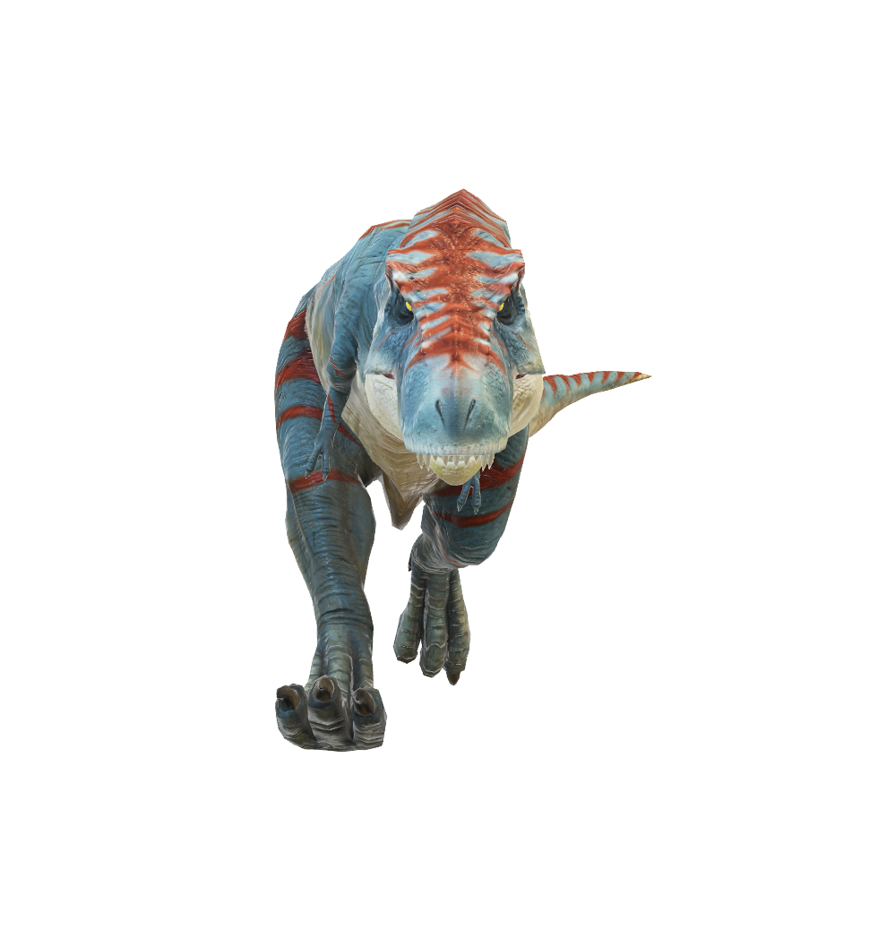
Thank you!

