Slide 1






Evolve Congress Session: Shared Decision Making
Professor Donald Campbell, Dr Cilla Haywood and Mrs Debra Letica

Slide 2
What is Evolve?
Evolve works with specialties to identify their ‘Top-Five’ low-value clinical care. Low-value care is tests, procedures and practices that, in particular circumstances, may:
  be overused,
  provide little or no benefit, or
  cause unnecessary harm.
This is important because:
In Australia 60% of care on average is in line with evidence- or consensus-based guidelines, 30% is some form of waste or of low value, and 10% is harm.
Braithwaite J, Glasziou P, Westbrook JI. (2020) The three numbers you need to know about healthcare: the 60-30-10 Challenge. BMC Medicine.
Notes:
As part of a global movement, Evolve is a flagship initiative led by physicians and the Royal Australasian College of Physicians (RACP) to drive high-value, high-quality care in Australia and Aotearoa New Zealand.
The RACP, through Evolve, is a founding member of Choosing Wisely in Australia and New Zealand, with all Evolve ‘Top-Five’ recommendations part of the Choosing Wisely campaign in Australia and Aotearoa New Zealand.
Evolve works with specialties to identify their ‘Top-Five’ low-value clinical care. Low-value care is tests, procedures and practices that, in particular circumstances, may:
be overused,
provide little or no benefit, or
cause unnecessary harm.
In Australia 60% of care on average is in line with evidence- or consensus-based guidelines, 30% is some form of waste or of low value, and 10% is harm. This is an average across specialties, with some specialties delivering more low value practices than others, but these numbers demonstrate that we can do better.

Slide 3

Shared-decision making in reducing LVC
There is evidence from systematic review that BOTH clinicians and patients tend to overestimate the benefits and underestimate the harms of clinical interventions.
SDM can enhance efforts to reduce LVC by:
  Fostering shared acceptance of uncertainty
  Closing the knowledge gap between patient and physician
  Promoting patient empowerment
  Enhancing trust through transparent communication
Notes:
Hoffmann TC, Del Mar C. Patients' expectations of the benefits and harms of treatments, screening, and tests: a systematic review. JAMA Intern Med. 2015;175(2):274-286; Hoffmann TC, Del Mar C. Clinicians' expectations of the benefits and harms of treatments, screening, and tests: a systematic review. JAMA
Braddock CH 3rd. Supporting shared decision making when clinical evidence is low. Med Care Res Rev. 2013;70(1 Suppl):129S–140S. doi:10.1177/1077558712460280

Slide 4
Shared Decision Making in Older Adults -
The Preop Geriatric Clinic
Dr Cilla Haywood MBBS (Hons) FRACP PhD
Physician – Austin Health/Northern Health
Honorary Clinical Senior Fellow – The University of Melbourne

Slide 5
The clinic – why, what, how

Slide 6
Why?
Increasing number of complex, frail, multimorbid older patients being considered for surgery
Evidence and local experience - improved operative and perioperative care but prolonged length of stay, poor functional outcomes noted.
    Not detected by usual anaesthetic assessment
Attributable to undiagnosed frailty and cognitive impairment
Anaesthetists / Manager of Surgical department very keen
Starting to get buy-in from surgical teams.
Good experience of POPS clinic – Dr Jugdeep Dhesi, Guy’s and St Thomas’ Hospitals, London.

Slide 7
What it is
0.1 FTE Geriatrician (soon extra 0.1 consultant and registrar)
Referral Criteria are age >= 75 with one or more of frailty, multimorbidity, functional decline or cognitive decline
90 minute assessment for new patient (see next)
Comprehensive geriatric assessment
Shared decision making
Liaison with other teams (surgeons, other specialties)

Slide 8
How - Comprehensive Geriatric assessment
Past history
History of the condition necessitating surgery including past treatments tried
Medications – who administers, how, adherence, intolerances/allergies
Smoking/alcohol/drugs
Mobility – including what exactly limits mobility
Driving, House environment
Function – PADLs, DADLs, IADLs, CADLs – including who does what and why
Finances
Cognition – subjective, objective, functional
Frailty markers – CFS, Edmonton
Social supports – 2nd and 3rd lines of help
I try to get an idea of functional trajectory – see slide later
Examination
NO particular anaesthetic assessment – that is job of anaesthetist.

Slide 9
How – the “money” questions
“what are you hoping you will get out of the surgery?”
“what do you want to do after the surgery that you can’t do now?”
What do family members or carers want/expect
Are the goals realistic or even relevant to the proposed surgery?
i.e. – wanting to walk from hip replacement if all 3 other limbs are poorly functioning
What risks have been discussed with you? What are you afraid of happening with surgery?
Then SDM/ACP discussions – see later

Slide 10
Hidden risks – frailty and cognitive decline

Slide 11
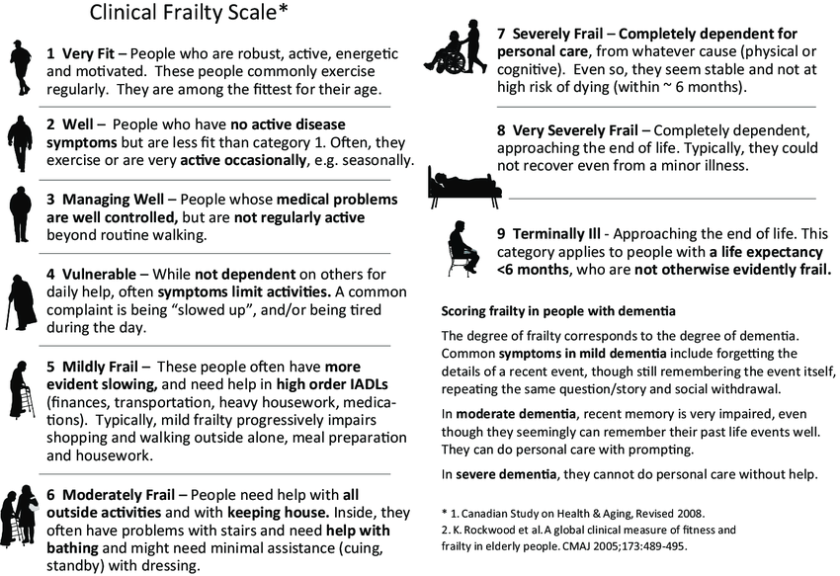
Frailty

Slide 12
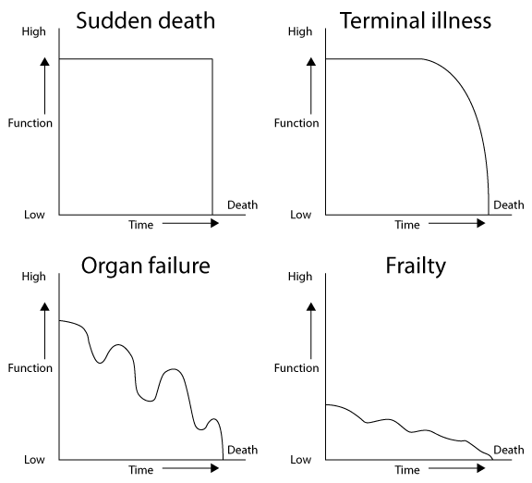
Monitoring of Trajectory is important
Which trajectory is your patient on?

Slide 13
Trajectories
Frailty
No surgery that I know of will make them do this!

Slide 14
Why is frailty important here?
A state of reduced reserve and resilience to an insult
NOT routinely looked for. Some enthusiasm shown by anaesthetics
Weakness/exhaustion/slowness/low physical activity/LOW
    Can be hard to tease apart symptoms of frailty from the symptoms requiring the surgery esp in cardiac surgery
Even uncomplicated surgery is a physiological insult – still has inflammatory mediator release, etc
    A few days in bed to a borderline patient – might be irretrievable loss of function
Older folk more commonly have unstable social support systems.
Hard to quantify risks, but important to get a sense of overall severity
    The worse it is, the harder it’ll be to come back from.
Important to assess and relay risks – high admission of risk of going to a nursing home is a material risk

Slide 15
More on frailty in surgery
“Can you send them to prehab?”
    No universally recommended or effective treatment for frailty
    Reasonable to trial protein/exercise if tolerated, there is time for it to work, and surgery is absolutely required, however no good evidence for the approach
    Need to question why we want to do the surgery.
    Concept of a ”point of no return” not well defined in literature, but we probably know it when we see it.
Associated with increased mortality and morbidity in the 30 days post surgery
Little data about functional trajectories in the weeks and months after
    General expectation is patient is “back to normal” after 3 months.
    This really, really needs to be addressed via research.

Slide 16
Cognitive impairment

Slide 17
Cognitive impairment
“Postoperative cognitive dysfunction”
Some apparently normal people have cognitive decline postoperatively, some gets better
Likelihood of development of cognitive impairment post surgery increases with
    Preop cognitive impairment
    Older age
    Lower educational attainment
    Suspicion if Diabetes/DWMI/other vascular disease
    Significant surgery (Cardiac very risky)
Due to inflammatory mediators released by surgery process, NOT the anaesthetic (ie spinal no better than general, shallow no better than deeper)
People often “not quite the same” after surgery
If somebody at high risk of critical cognitive decline, this needs to be explained as part of consent process.

Slide 18
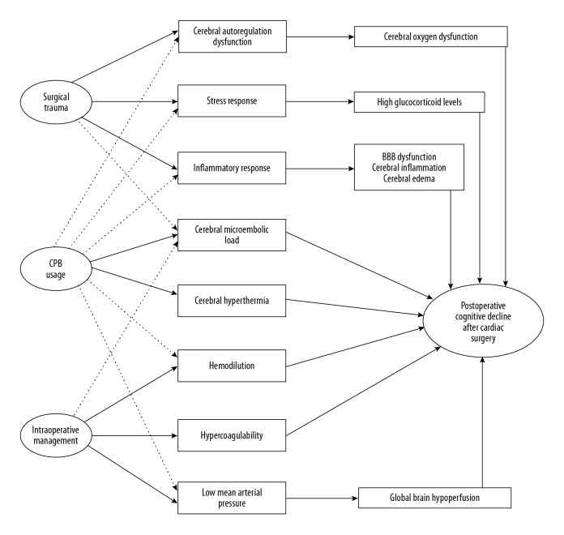
Postoperative Cognitive Decline After Cardiac Surgery: A Narrative Review of Current Knowledge in 2019, Med Sci Monitor

Slide 19
Shared decision making

Slide 20
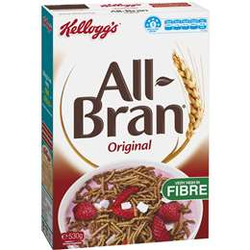
Shared Decision Making - BRAN
BENEFITS – do we think the surgery will do what we think it will
RISKS – emphasis on ”non classical risks” – functional decline and frailty. Individualised. H/M/L rather than %
ALTERNATIVES – if symptoms they need to be treated
what would happen if we do NOTHING – can be a legitimate option

Slide 21
The wider context
What does the patient expect from a procedure?
What does surgeon expect from a procedure?
What does anaesthetist expect from procedure?
What does health service expect from a procedure?
What does government/funder expect from a procedure?

Slide 22
The wider context
What does the patient expect from a procedure?
    We should ask them.
What does surgeon expect from a procedure?
    We should ask them
What does anaesthetist expect from procedure?
    For the patient not to die on the table or in the recovery room
What does health service expect from a procedure?
    For there to be no complications/HACs
What does government/funder expect from a procedure?
    Improved QALY/DALY ?????
    Not to be in the news.

Slide 23
Vignette – Beware the “good” 87 yo.
“Good” 87 yo gentleman – Independent PHx t2dm, blindness. Usually lives alone on houseboat on river, friends look out for him. Goes out all day cycling.;
NYHA class 1 Angina, fatigue
Had TTE/Angio – TVD
Referred for CABGS
Assessment – not frail, functionally independent in familiar settings, but some unexplained LOW, some risk factors for delirium.
Most important to patient to be independent down
B- clear coronary vessels. R – mod risk of cognitive/functional decline A – optimize medical treatment N- might get worse / “drop dead”, surgery would probably not alter overall prognosis.
D/W patient, daughter and surgeon – optimize medical management, directions re activity.
Lessons
    Beware the “good” elder. You want to keep them that way.
    Look at prognosis independent of condition for which being operated on.
    Death not the worst outcome at extreme age

Slide 24
Vignette – SDM in the time of covid.
92 yo female. Presented with left abdominal pain – ruptured renal pelvis. Biopsy/imaging renal cell cancer. Surgeons asking re: Laparoscopic Nephrectomy vs Laser ablation of tumour
Lives with son. No services but son does some heavier ADLs
Past history- cardiomyopathy, deafness. Hard to assess cognition on phone.
Clinical Frailty Score 5
Very noncommittal re treatment preferences, however adamant that she wanted to stay at home as long as possible
B- potential cure. R- worsening of function disallowing stay at home A- laser ablation N- Potential symptoms related to kidney obstruction
Discussion with Urologist – aim to do any procedure for symptom control, rather than prognosis (likely to be limited to around 18/12 regardless). High risk of decline in function with major surgery
Decision made between family and surgeons - Laser ablation.

Slide 25
Final points
Most surgical consent focuses on risks, and mainly intra-operative risks.
Patients generally most concerned by potential benefit. If no benefit can reasonably achieved, patients less inclined to accept risk.
Cognitive and functional decline (with resultant loss of independence) is an important risk to assess for and discuss.
Not necessarily fair or correct to only present options in complex situations – need to recommend treatment based on patients stated desired outcomes.
Important to work as team with surgical and anaesthetic team to present consistent narrative to patient and family.

Slide 26



Evolve and Shared Decision Making
Debra Letica
RACP Consumer Advisory Group
Notes:
Thank you Professor Campbell (Don Campbell)
Good afternoon everyone.
It is an honour for me to be here, again this year, thank you for the invitation. Sharing & learning together at the 2020 RACP Congress, as a member of your Consumer Advisory Group or CAG for short.
I’d like to begin by acknowledging the traditional custodians of the land on which we meet today. I would also like to pay my respects to Elders past, present and future. Also, to pay respects to those from New Zealand - “For this gathering. Seek knowledge & understanding. Have purpose in all that you do. Stand tall, be strong. Let us show respect for each other”
I’m sure you are aware of your RACP Consumer Advisory Group. We have consumer representatives from across Australia & New Zealand that are engaged in the way the Colleges next generation of specialists are being educated and learning on the job. Involving consumers in this work helps us improve the quality and the relevance of our work. Experience of the health system as a patient offers a unique perspective that adds value to RACP. I do encourage you to connect with your State or NZ Consumer Representative.
Thank you to each of you for being here to listen to my consumer / carer perspective in this Evolve Session about Shared Decision Making.

Slide 27
SHARED DECISION MAKING
Shared decision making is a process where the
clinician and consumer (and their family, partner
or carer) make health decisions together.
Consumer Health Forum of Australia
Notes:
I always like to start with a definition to get my mind on track: SO
The Consumer Health Forum of Australia defines Shared Decision Making as:
“ a process where the clinician and consumer (and their family, partner or carer) make health decisions together.”
The catch word here for me is “a process”, it is an ongoing process that grows or evolves as the consumer / carer “processes” or comes to grip with, what is happening to themselves or their loved one. The more their understanding grows the more questions will come to mind.
So what is that magical key ingredient to enable that person to ask those questions and empower patients to take an active roll in decisions about their health. As Don said, joint decision making is a key enabler for increasing quality of patient care and reducing low-value care.
Through my consumers eyes the key is that I feel SAFE.
I came across this poem at my local hospital cafe recently. I don’t know who wrote it but I’d like to share it with you as it struck a cord with me about the importance of a consumer feeling “safe”.

Slide 28

ADVICE FROM A PATIENT
This may be a normal day at work for you
BUT it’s a BIG DAY in my life.
Notes:
Its entitled “Advice from a Patient”
This may be a normal day of work for you
But its a big day in my life.
The look on your face & the tone of your voice
Can change my , entire view of the world.
Remember: I’m not usually this needy or scared.
I am here because I TRUST you, help me stay confident.
I may look like I’m out of it
BUT I can hear your conversations
I’m not used to being naked around strangers
Please keep that in mind
I’m impatient because I want to get the heck out of here
Nothing personal
I don’t speak your language well
You’re going to do what to my what!
I may only be here for 4 days
BUT I’ll remember you for the rest of my life
Your patients need your patience.
Beautiful! Captures how it feels to be a patient very well – we’re out of our comfort zone.

Slide 29
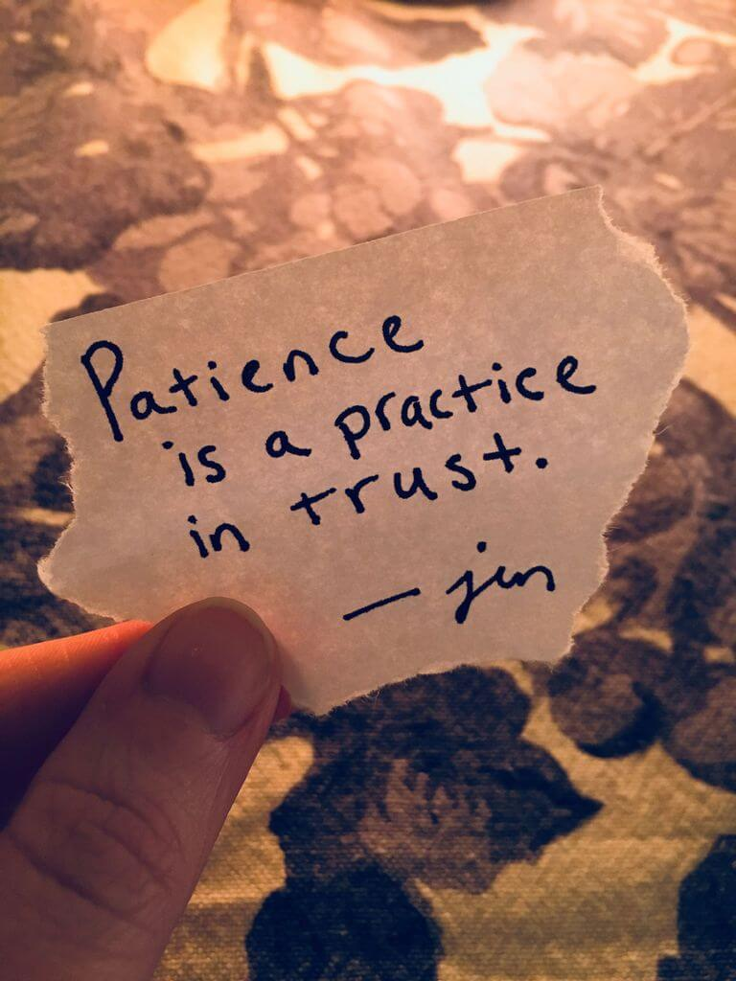
Your patients need your patience.

Slide 30
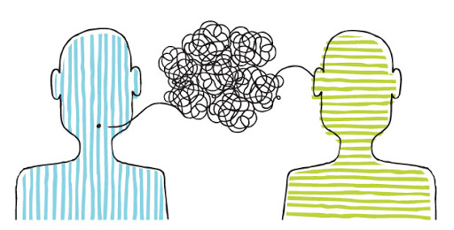
COMMUNICATION
Consumer and carers feel safe when they perceive that we are listened to and heard.
Notes:
So what enables a consumer or a patient to feel safe?
With that thought - a short personal patient experience .
A few years ago I woke up one morning with acute adominal pain. I’ve not had children so this intense pain was a new experience for me, I was about 50 ish.
I was the Licensee of our Conveyancing Practice, a stressful occupation to say the least. We had decided to down size our business so that we could balance our life more easily, so it was just me & my husband Alvin who was the Outside Clerk which meant he attended each settlement in person in the CBD. Each morning was a bit of a rush in preparing the settlements for that day. Obtaining payout figures of mortgages from banks, & you know what banks are like to deal with. Printing & ordering bank cheques & collating settlement instructions with the correct cheques & signed legal documents was vital & took great concentration. It was extremely important to have everything perfect, no room for any errors otherwise the risk was that the settlement wouldn’t be completed as planned which then had difficult consequences for our clients.
Anyway the pain was increasing. So after the Outside Clerk had gone off I called a taxi to take me to my GP as I couldn’t drive by this stage, I could hardly stand up at all. I arrived at my GP, who wasn’t in that day so I waited to see another. Who examined me, asked a few questions – gave me some pain meds & said go home and if it gets worse go to ED. Alvin was back from Perth by this time and rang to check how I was & I asked him to pick me up from the GP. I waited a little, felt really unwell, so when he arrived I asked him to take me straight to ED.
Luckily I didn’t have to wait too long in ED. The Doctor examined me asked questions suggested that I may be pregnant - which was somewhat alarming! I can’t be pregnant I’m 55, honestly! All the time my brain is going on hyper alert about this possibility – with many different concerns and panic. They sent me for a scan. The result of which was that I had appendicitis & needed to go to Murdoch as I had private health insurance, you will need surgery , I don’t know why I couldn’t have stayed there.
Anyway to cut a long story short I checked in to Murdoch, the pain meds were doing a fine job & I was feeling much better, but a bit out of it. The surgeon arrive, stood at the foot of my bed, he said that he’d just come up to say that he would pop me on the end of the days surgery list which meant surgery after 10pm. I think it was about 7pm at this stage.
I looked at this young fellow at the foot of my bed & he looked very tiered to me. I asked him how long he’d been here. He said oh from about 7am this morning. Really, I said – well you look tiered to me why don’t you go home get some sleep & come back see me tomorrow. What I was really thinking in my head was “There is no way you’re coming anywhere near me with a knife to mess with my insides whilst you look like that!”
Anyway he doubled checked that this was ok& that is exactly what happened he went home got some sleep & I had surgery the next day. I remember this , with the same emotion, as if it was yesterday it was Australia Day 2010
So one of the ingredients for a consumer to feel safe is “communication” but not just words its the whole interaction, what you look like – I’m assessing your mannerisms, how you greet me & introduce yourself the tone of your voice, the look on your face, are you in a hurry or stresssed – do I feel you’re friendly & understanding, your not thinking that I’m over reacting, anxious or annoyed that I’m taking too much of your time. All of my summing up of our interaction with each other is really so that I can be sure that I can trust you and is done in a few minutes, its ongoing, I can feel the tension in my body relax as I gain confidence in you as a person - a fellow human being.
Communication is of course words, but it is also the tone of your voice, & your body language as I’ve just described how it feels
Consumers feel safe when they perceive that they are listened to & heard.
.

Slide 31
COMMUNICATION
“We have two ears and one mouth so that we can listen twice as much as we speak.”
-Epictetus
Notes:
Communication is of course words, but it is also the tone of your voice, & your body language.
Consumers feel safe when they perceive that they are listened to & heard.

Slide 32
LISTENING
Empathy is listening with the ears of another
Empathy is seeing with the eyes of another
Empathy is feeling with the heart of another.
Notes:
LISTENING - is about being present. Being present with empathy, with compassion & understanding.
BY doing so we are able to “be in the moment” to experience that human connection with each other.

Slide 33

WHY
I need to “feel” that you understand me
I will then “trust” you
I will then “hear” what you’re saying
I will then feel safe to ask questions
Notes:
Why is this so important to me as a consumer?
I need to “feel” that you understand me
I will then “trust” you
I will then “hear” what you’re saying
I will then feel safe to ask questions

Slide 34

RISKS
Lack of trust leads to:
2nd or 3rd opinion sought – which will decrease your ability to reduce low value practices
Reduced health outcomes
Increases ED presentations
Increases costs
Notes:
So why is trust from a consumer so important to Doctors conscious of low-value care?
Low value care to me means being confident that what you’re sharing with me is reliable and safe. If I don’t feel confident that I can trust the expertise your sharing with me I’m less likely to listen or follow it, even if I say I will. All I’ll want to do is end the conversation, end the meeting without seeming rude or difficult. Then I’ll go back to my GP to get another referral for another specialist for a 2nd, 3rd or even 4th opinion until I am confident with the advice I’m receiving. The advice maybe no different, but the difference to me is that I felt listened to, heard, appreciated, and reassured.
The cost of obtaining 2nd opinions is not something I would even think about as being inappropriate.
I wouldn’t even think about the cost to me personally in terms of time & emotion, nor perhaps financial costs or out of pocket for me nor the additional cost to the health system this wouldn’t even cross my mind. That’s not a good thing and leads to our health system being unsustainable.
Consumer just want reassurance that we don’t need a battery of tests or more medicines.
We sometimes need assurance that we’re getting all the medicines we need (or don’t really need any). Plus reassurance that the medicines I’m already taking even over the counter ones aren’t interacting with each other & causing the issue in the first place.
Perhaps the worst thing consumers do when they don’t trust their health team is they’ll go and google the issue we have, and you’ll end up with a 1,000 Dr Google questions. We can get overwhelmed with advice from well meaning family & friends that we trust, even though their advice is more often incorrect. We need Doctors to treat us as they would their parents or brothers & sisters with kindness, compassion & understanding – partner with me, walk alongside me gently helping me to Choose Wisely.
Doctors need to calm our fears.

Slide 35
CHOOSING WISELY - 5 QUESTIONS
Do I really need this test, treatment or procedure?
What are the risks?
Are there simpler, safer options?
What happens if I don’t do anything?
What are the costs?
Support shared-decision making by encouraging your patients to ask questions.
Notes:
It can be hard for consumers to have the confidence to ask questions about things that matter to them.
One tool I’ve found very useful in me preparing for my doctors appointment are the NPS Medicinewise Choosing Wisely 5 Questions.
It is a fantastic tool for consumers to use to ask questions. We may not need to use all 5, and more may spring to mind but they are a conversation starter & they’re available in different languages on their website.
Just in case you’ve not heard of them the 5 Choosing Wisely questions are:
Do I really need this test, treatment or procedure?
What are the risks?
Are there simpler, safer options?
What happens if I don’t do anything?
What are the costs?

Slide 36

TOP TAKE OUTS
Consumers MUST feel safe to engage
Listen – with empathy
Two ears & one mouth!
Notes:
TOP Take Outs
We must feel safe to engage
Listen with empathy
Two Ears one mouth
I was fortunate to have a really good Mentor in my early career, a man called Mal Davey.
Mal taught me that it was so important to really listen to your customer or client as it gave you the opportunity to really get to know & understand the person in front of you. Without taking the time to do so, to really listen you cannot help the person your trying to help in the way that they need you to help.
I must say his advice was well founded.

Slide 37
THANK YOU ALL FOR
LISTENING
Contact: evolve@racp.edu.au
Visit: evolve.edu.au
Notes:
So in closing – thank you so much for sharing your time today to really listen to my presentation & discover what that magical key is for consumers & carers.
I really appreciate the opportunity to share with you my insights as a consumer & carer from my lived experience

