Slide 1
Safer Care Victoria
Professor Andrew Wilson
Chief Medical Officer

Slide 2
Key Events in 2016
Bacchus Marsh Djerriwarrh Health
RACS Bullying and Sexual Harassment issues
VAGO Audit on quality and safety
VAGO Audit on Bullying and Harassment
Duckett Review of Quality and Safety in the Victorian Health System

Slide 3
Many Issues
“Catastrophic” Failure of clinical governance
Board and CEO Replaced
Issues with information sharing between agencies – AHPRA, VMIA, Health services, DHHS, Health Services Commissioner
Issues with culture
Issues with incident monitoring and response

Slide 4
VAGO Audits
Weaknesses in oversight of quality and safety
Particularly in area of incident reporting and response
Entrenched cultural issues with no evidence of systemic response

Slide 5
Duckett Report Into Quality and Safety
Themes
Data – Access and Use for Improvement
Clinical Governance
Clinical Engagement
System Leadership

Slide 6
We are the state’s lead agency for improving health quality and safety
Established January 2017 as part of Targeting Zero health reforms:
    creating a deliberate separation of quality and safety from other functions of the department
    elevating the importance of quality and safety improvement
    bringing a new, independent-minded approach to driving improvement and innovation

Slide 7
Our aim is outstanding healthcare for all Victorians. Always.
Sentinel event reports System safety reviews
Performance monitoring Safety alerts and advisories
Clinical guidance Advice and support
Patient feedback Consumer participation
Improvement projects Innovation partnerships
Capability building Leadership and governance

Slide 8
We bring a new approach to improving quality and safety
    We are independent-minded and challenge the norm
    We place patients and families at the centre of everything we do
    We work closely with health services and clinicians to help identify areas for improvement and create sustainable change
    We underpin our work with evidence-based best practice

Slide 9
Changing how we engage and work with clinicians
Reinvigorated our clinical networks to drive improvements in areas of unwarranted variation
Established new specialist networks for mental health and infection
Developed network plans and projects to improve performance around readmissions, complications, length of stay and mortality
Established the Victorian Clinical Council to advise SCV, the department and the Minister

Slide 10
Strengthening Victoria’s sentinel events program
Reviewed processes and training to increase reporting by health services, and improve quality of review and outcomes
Introduced SCV Academy to conduct system safety reviews
Supporting use of consumers and external members on RCAs:
    introducing PEER platform for health services to commission external members
    funding consumer training and service tools for meaningful participation

Slide 11
Focusing on patient experience and participation
Finalising a Partnering in Healthcare framework to guide consumer engagement across all public hospitals
Established the new Patient and Family Council to test SCV and department programs and initiatives
Funding Health Issues Centre to provide training for services and consumers
Trialling patient complaint and feedback methods

Slide 12
Providing best practice guidance and advice
Expanding clinical guidance issued by our clinical networks and Chief Clinical Officers
Monitoring performance indicators to inform sector feedback
Developed a clinical governance framework that elevates quality and safety improvement
Supporting the state’s three mortality and morbidity councils to disseminate reports and recommendations

Slide 13
Supporting innovation and improved capability
Support the Better Care Victoria Board and administration of $10m innovation fund
Supporting sector-led innovation projects through coaching, training and resource development
Scaling two successful projects to other health services: Think sepsis. Act fast. and Choosing Wisely
Developing a suite of leadership programs for future quality and safety leaders

Slide 14
Review and response: data & stewardship
 |  | 2016-17 |  |  |  | 2017-18
Measure | Target | Qtr1 | Qtr 2 | Qtr 3 | Qtr 4 | Qtr1 | Comment
Unplanned Readmissions (rates)
AMI | 3.7 | 1.9 | 1.4 | 1.3 | 0 | 2.5 | 12mth rate = 1.4
Knee Replacement | 6.0 | 12 | 19 | 16.7 | 10 | 4.5 | 12mth rate = 12.7
Hip Replacement | 2.5 | 0 | 0 | 9.4 | 0 | 0 | 12mth rate = 3.4
Heart Failure | 10.3 | 7.4 | 10.7 | 8.9 | 12.3 | 16.2 | 12mth rate = 12.2
Mortality (rates)
AMI | 3.1 | 3.7 | 2.6 | 2.9 | 0 | 0.8 | 12mth rate = 2.01
Stroke | 10.5 | 11.5 | 7.2 | 8.3 | 11.6 | 6.8 | 12mth rate = 8.7
Fractured NOF | 3.0 | 5.9 | 3.7 | 3.9 | 1.8 | 1.8 | 12mth rate = 2.5
Pneumonia | 4.1 | 2.8 | 4.9 | 2.5 | 2.7 | 1.7 | 12mth rate = 2.96
Low mortality DRG deaths | Count | 3 | 6 | 5 | 2 | 4
Safety
Safety culture | 80% | 89% | 88% | 89% | 89%
VHES - Patient experience | 95% | 92% | 89% | 91% | 96%
Infection surveillance SAB | 2.0 | 0.8 | 0.4 | 0.7 | 0.4
Infection surveillance CLABSI | 0.0 | 0 | 0 | 0.7 | 1
Hand Hygiene | 80% | N/A | 84% | 84% | 85%
HCW Influenza Immunisation | 75% | 80% | N/A | N/A | N/A
Sentinel events | Count
Reliability
Elective surgery patients admitted on time | 95% | 77% | 75% | 75% | 77%
ED patients LOS > 24hrs | 0.0 | 0 | 0 | 0 | 0
Mental health seclusion rates per 1000 bed days | 15.0 | 12 | 11 | 13 | 11
As data submission may be lagged the "Qtr" columns refer to the PRISM or Monitor in which the results were reported.
SCV can help to identify results to focus on.
Reviewing:
-most recent data
-historical outcomes
-statistical significance

Slide 15
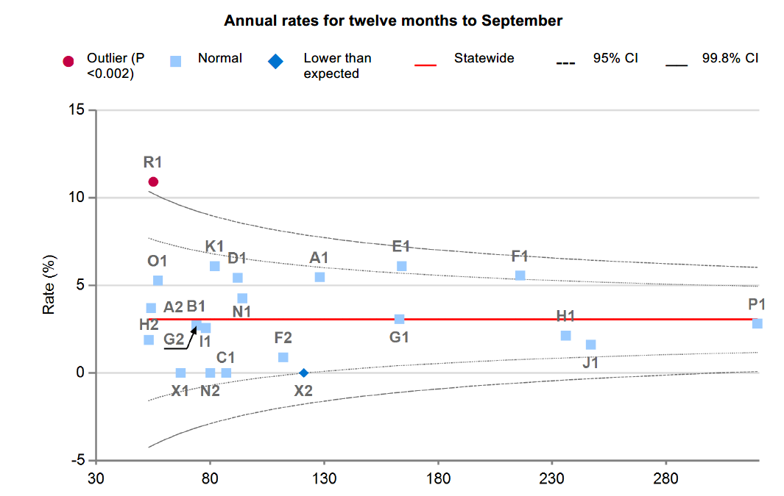
Review and response: data & stewardship
SCV will offer Board Quality committees training in expert data analysis
which hospital are you worried about?

Slide 16
Responses to Performance Measurement and Reporting
There is way too much of this data
The data is old
The measures are wrong – when we check, everything is OK
This is a burden on us – the board don’t understand the data and nothing changes
You don’t know what you are doing
This will affect patients access to high risk therapy

Slide 17




Governance Failings
Essendon
AMP
Etc

Slide 18
Health System Governance
Strengthen Oversight – SCV, VAHI
Strengthen Boards – Increased oversight of appointments, Clinicians on boards, limit terms, board training and skills, support for board quality chairs
Increase transparency
Increased patient focus

Slide 19

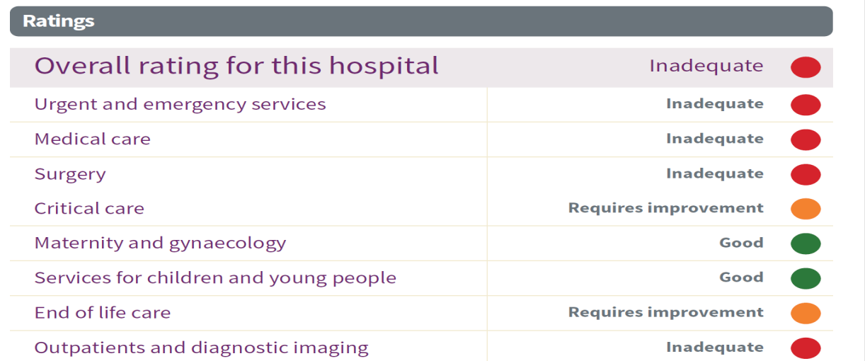

Slide 20
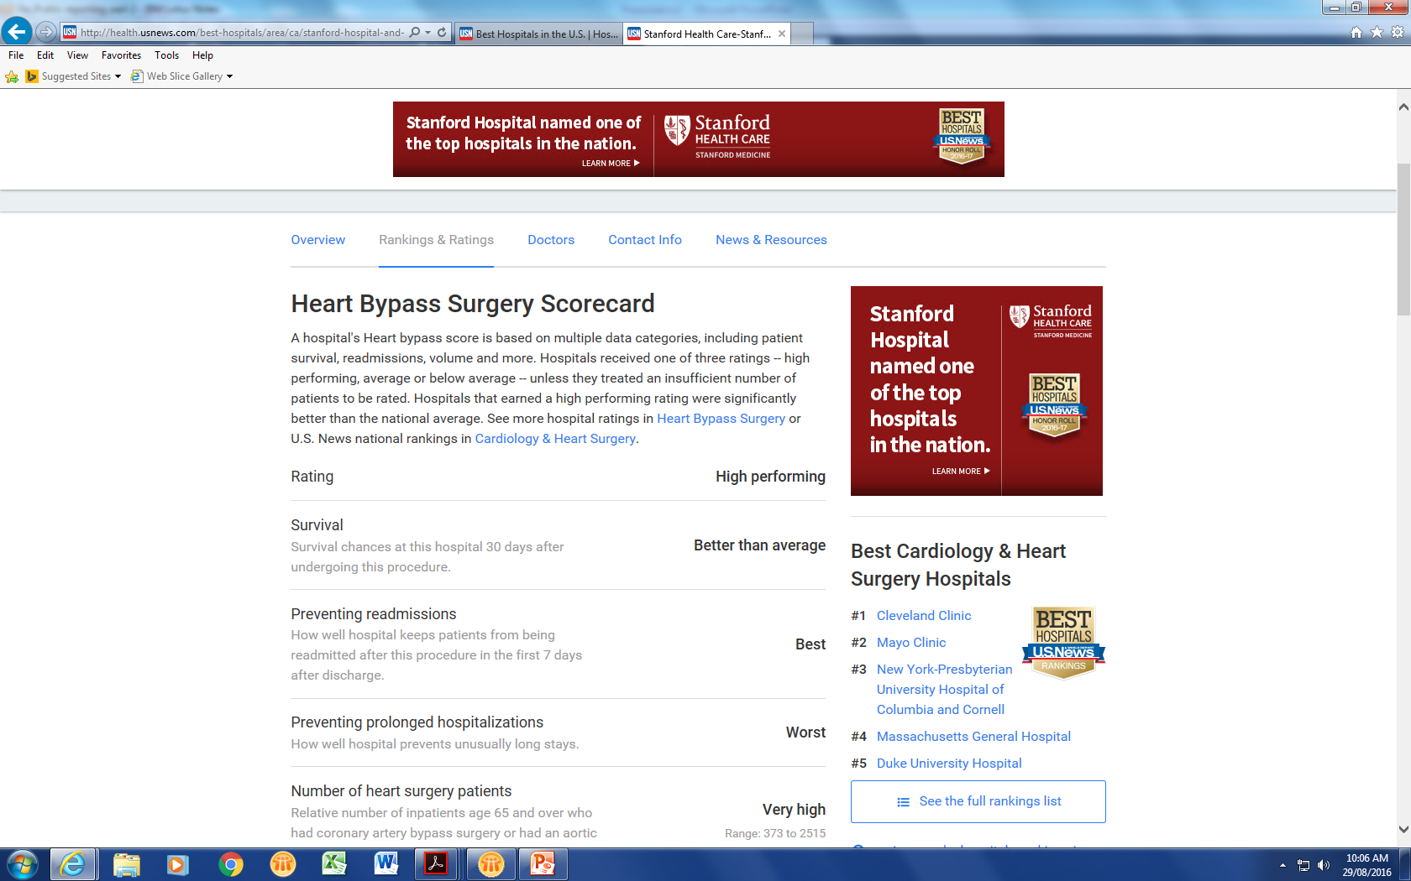

Slide 21
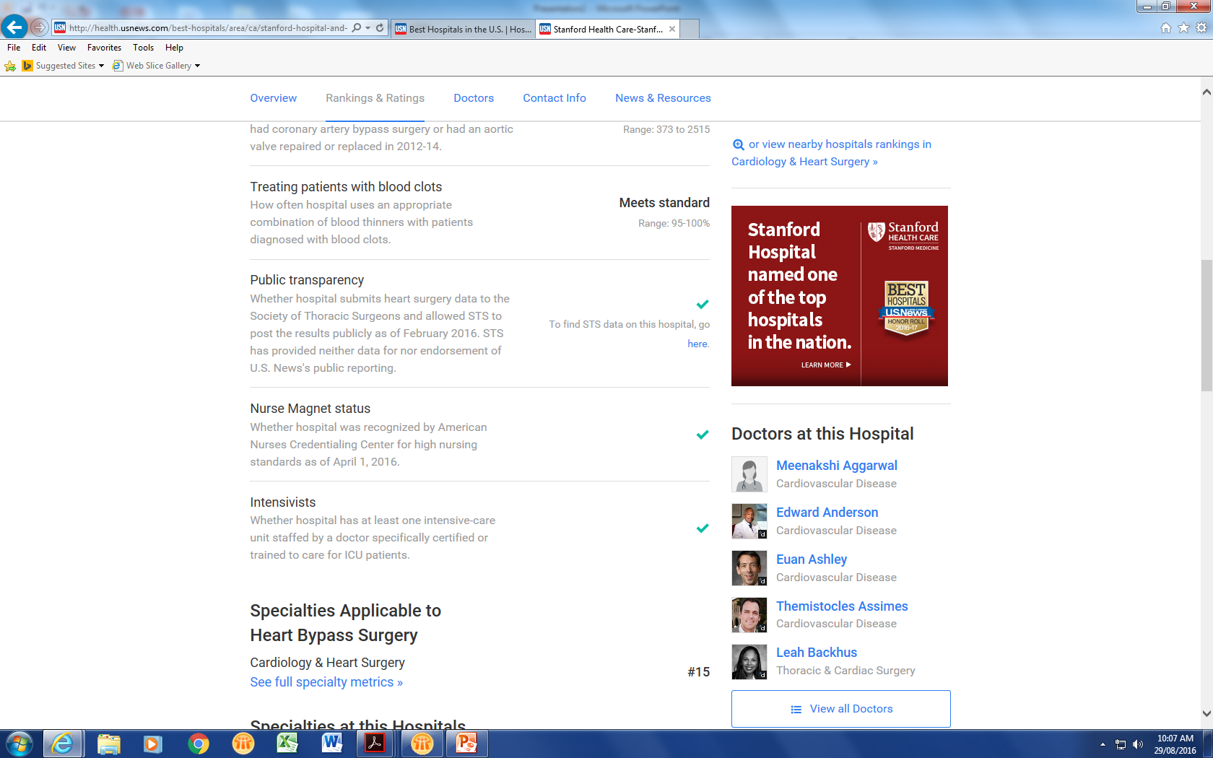

Slide 22
What’s Different?
Strong input into system management and design
Clinician influence in workforce and incident management process
Volume outcome and Q and S input into programmes
Stronger relationships with sector – esp for tough issues
Driving use of data and increasing access for the sector

Slide 23
Data Liberalisation
Underuse of administrative data – esp for improvement
Data linkage unit – linked data in DHHS
Much clinical data in registries
Data linkage programme
Embedded in work of networks
Partnerships with academia and clinicians

Slide 24
National Data Linkage Demonstration Project: APDS-NDI-PBS-MBS
De-identified linked data, five years (July 2010-June 2015), NSW & Victoria
3,206,125 admitted patients
July 2011 – December 2013
45,731 admitted with a primary diagnosis of AMI
(ICD-10-AM codes I21.X)
Patients hospitalised with AMI
50% ≥75 years
59% male
31% received percutaneous coronary intervention (PCI)
8% received coronary artery bypass grafting (CABG)
Did not meet inclusion criteria
Non-concessional PBS claims
No PBS dispensing claims
Died in hospital
Hospitalised as DVA patient
<18 years
Data irregularities
P2Y₁₂ receptor antagonists
(aka ADP receptor antagonists) in AMI
Clopidogrel
Clopidogrel/aspirin
Prasugrel
Ticagrelor (PBS-listed Aug 2012)
24,583 patients for analysis
13,944 in NSW | 10,639 in Vic
Notes:
WILL EXPLAIN UNDER COPAYMENT ISSUE HERE
EXCLUSIONS ARE ROUGHLY IN ORDER OF FREQUENCY

Slide 25
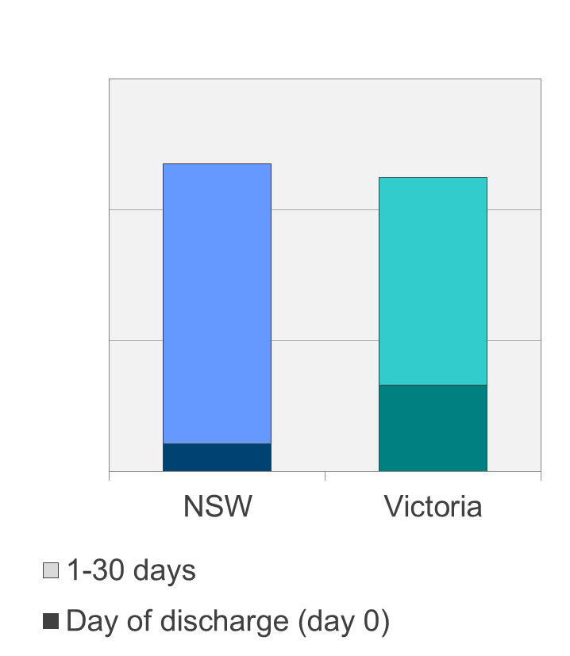
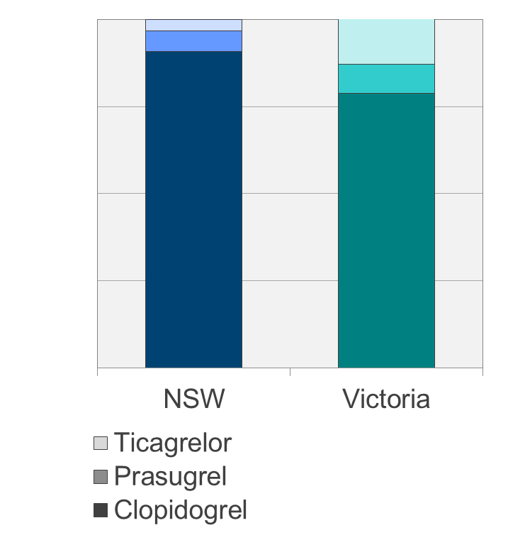
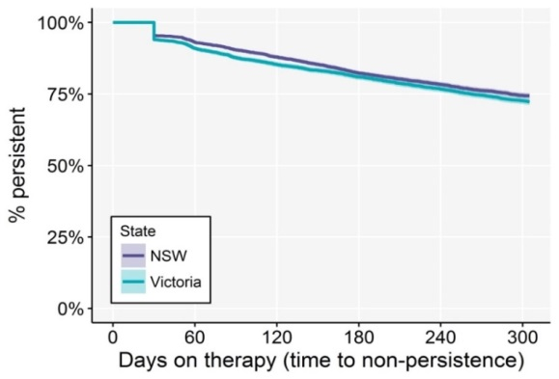
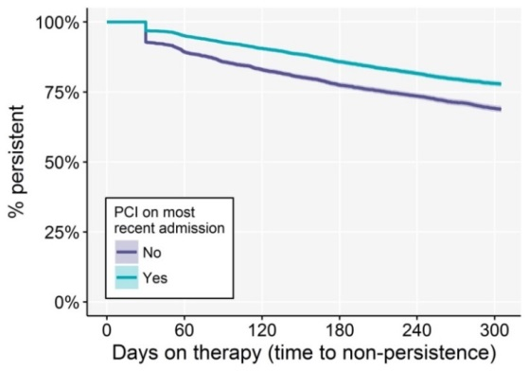
Variations in ADP receptor antagonism in AMI
Timing of prescription
Choice of therapy
59%
56%
30-70% prescription at 30 days
Persistence to 12mths
74.7%

Slide 26
National Data Linkage Demonstration Project:
AF de-identified linked data (July 2010-June 2015)
3,206,125 admitted patients
July 2011 – December 2013
130,221 admitted with a primary or secondary diagnosis of AF
(ICD-10-AM codes I48.X)
AF Population Characteristics
64% ≥75 years
50% male
95% CHA₂DS₂-VASc ≥ 2
Did not meet inclusion criteria
Non-concessional PBS claims
No PBS dispensing claims
Died in hospital
Hospitalised as DVA patient
<18 years
Data irregularities
Oral Anticoagulants
Warfarin
Dabigatran (PBS 2011)
Rivaroxaban (PBS 2012)
Apixaban (PBS 2013)
82,996 patients for analysis
49,190 in NSW | 33,806 in Vic
Notes:
WILL EXPLAIN UNDER COPAYMENT ISSUE HERE
EXCLUSIONS ARE ROUGHLY IN ORDER OF FREQUENCY

Slide 27
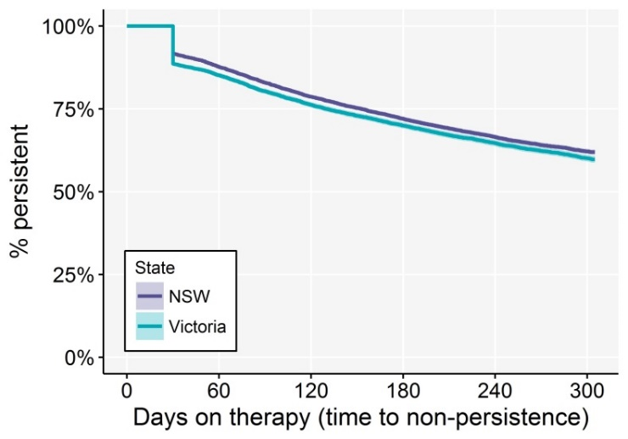
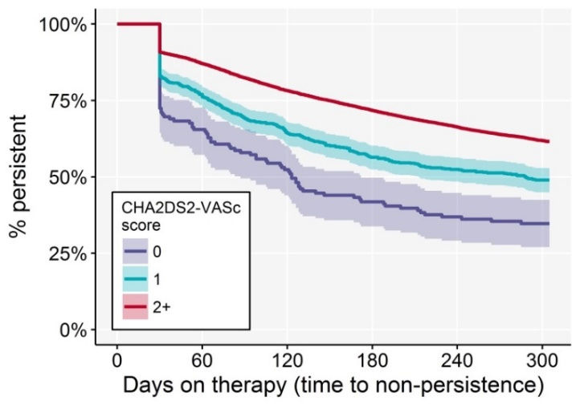
OAC Dispensing, Variation and Persistence
OAC Dispensing, Persistence and Variation
60.4% persistence
22%-53% variation
91% warfarin

Slide 28




Connect with us
www.bettersafercare.vic.gov.au
info@safercare.vic.gov.au
@safercarevic
Safer Care Victoria
Subscribe to our e-news at www.bettersafercare.vic.gov.au

Slide 29
Current Projects
Responding to harm signals
Colonoscopy Safety
Anti coagulant safety
System Planning
Cardiac arrest linked data

Slide 30
Clinicians Making a Difference
System viewpoint
Credibility with sector and system managers
Need to be embedded
Understand everyone needs to “win” in discussions
Working on the “tough” challenges – workforce reform, system quality and safety, appropriate and high value care, complex and high volume therapy

Slide 31
Partnership with Sector
Type 1 Diabetes in Children
Pre eclampsia outcomes
NHMRC ECHIDNA Project
Model of honorary appointments and sabbaticals – many focused on data projects

