Slide 1





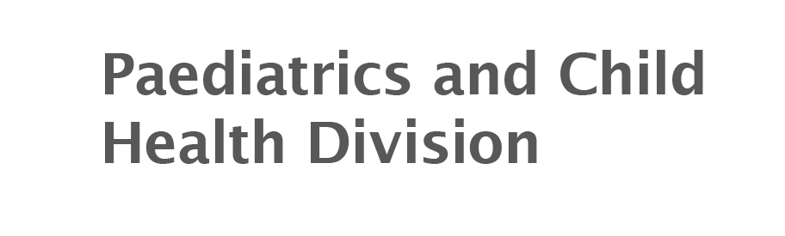
Management of bronchiolitis
RACP, Paediatrics and Child Health Division

Slide 2
Toby
Patient medical history (PMHx)
3-month-old boy
Born at term
Feeding and growing well
Immunisations up to date
No significant family history
Symptoms
2 days history of coryza and cough
1 day of increased work of breathing
Feeding ~ ½ normal

Slide 3
Toby
Examination
Active
Well hydrated
Coryzal
Afebrile, RR 80, HR 140, SaO2 94%
Moderate work of breathing
Bilateral wheeze and crackles
Reduced air entry right lower base
Tests / Investigations
Nil so far

Slide 4
What is the most important investigation for Toby (NON-pandemic times)?
Nasopharyngeal aspirate
Blood culture
Chest xray
Nothing

Slide 5
What is the most important investigation for Toby?
x Nasopharyngeal aspirate – this should not be done other than during a pandemic. [In current times, a NPA would be done for SARS-CoV-2]
x Blood culture – this child is not septic. A blood culture is likely to return either negative or with a spurious result, resulting in more unnecessary testing
x Chest xray – these do not discriminate well between bacterial and viral infections and are likely to lead to unnecessary testing
Nothing

Slide 6
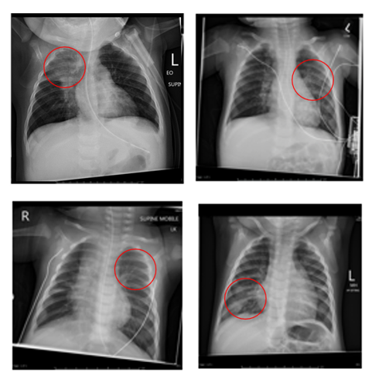
What is best practice?
Chest X-rays for infants with acute lower respiratory tract infections rarely affect clinical treatments and outcomes.
Chest X-ray films do not discriminate well between bronchiolitis and other forms of lower respiratory tract infection. The images to the right are ALL bronchiolitis but mimic pneumonia.
It is estimated that 133 children with typical bronchiolitis would have to undergo radiography to identify 1 radiograph that is suggestive of an alternate diagnosis. In addition, false positives lead to over-use of antibiotics leading to unnecessary side effects and increase the risk of antibiotics resistance.

Slide 7
So really do nothing?
The most important management tool is clear and effective communication.
Important education points include:
Bronchiolitis is a viral infection and antibiotics/medications will not help
When infants are unwell, feeding becomes difficult and therefore supporting oral intake is important – small frequent feeds are best
If oxygen saturations become low, we can support the infant’s breathing – it is safe for infants to have intermittently low saturations and continuous monitoring is not required
Normally the infant’s breathing will become worse on day 3 and then gradually get better, the cough may linger for up to 2 weeks

Slide 8
What treatment does Toby require?
Oxygen therapy
Salbutamol
Nasogastric feeds
Nothing

Slide 9
What treatment does Toby require?
x Oxygen therapy – Do not delay discharge if saturations are above 90%
x Salbutamol – risks outweigh benefits
Nasogastric feeds – supplemental feeding is recommended for a child unable to achieve 2/3 normal feeding
x Nothing

Slide 10
What is best practice?
Salbutamol does not improve any meaningful clinical outcome such as:
    oxygen saturation
    hospital admissions
    duration of hospitalisation
    time to resolution of illness
Salbutamol has the following adverse impacts:
    tachycardia
    oxygen desaturation
    tremors

Slide 11
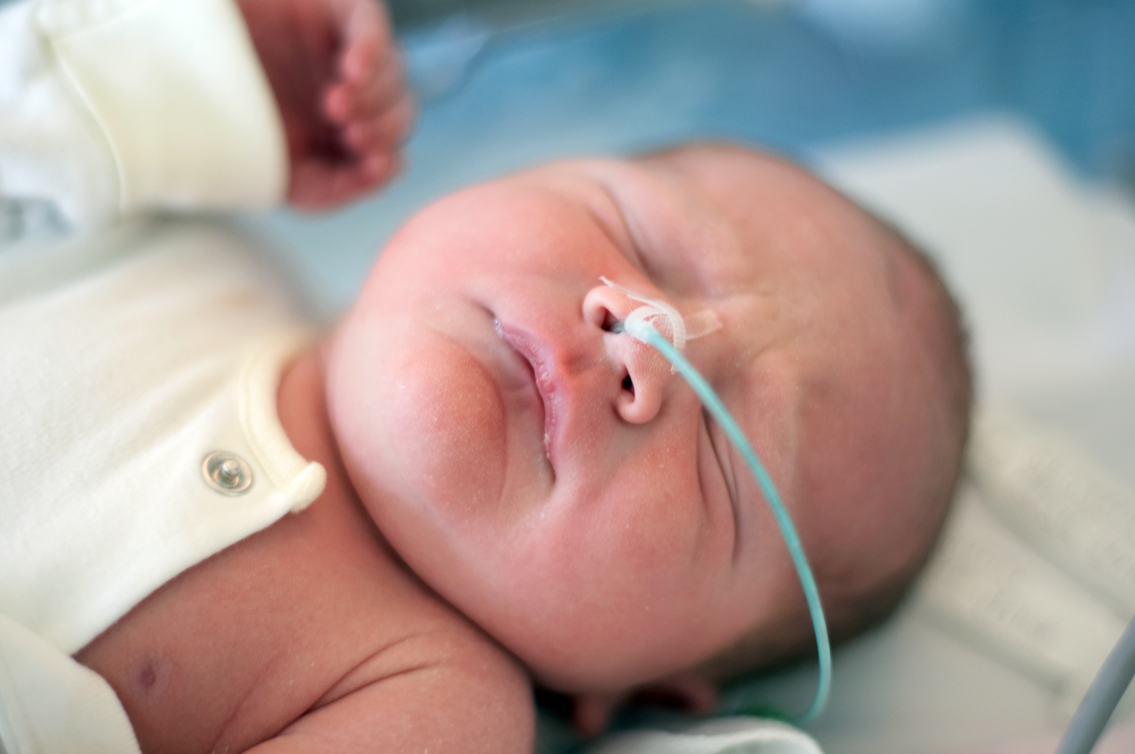
What is best practice?
Feeding is often affected in bronchiolitis and fluid supplementation is recommended when oral intake is less than 2/3 normal
Nasogastric feeds are safer than IV fluids and have the additional benefit of offering nutrition.

Slide 12
Evolve Recommendation
Do not routinely undertake chest X-rays for the diagnosis of bronchiolitis in children or routinely prescribe salbutamol or systemic corticosteroids to treat bronchiolitis in children
RACP, Paediatrics and Child Health Division
Evolve is facilitated by the Royal Australasian College of Physicians

Slide 13
References
Beigelman A, King TS, Mauger D, et al. Do oral corticosteroids reduce the severity of acute lower respiratory tract illnesses in preschool children with recurrent wheezing? Journal of Allergy and Clinical Immunology. 2013; 131(6):1518-25.
Bordley WC, Viswanathan M, King VJ, et al. Diagnosis and testing in bronchiolitis: a systematic review. Archives of Pediatric Adolescent Medicine. 2004; 158(2):119-26.
Cao AY, Choy JP, Mohanakrishnan L, Bain RF, van Driel M. Chest radiographs for acute lower respiratory tract infections. Cochrane Database of Systematic Reviews. 2013; 12: CD009119.
Fernandes RM, Bialy LM, Vandermeer B, et al. Glucocorticoids for acute viral bronchiolitis in infants and young children. Cochrane Database of Systematic Reviews. 2013; 6:CD004878.
Gadomski AM, Scribani MB. Bronchodilators for bronchiolitis. Cochrane Database of Systematic Reviews. 2014; 6:CD001266.
Hartling L, Fernandes RM, Bialy L, et al. Steroids and bronchodilators for acute bronchiolitis in the first two years of life: systematic review and meta-analysis. British Medical Journal. 2011; 342:d171.
Modaressi MR, Asadian A, Faghihinia J, et al. Comparison of epinephrine to salbutamol in acute bronchiolitis. Iranian Journal of Pediatrics. 2012; 22(2):241-4.
Schuh S, Lalani A, Allen U, et al. Evaluation of the utility of radiography in acute bronchiolitis. Journal of Pediatrics. 2007; 150(4):429-33.
Yong JH, Schuh S, Rashidi R et al. A cost effectiveness analysis of omitting radiography in diagnosis of acute bronchiolitis. Pediatric Pulmonology. 2009; 44(2):122-7.

Slide 14
How this case study was made
This case study was developed through the RACP Evolve initiative. It was drafted by Dr Joanna Lawrence based on an Evolve recommendation on low-value practices.
This case study was reviewed by the RACP Evolve Policy & Advocacy Interest Group, the RACP Paediatrics and Child Health Division, Thoracic Society of Australia and New Zealand, Australasian Society for Infectious Diseases, Royal Australasian College of General Practitioners, Australian College of Nurse Practitioners, and the Australian Physiotherapy Association.
With special thanks to Associate Professor Nitin Kapur, Dr Sern Wei Yeoh, Professor Jennifer Martin, Professor Robert Batey, Dr Brendan McMullan and Dr Catherine Lucas for their feedback.
This case study was approved for publication by the RACP Paediatrics and Child Health Division in September 2022.

Slide 15
Evaluation
How likely is this Evolve recommendation to change your practice?
Not at all
Somewhat
Significantly
Explain your reasoning

Slide 16
About Evolve
  As part of a global movement, Evolve is a flagship initiative led by physicians, specialties and the Royal Australasian College of Physicians (RACP) to drive high-value, high-quality care in Australia and New Zealand.
  Evolve aims to reduce low-value care by supporting physicians to:
    be leaders in changing clinical behaviour for better patient care
    make better decisions, and
    make better use of resources.
Find out more:
  www.evolve.edu.au
Get in touch:
  evolve@racp.edu.au

